Slide 1
Suspension Guidelines
Presented by
Dr. Damon Zavala, D.O., F.H.M.- NSAC
and
Dr. Brad Lee, M.D., J.D.- NSAC
at the Association of Ringside Physicians Annual Conference
18 September 2021

Slide 2
Disclaimer
The information and opinions expressed in this presentation is solely the opinion of the presenters and does not necessarily reflect the position of the Nevada State Athletic Commission nor the State of Nevada

Slide 3
objectives
What are essential elements of the optimal post fight evaluation form
Defining mandatory rest based on rounds started (Boxing/MMA)
What suspensions should be given for TKO’s, KO’s, “Tough fight” etc…
Considerations that should be taken into account when levying suspensions

Slide 4
Ground Rules
What we are presenting is the way we do it in the NSAC
Not necessarily the “right” way
Definitely not the only way
It is only intended to be food for thought and to stimulate further discussion
These are the guidelines we follow for professional events
Not suggesting these rules should be followed for amateur events
Please note that we are discussing primarily UFC MMA events and Top Rank Boxing events – circumstances may require modification for other promoters and/or other combat sports

Slide 5
Considerations
Doing what is best for the fighter – what does that mean?
Medically
What sort of medical follow-up is available to the fighter?
What medical resources are available where the fighter resides?
Financially
Should you allow a chronologically challenged fighter to fight – will it change your suspension?
What if suspension will prohibit the fighter from getting another payday?
There are relatively few absolutes
Reasonable minds can differ
You will be second guessed – have a thick skin

Slide 6

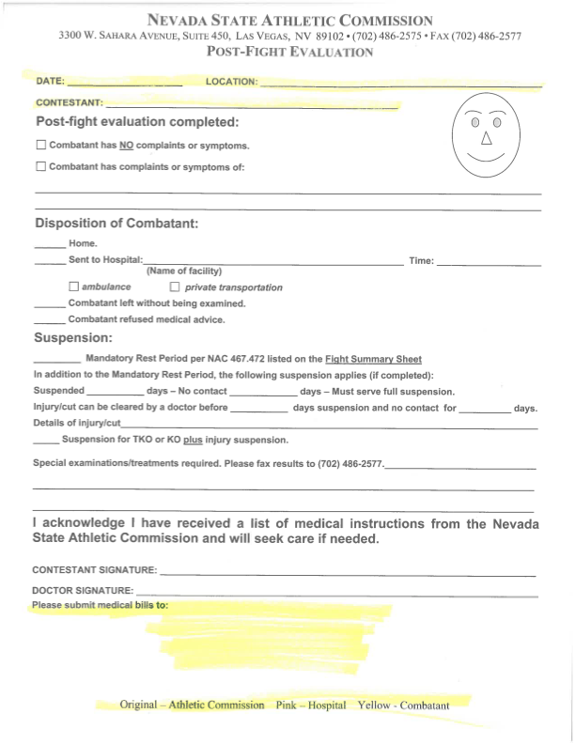

Post Fight Evaluation form

Slide 7
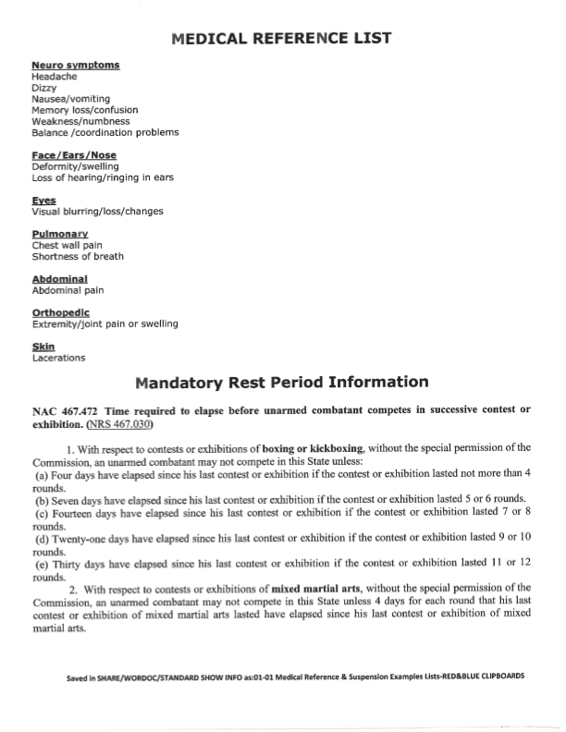
Mandatory Rest

Slide 8
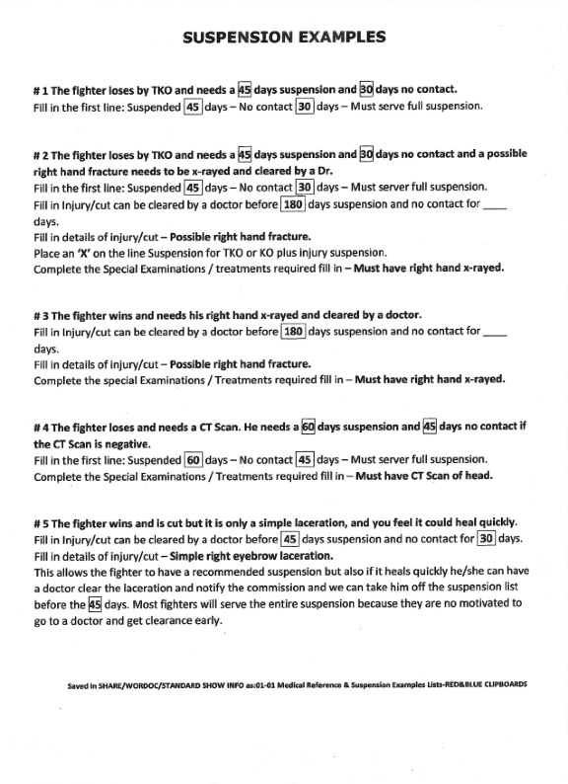
Suspension examples

Slide 9
Conclusion
Suspensions are more of an art than a science
There are relatively few absolutes is giving suspensions
Many factors go into determining the length of the suspension
Reasonable minds may differ on the length of the suspension
Different commissions may have different rules regarding suspensions
Amateur suspensions may differ from those for professional bouts

