Slide 1

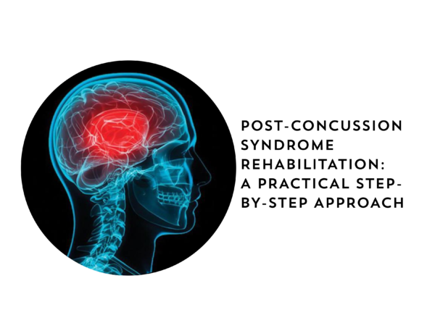
Common Misconceptions Surrounding Concussion: Results of a Survey
Tyler Weinstein
Dr. Nitin K Sethi, MD, M.B.B.S

Slide 2
Introduction
Defined as a transient disorder of brain function
Definition includes long-term sequela
Lack a unified definition from the AAN and AANS
“Concussion” used loosely in literature
Notes:
Essentially, it has been defined as a rapid alteration in brain function. Sequlae include headaches, cranial nerve symptoms, cognitive and somatic impairments. AAN is the American Academy of Neurology. AANS is the American Association of Neurological Surgeons.

Slide 3
Objectives
Administer google forms questionnaire to college students
Identify demographic information within the sample population
Identify misconceptions surrounding concussions

Slide 4
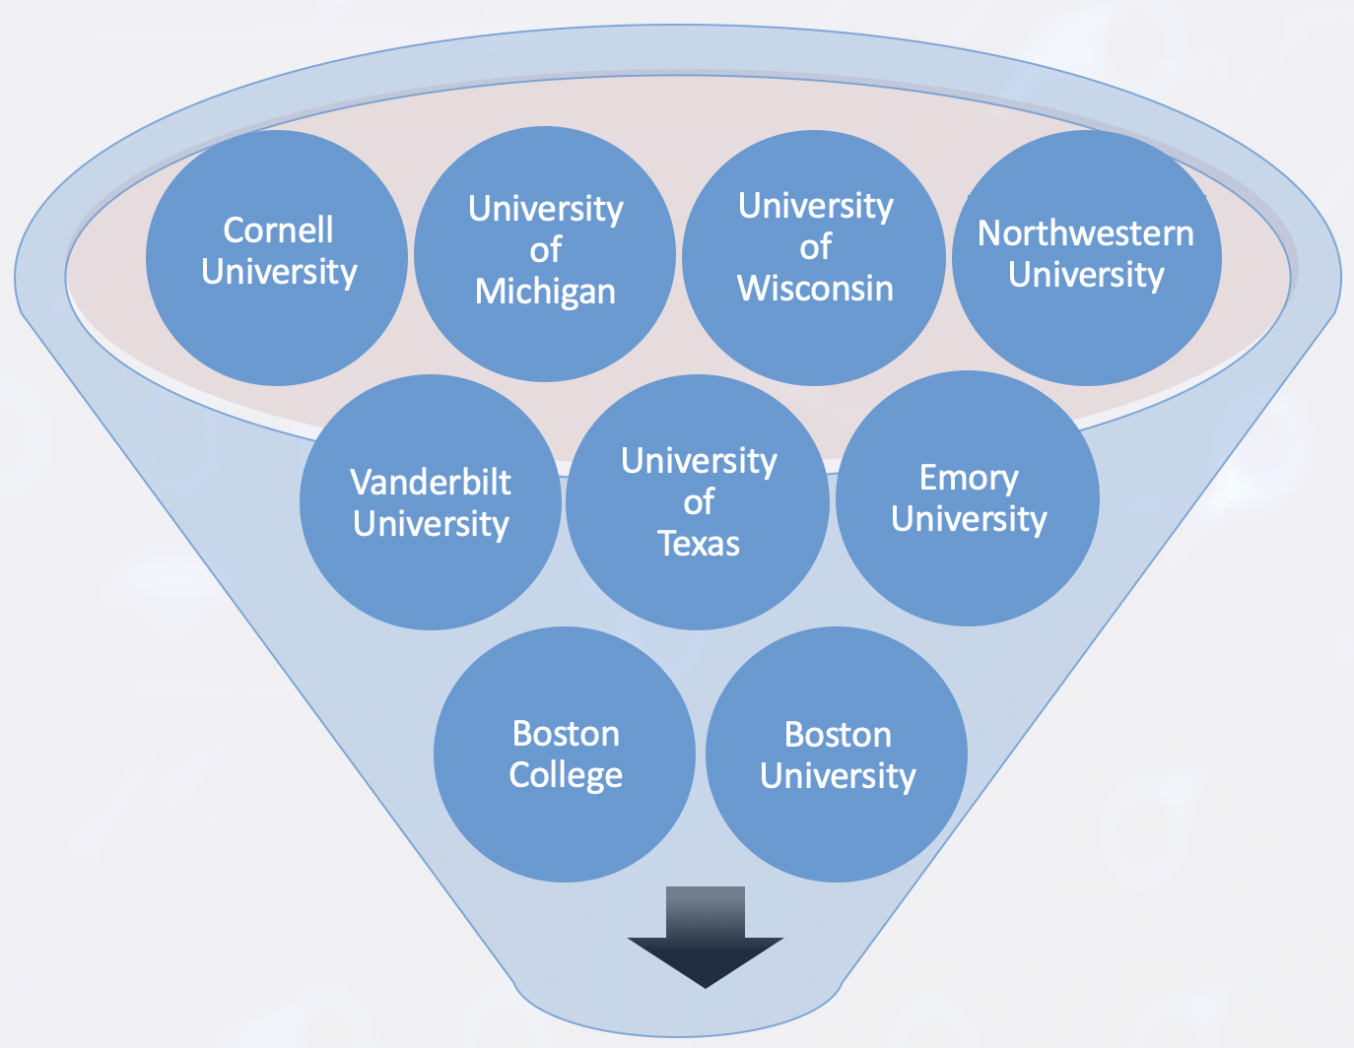

Sample Population

Slide 5
Methods
Common Questions
What symptoms are commonly associated with a concussion?
What is the definition of a concussion?
Is there a difference between a concussion and traumatic brain injury?
Is loss of consciousness common for a concussion?

Slide 6
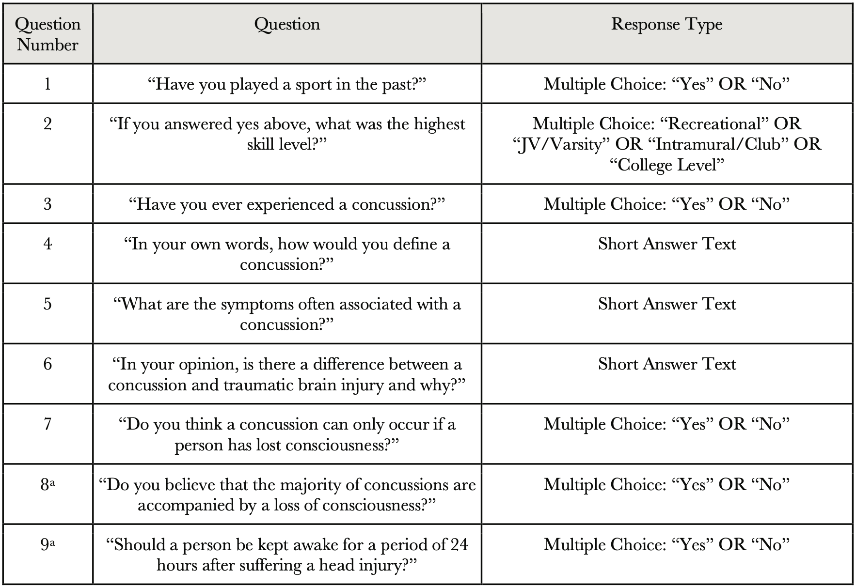
Methods Continued
Included 42 college students ages 18 to 23 years old
Google survey had both multiple choice and short answer responses
One week after survey → Questions 8 & 9 added to determine presence of other misconceptions
All questions required responses to submit the questionnaire.
a. Questions 8 and 9 were added to the survey one week after questions 1-7.
Exactly 12 out of 54 (22.2%) total respondents answered questions 8 and 9

Slide 7
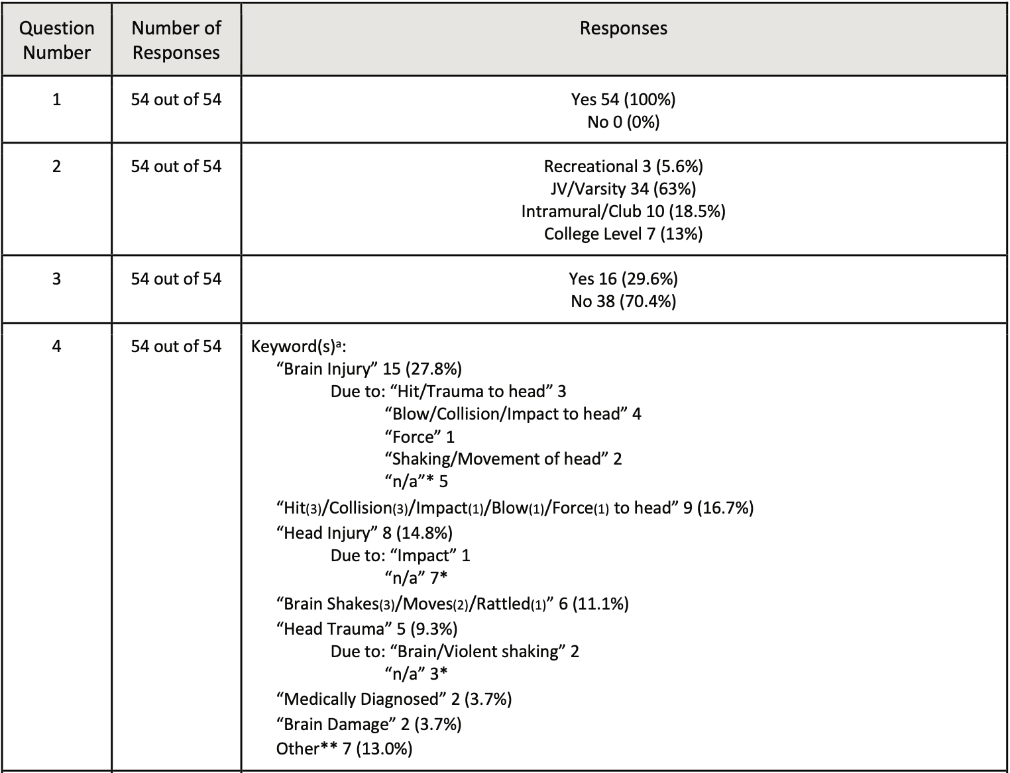
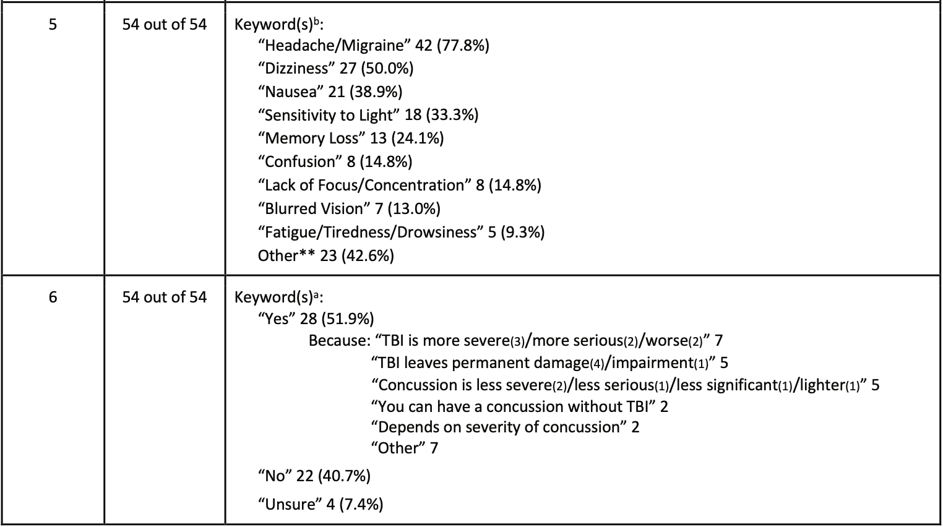
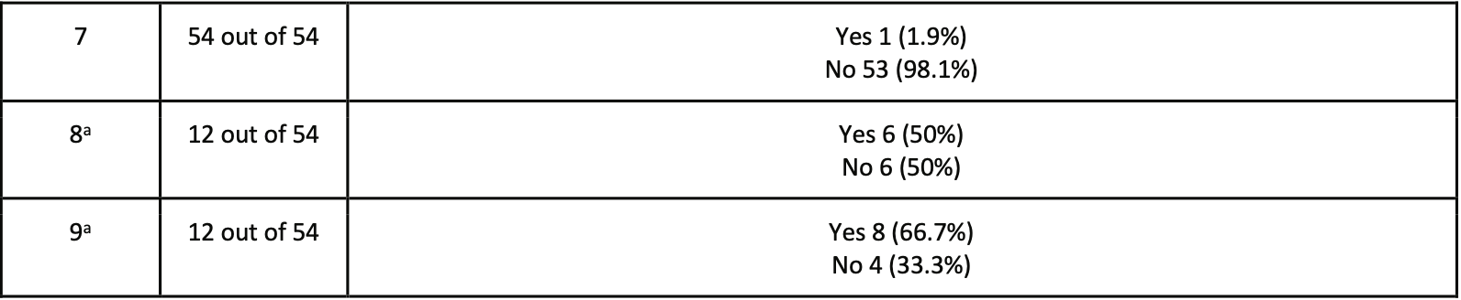
100% former athletes
Results of Survey
14 different “definitions”

Slide 8
Results Continued
Study Population
94.4% of participants played at a competitive level
29.6% of participants have experienced a concussion
100% of participants played a sport in the past
Definitions
27.8% → Brain Injury
Solidifies claim: There is no single definition among this educated cohort of athletes
16.7% → Some type of hit to head
11.1% → Brain movement
13.0% → Other

Slide 9
Results Continued
Only 24.1% and 14.8% classified “memory loss” and “confusion” as symptoms
  0 responses included “vomiting” or “lack of coordination”
40.7% → NO difference between a concussion and TBI
Questions 8 & 9:
  6 of 12 (50.0%) → Majority of concussions include loss of consciousness
  8 of 12 (66.7%) → Incorrectly answered (keep someone awake for 24 hours after a head injury)

Slide 10
Discussion
Misconceptions are common among educated college students
Unaware that direct impact to the head is not necessary for a concussion
Sleep can be beneficial in patients who have suffered a concussion
Concussion symptoms are subtle, varied, and wholly subjective
Mild concussions are common and do not warrant neuroimaging

Slide 11
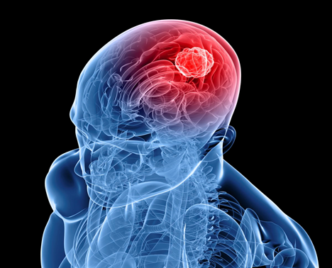
Conclusion
1. A standardized definition of concussion is the need of the hour
2. A definition can help dispel misconceptions
3. The term “concussion” should be used
cautiously
- Mild, moderate, or severe TBI with the
lay public instead
4. Physicians must use every opportunity
to educate the public on the subtle
symptoms of concussions

