Slide 1
TKO/KO Rates Across the States
An Analysis of Professional Boxing Fights
Eric Twohey, MD
Association of Ringside Physicians 2021
9/19/21

Slide 2
Outline
Background
Female v. Male
Weight Class
Fighter Exposure Score
States
Conclusion
Notes:
Want to be concise in presenting data, give time for smart people to give their thoughts and discuss where to go from here

Slide 3
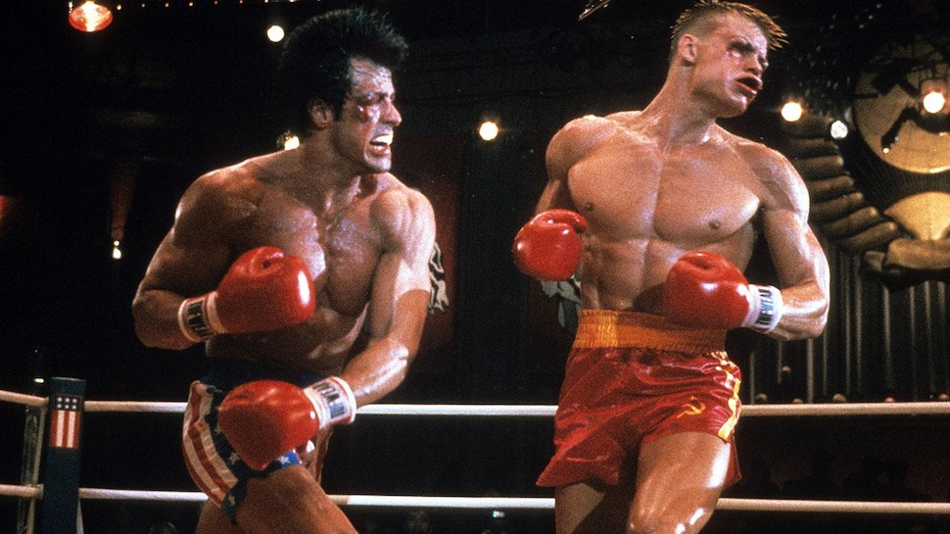
Background - Definitions
KO: failure of combatant to get up after being knocked down by his/her opponent before the referee counts to 10; LOC
TKO: stoppage due to concern for injury, throwing in the towel, no longer adequately defending him/herself, 3 knockdown rule
https://ringsidearp.org/wp-content/uploads/2020/01/Concussion-Combat-Sports-2018.pdf
Notes:
General definitions of KO/TKO, more aimed at fellow residents who aren’t familiar

Slide 4
Background
Duk Koo Kim death 1982-->decreased rounds, increased ropes, pre-fight evaluations
Baird et al 2010
339 boxing fatalities from head injury between 1950-2007
Variables: age, KO/win/loss, # of rounds, weight class, location of fight and terminal event
Conclusions
79-80% of deaths associated with KO/TKO before and after 1983
Decline in mortality after 1983 likely due to less exposure (fewer fights/shorter careers), not reduction in rounds
Baird, Lissa C., et al, “Mortality resulting from head injury in professional boxing: case report.” Neurosurgery 67.2 (2010): E519-E520.
Notes:
Duk Koo Kim death in 1982 , 14th round, SDH, died 4 days later
After Kim’s death, world boxing council changed rounds from 15 to 12, increased # of ring ropes, extensive pre-fight evals
2010, Baird evaluated morality and variables a/w mortality in boxing using the Manuel Velazquez boxing fatality collection
avg age of death 22-24
death more likely in the lower weights
Bottom line: a significant amount of mortality is a/w KO/TKO outcomes, future analyses should focus at least partially on variables a/w with this and intervene when necessary/able

Slide 5

Background
Velasco et al 2019
6 months of professional boxing fights in USA, n=1724
Results- winless boxers at increased likelihood for losing by KO/TKO (75% of 0-4 fighters)
Conclusions
may need closer monitoring of boxers early in career at greatest risk for successive losses
additional scrutiny during licensing process
Velasco, George, et al. “Retrospective Analysis of Professional Boxing Fight Outcomes in the United States during a 6 Month Study Period in 2017”. Neurology 93. 14 Supplement 1 (2019): S11-S12
Notes:
Subgroup analysis on particular states- Dr. Neidecker and North Carolina
30+ losses, not more likely to get KO/TKO
Dr. Neidecker, Sethin, Muzzi,

Slide 6

Background - Big Picture
In an attempt to best care for the well being of boxers and other combat athletes, efforts must be focused on identifying athletes at increased risk for morbidity and mortality and implementing surveillance/restrictions that decrease these risk factors

Slide 7
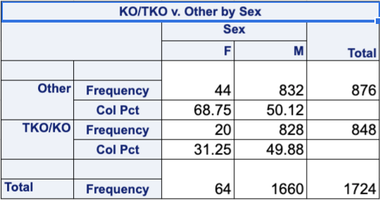
KO/TKO Rates - Male vs. Female
Male- 50%, Female 31%
p=0.0034
Bottom line: male professional boxers are significantly more likely to lose via KO/TKO
Notes:
Unable to assess KO/TKO v. other in winless fighters as n=9 in females
Interesting as females, compared to men, in several sports have higher rates of concussions/increased symptom severity
Fighter Brain Health Study
file:///Users/erictwohey/Downloads/Follmer2019_HeadTraumaMMA.pdf

Slide 8
KO/TKO Rates - Fighter Exposure Score
Fight Exposure Score- function of cumulative fights and intensity of exposure
Bernick et al 2015- Increase in FES associated with reductions in caudate, amygdala, and thalamus
1=1-15 fights, < or equal to 1 fight/year
2=1-15 fights, >1 fight/year
3= >15 fights, < or equal to 1 fights/year
4= >15 fights, >1 fight/year
Bernick, Charles, et al. “Repeated head trauma is associated with smaller thalamic volumes and slower processing speed: the Professional Fighters’ Brain Health Study.” British Journal of Sports Medicine 49.15 (2015): 1007-1011
Notes:
wont pretend to know this better than Dr. Bernick himself, but increased repetitive head trauma was a/w reduced brain volumes and processing speed

Slide 9
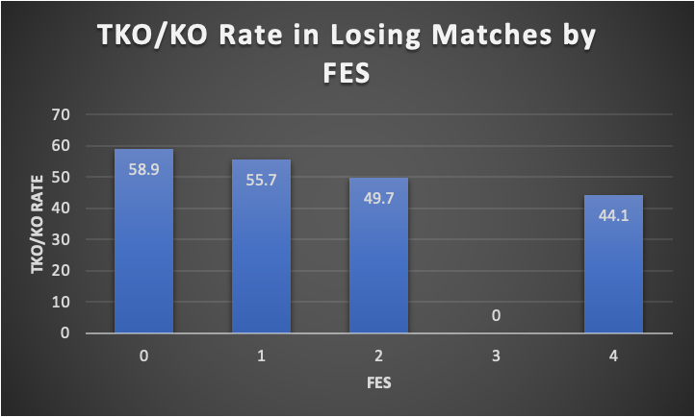
Fighter Exposure Score
p=0.0006
experience, self selecting fighting style
Velasco et al- fighters w/ >30 losses not at increased likelihood of TKO/KO
?Boxing severity index
Bottom line- association between FES and TKO/KO rates
Notes:
?Utility of FES 3. Need to recategorize? More experience leads to less likely TKO/KO. Not surprising, self selecting for fighting style. Velasco et al finding boxers w/ greater than 30 losses not at increased likelihood of TKO/KO, however still have to concerned about cumulative impact

Slide 10
KO/TKO Rates - Weight Class
Professional Boxing Weight Classes
Flyweight 112
Bantam 118
Feather 126
Light 135
Welter 147
Middle 160
Light HWT 175
HWT 200+
n | 205 | 111 | 192 | 138 | 121 | 81
Weight | <126 | 127-139 | 140-153 | 154-167 | 168-199 | 200+
Notes:
difficult to breakdown by true weight classes with a lot of catch weights

Slide 11
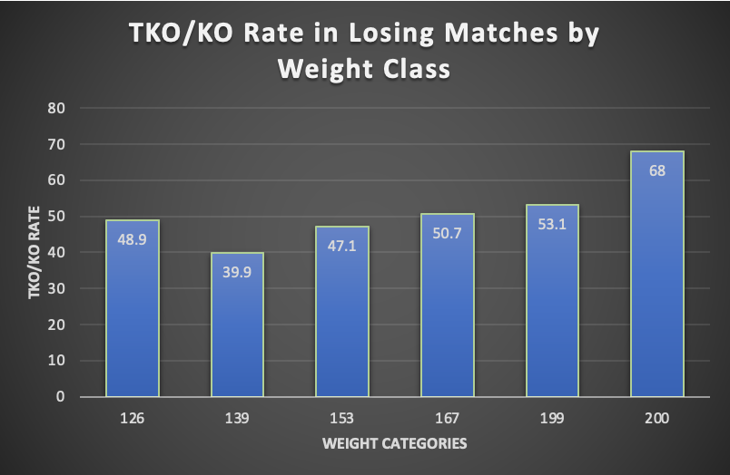
KO/TKO Rates - Weight Class
p<0.0001
Significant when looking just at men, not women
Bottom Line - there is an association of KO/TKO rates when broken down by weight class
Fight Matrix (All UFC events)
HWT- 49.6%
Flyweight- 22.4%
https://www.fightmatrix.com/ufc-records/ufc-fight-outcomes-by-weight-class/
Notes:
Interesting trend in lightweights as higher proportion of females in those lower weight classes. Association and trend held true when just looking at men: 126- 49.8, 139-40, 153- 47, 167-51.9, 199-54, 200-68.4
When looking at outcomes by weight class separating by sex…
Association held for mens p<0.001, but not for women p=0.84
However <126 n=23, >200 n=1
N total=64, 139 and under n=43

Slide 12
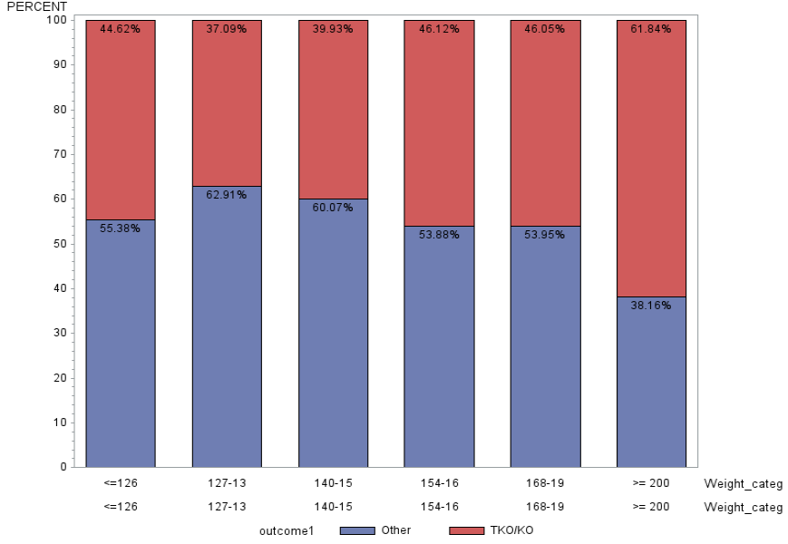
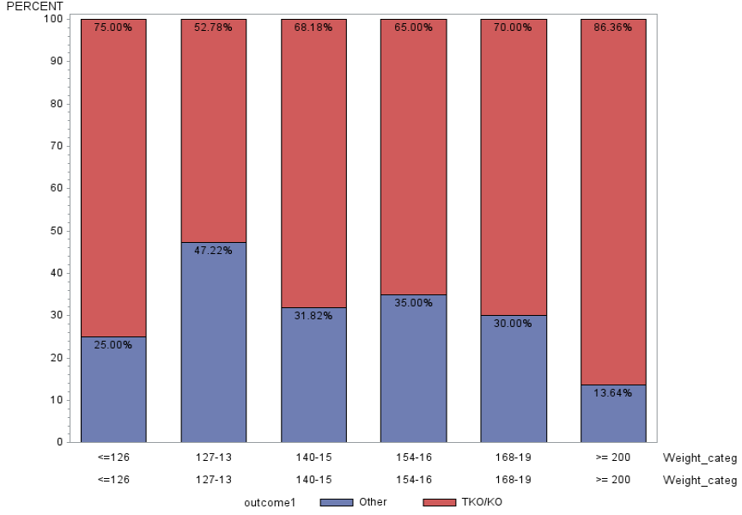
KO/TKO Rates - Weight Class
Winning %>0 vs. Winless fighters (bouts>0)
Winless <126 lose by KO/TKO 75%, HWT 87%
Bottom line- it appears that not having any win increases likelihood of KO/TKO regardless of weight class
Notes:
<126: TKO/KO jumps up 30% w/ winless fighters
>200: 86% of winless fighters lose by TKO/KO
?HWT in general closer supervision early on in career?

Slide 13
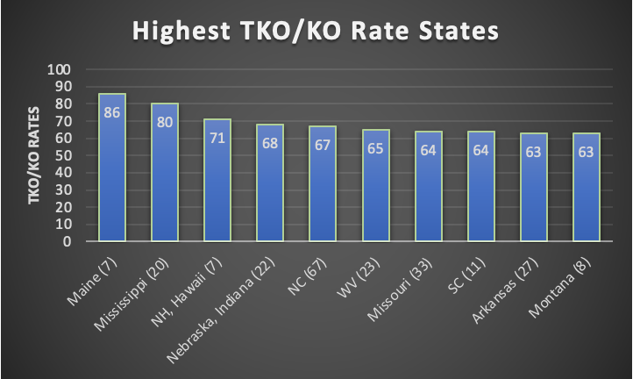
KO/TKO Rates - Highest States
Notes:
North Carolina, Missouri the only big ones on there

Slide 14
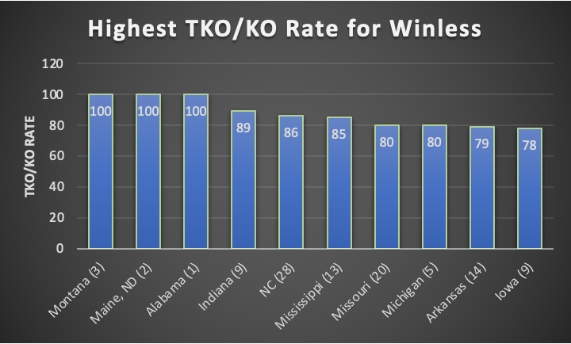
KO/TKO Rates - Highest for Winless
Notes:
North Carolina

Slide 15
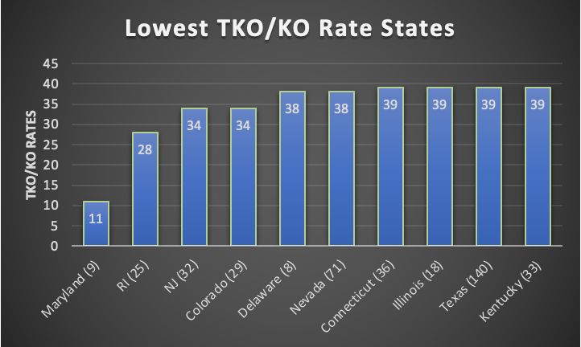
KO/TKO Rates - Lowest States
Notes:
Notice Texas and Nevada
?Nevada by choice of high level fighters

Slide 16
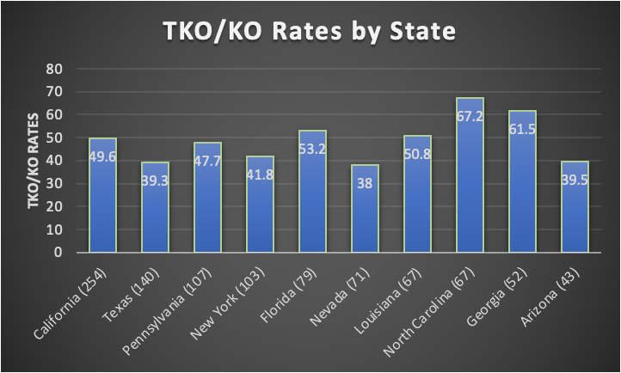
KO/TKO Rates - States, Highest Frequency Bouts
Bottom line- there is a lot of variability between KO/TKO rates in professional boxing between states across the USA
Notes:
Rates of top 10 highest frequency states
Bad states- NC, GA, Florida, California
Good states- Texas, Nevada, Arizona

Slide 17
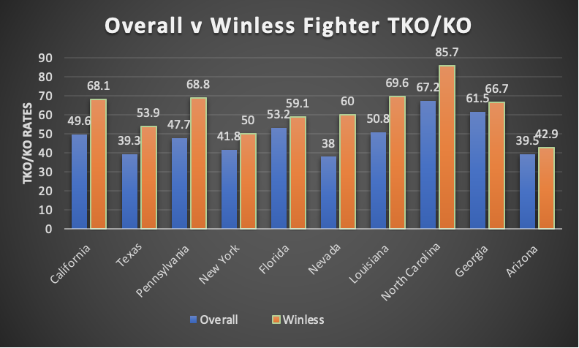
KO/TKO Rates - States, Highest Frequency Bouts
Bottom line - increased risk for TKO/KO for winless fighters across all states
Notes:
Nevada- steep drop off in frequency of actual fights, ?d/t only good/big name fighters fighting there
Frequency for nevada drops from 71 to 5 when evaluating winless fighters
Split up by highest and lowest frequency for winless fighters: High= GA, CA, PA, LA, NC; Low= AZ, NV, FL, NY, TX
Note- Steepest change in TKO/KO frequency- Nevada (22), Pennsylvania (20) Louisiana (18.8), NC/California (18.5)

Slide 18
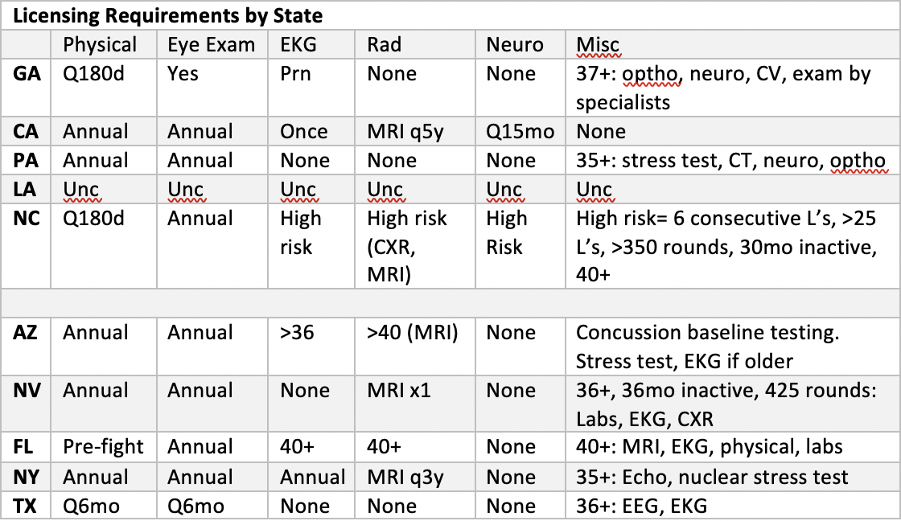
Breakdown of Licensing Requirements
Top=states with highest KO/TKO rates for winless fighters
https://www.abcboxing.com/medical-requirements-by-commission/
Notes:
Got this info from internet confirmed as of 2018 i believe, however people in audience may know more of the nuance
both require 180 to annual physical
eye exams generally required, EKG did not see anything
Radiology- maybe the good states are requiring more imaging
Neuro- if anything, bad states are requiring more neuro
Big Points: what we consider high risk, age that we intervene at
LA had unconfirmed licensing requirements
GA eye exam did not specify frequency
Split up by highest and lowest frequency for winless fighters
top= highte

Slide 19
Conclusions/Points of Discussion
Men significantly more likely to lose by KO/TKO
Inverse Relationship between FES and KO/TKO rates
Winless fighters more likely to lose by KO/TKO across all weights
75%, 86% at lowest and highest weights, respectively
Miscellaneous licensing requirements centered around older fighters, ? need for earlier intervention/restrictions
Notes:
However, data for women limited by numbers, would expect to change as more women get involved, more training.
While higher FES a/w lower TKO/KO rates, ?self selecting, still having significant repetitive head trauma
Miscellaneous requirements centered around protecting older fighters, does not seem to be consistent state to state. As data emerges may need to start benign more stringent early on in fighters career. ?more frequent check ups, longer suspension periods?

Slide 20
Future Directions
Webscraping-->expanding dataset?
Further subgroup analyses- age, years fighting, rounds
Continuing to gather more data, especially for women
Comparative studies to MMA, Fight Matrix

