Slide 1
Spontaneous Pneumothorax Case
Dr. Kim Meathrel
Presented by: Joshua Martin, OMS III

Slide 2
The Case……
18 y/o male, college swimmer and boxer
No previous medical history
3 months post spontaneous pneumothorax
Treated with chest tube and cleared by surgeon
Patient had been back in the pool doing some light swimming with no SOB
Wants clearance to return to the boxing gym

Slide 3
Physical Exam Findings
Slight apical pneumothorax seen on CXR
PE otherwise normal

Slide 4
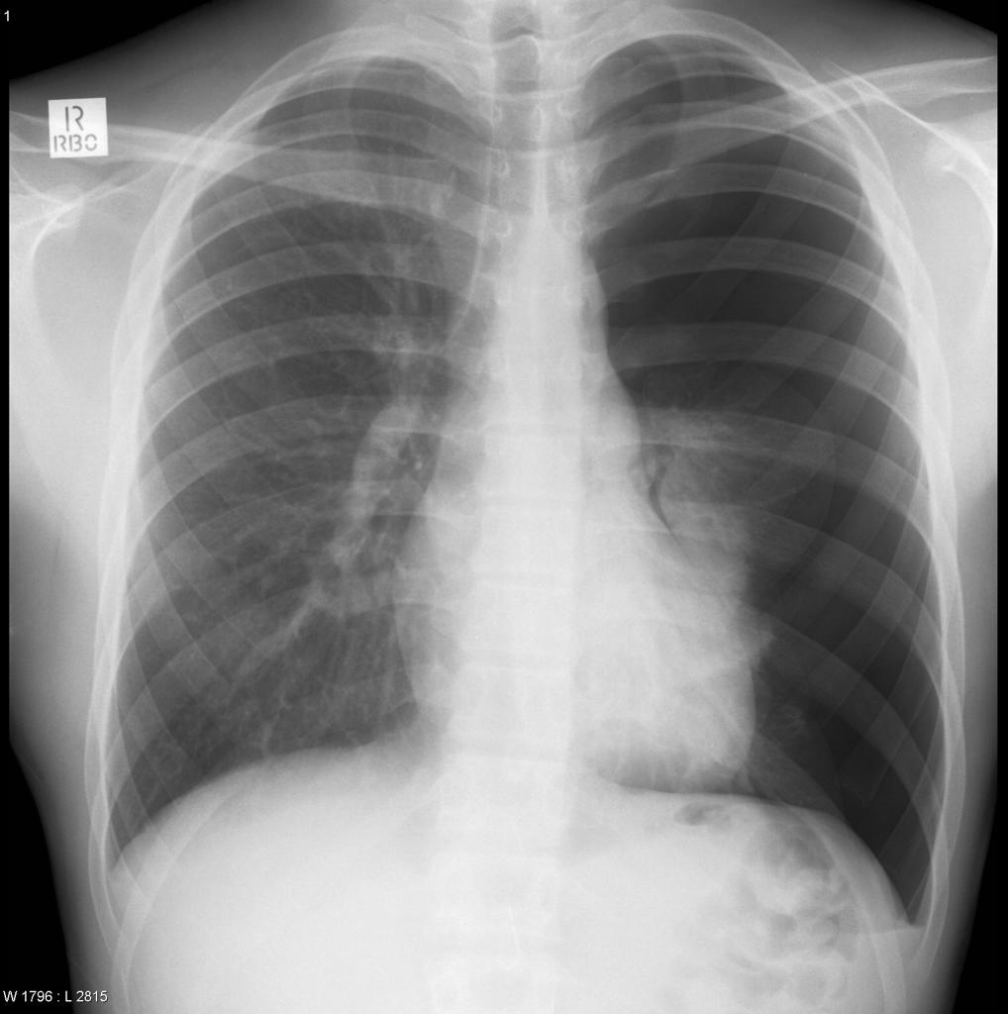
Background
Pneumothorax=collapsed lung caused by air leaking into pleural space, between lungs and chest wall
Dyspnea, uneven chest expansion, chest pain, decreased fremitus, hyperresonance, and diminished breath sounds
Often caused by trauma including rib fractures that puncture the pleural sac
Figure 1: Pneumothorax chest x-ray from Gorrochategui, Martin. “Pneumothorax: Radiology Reference Article.” Radiopaedia Blog RSS, radiopaedia.org/articles/pneumothorax?lang=us.

Slide 5
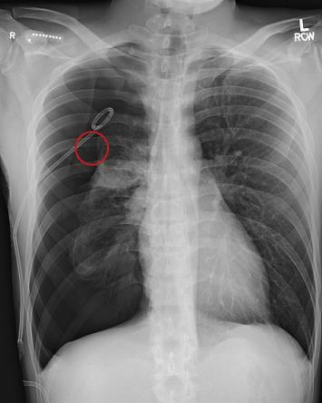
Spontaneous Pneumothorax
Most common in men ages 20-40
No apparent cause such as trauma, but thought to be due to ruptured subpleural blebs or bullae that could have a genetic factor
Not associated with exertion or activity
Rare in athletes
Figure 2: Bleb CXR from Segraves, Justin M., and Megan M. Dulohery. “Primary Spontaneous Pneumothorax Due to High Bleb Burden.” Respiratory Medicine Case Reports, Elsevier, 24 Aug. 2016, www.sciencedirect.com/science/article/pii/S2213007116300806.

Slide 6
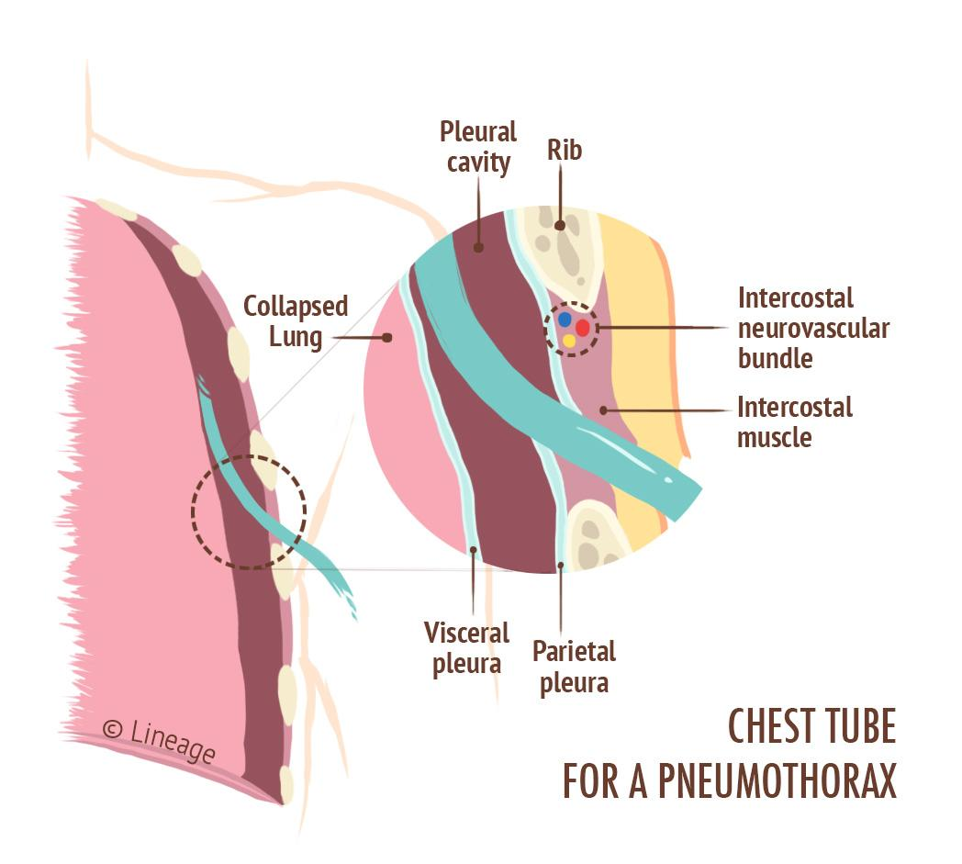
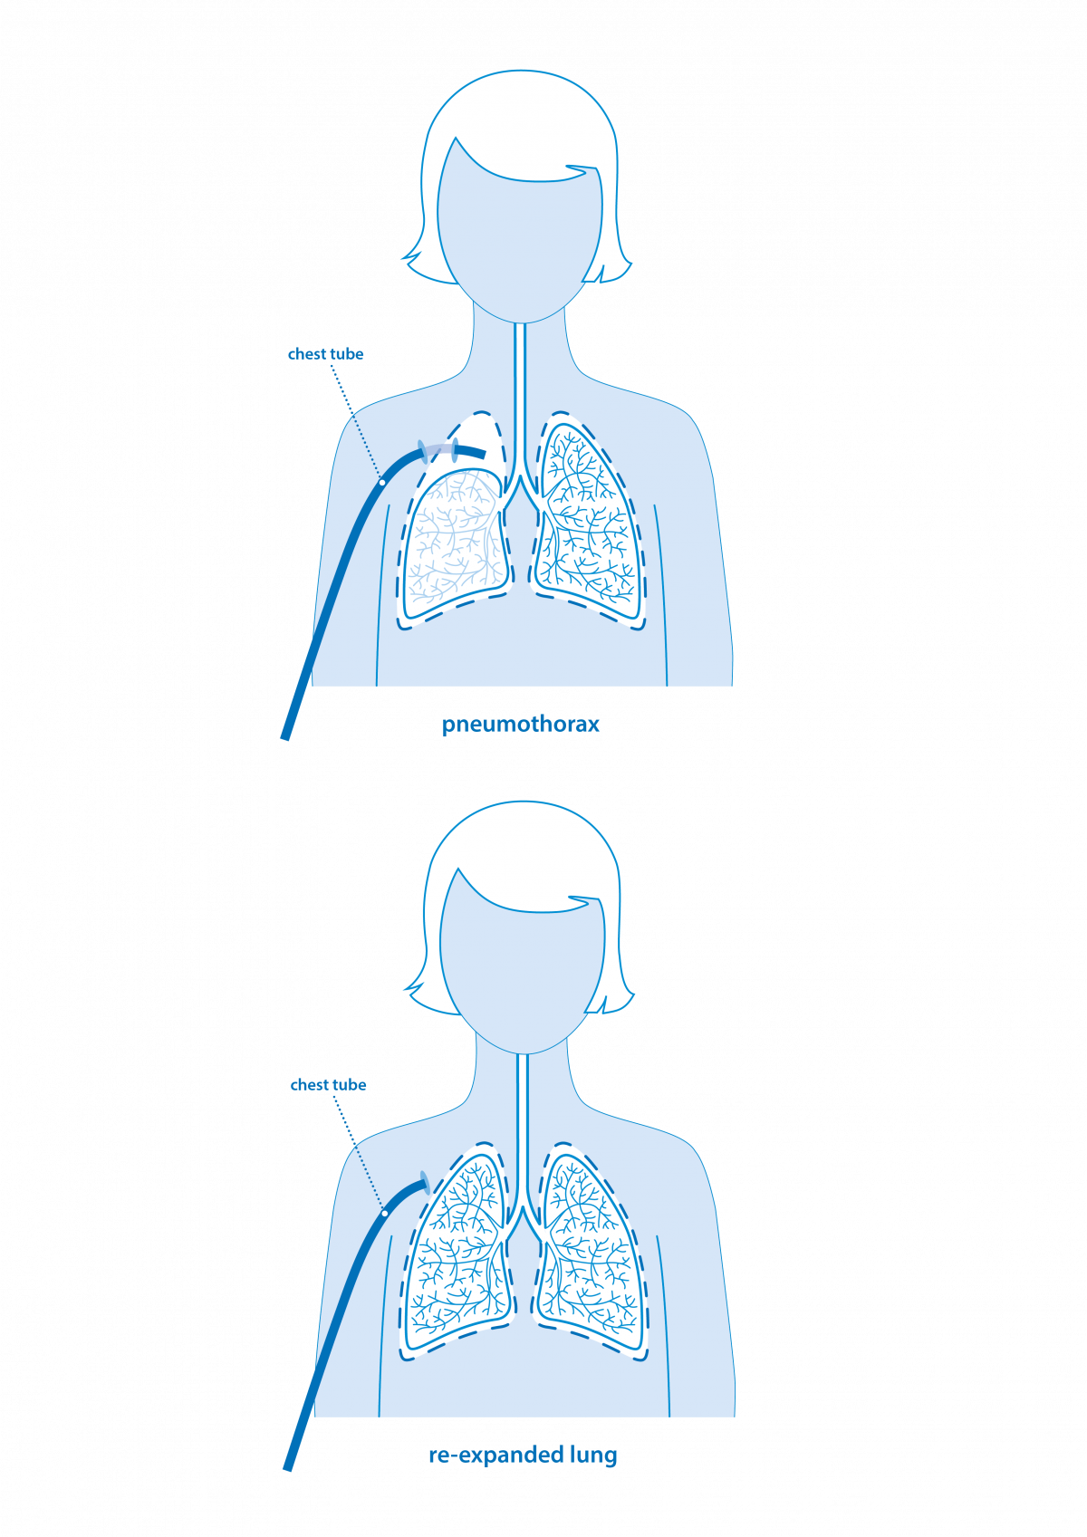
Treatment
Treatment for spontaneous pneumothorax can vary depending on the size and stability.
Often, treated with a thoracostomy where a needle or chest tube is used into drain the air from the intrathoracic space and re-inflate the lung.
Some cases only require supportive therapy and observation
Figure 4: Chest Tube Placement from “Pneumothorax.” Pneumothorax - Respiratory - Medbullets Step 1, step1.medbullets.com/respiratory/117051/pneumothorax.
Figure 3: Lung re-expansion from “Pneumothorax (Collapsed Lung).” British Lung Foundation, 10 Feb. 2020, www.blf.org.uk/support-for-you/pneumothorax.

Slide 7
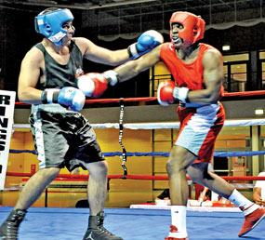
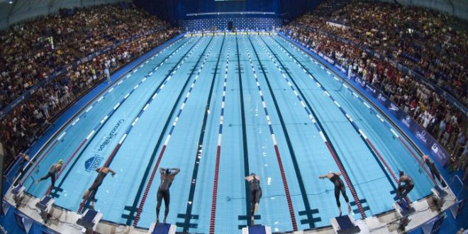
Do you clear him to return to training??

Slide 8
Risk Factors for Recurrence
According to UpTODate, recurrence rate for males ranges from about 4% in the first week to 20% in the next 5 years.
Higher in females
Recurrence could be as high as 50% when treated nonoperatively
Risk factors include female gender, tall stature in men, low body weight, smoking, blebs or bullae
Occupations or hobbies such as scuba diving or pilot

Slide 9
Return to Play Standards/Recommendations
No specific boxing recommendations, but 3-4 weeks after resolution of the pneumothorax seems to be the accepted standard
Should take into account risk factors for recurrence, severity of pneumothorax, and sport or activity patient is returning to
Online forum: Amateur MMA fighter returned to training and trained for a marathon with no problems a year after spontaneous pneumothorax. Others said from a month-2 years and most had not taken a fight yet
No published guidelines for return to play following spontaneous pneumothorax
Accepted that athletes should be cleared for some activity, but counseled on the risk of recurrence
Curtin et al study had a basketball player return to play 3 weeks post pneumothorax with no complications or difficulty.

Slide 10
Dr. Meathrel cleared him to return to the boxing gym for cardio, but no sparring. Will need to get a cardiac US before clearance to spar or compete.

Slide 11
Acknowledgements
Thank you to:
Association of Ringside Physicians
Dr. John Neidecker
Dr. Kim Meathrel
Sources:
BLONSTEIN, J L, and E CLARKE. “Further Observations on the Medical Aspects of Amateur Boxing.” British Medical Journal, U.S. National Library of Medicine, 16 Feb. 1957, www.ncbi.nlm.nih.gov/pmc/articles/PMC1974361/?page=1.
Curtin, Sean M, et al. “Pneumothorax in Sports Issues in Recognition and Follow-Up Care.” THE PHYSICIAN AND SPORTSMEDICINE, vol. 28, no. 8, Aug. 2000.
“Pneumothorax.” Mayo Clinic, Mayo Foundation for Medical Education and Research, 21 May 2021, www.mayoclinic.org/diseases-conditions/pneumothorax/symptoms-causes/syc-20350367.
UpToDate

