Slide 1
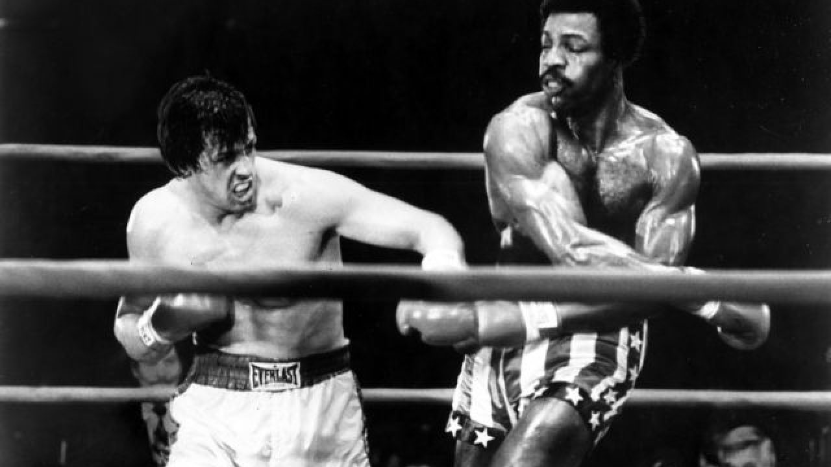
The show must go on
Or not… should CTE claims stop a show

Slide 2
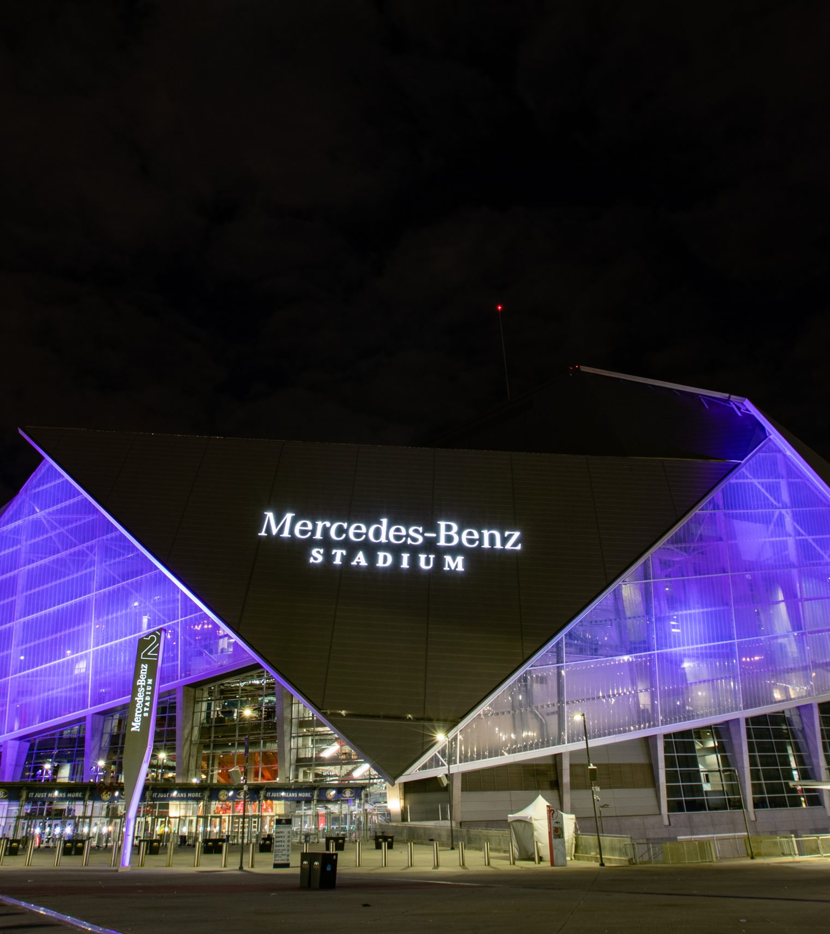
WORLDWIDE PPV MAIN EVENT
• 24 year old former disney channel star, turned youtube celebrity with a boxing record of 2-0
First won via TKO against another Youtuber
Second via KO against a inexperienced Former Professional Basketball Player

Slide 3

Like you said, I've gone and gotten brain scans and have early signs of CTE."I love this sport and wouldn't trade it for anything else. And I'm a fighter, and people will see that.
–Fighter

Slide 4
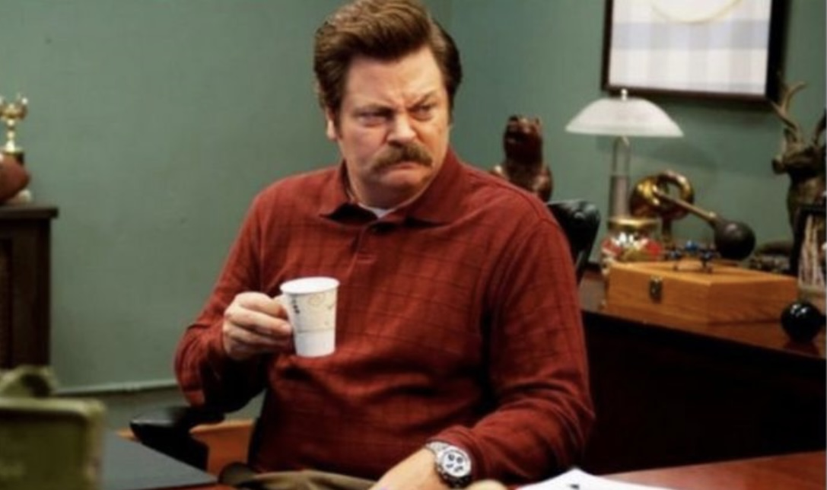

Slide 5
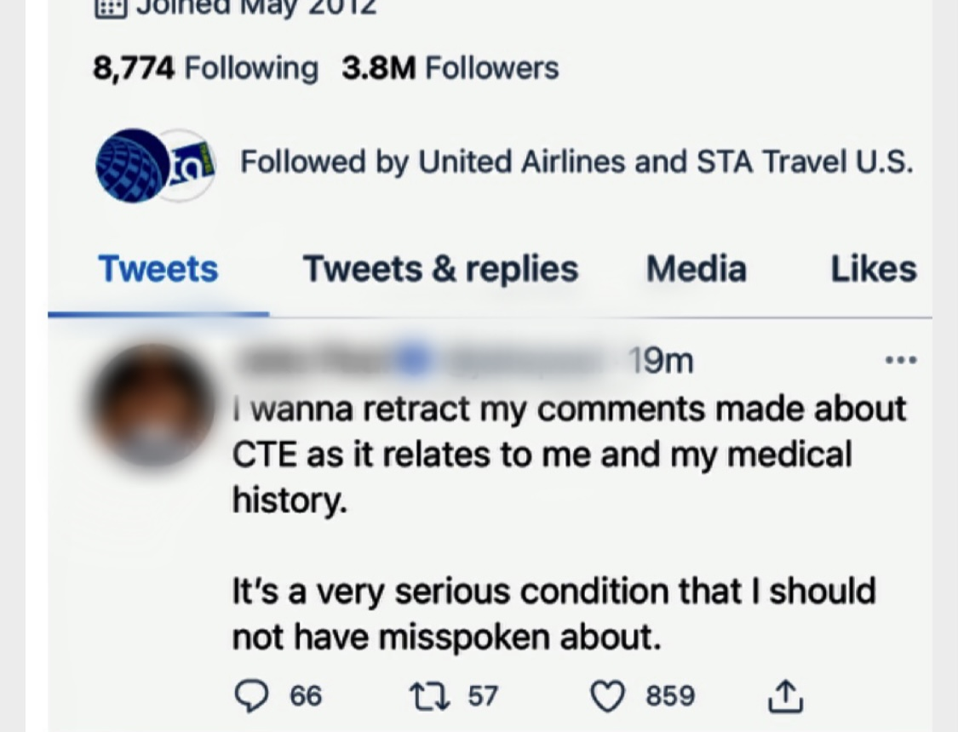
“Type a quote here.”
–Johnny Appleseed

Slide 6
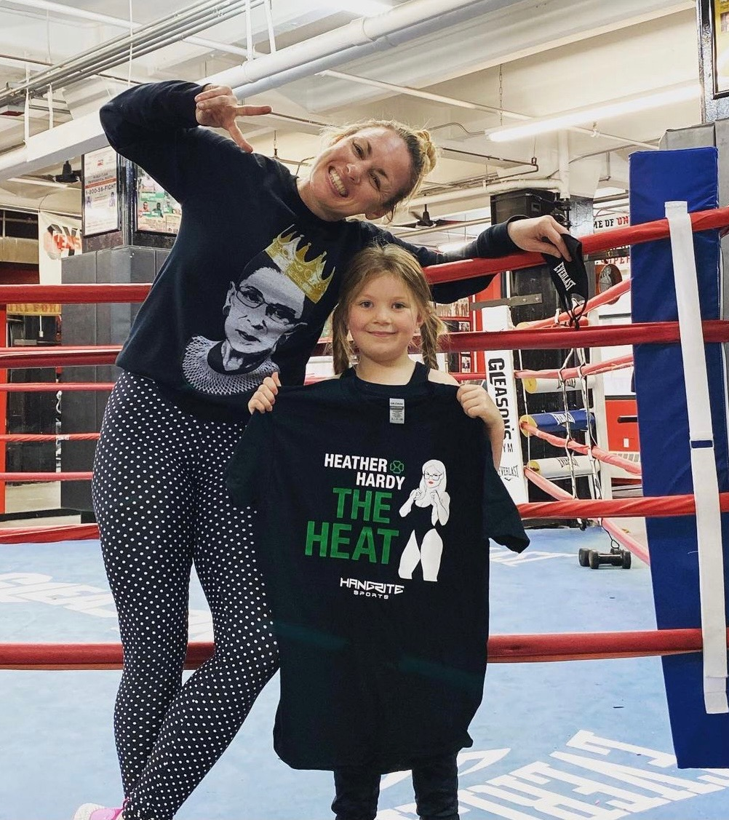
Celebrity Boxing
Started in Gleason’s gym in Brooklyn Newyork in the 1980’s

Slide 7
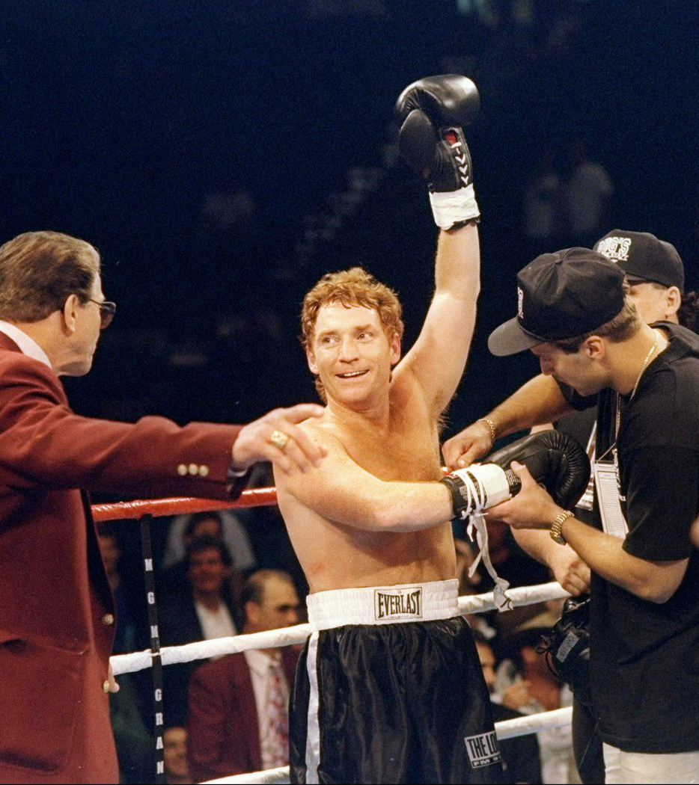
Celebrity Boxing’s rise
Celebrity boxing spread to the UK where, labeled as “Dangerous and Irresponsible” has since then only hosted a few events.
Fox Network started a tv show called “Celebrity Boxing” During the explosion of reality television.
Some of the early events included: Donny Osmond, Todd Bridges (of different strokes) and perhaps most notably the infamous Tanya Hardin

Slide 8
Fast forward ⏩
Take a step into 2021 and you have Jake Paul vs Ben Askren which earned more then 75 million dollars. The event featured heavy hitter performances from the like of Justin Bieber and The Black Keys showing that as a Mega Million dollar earning industry Celebrity Boxing Just Might Be Here To Stay.

