Slide 1
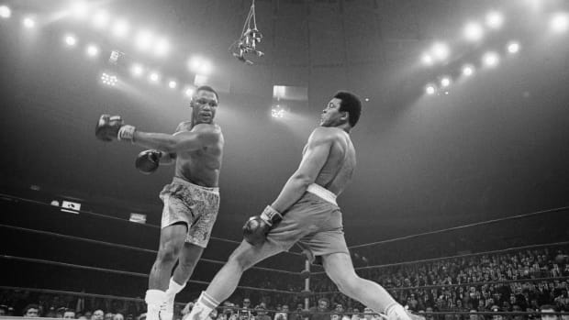
Shoulder Injuries in Combat Sports
Rance McClain, DO

Slide 2
Objectives
Differentiate acute vs chronic shoulder injuries in combat sports
Diagnose risk factors for shoulder injuries
Construct mechanisms of injury likely to occur in various combat sports athletes and situations

Slide 3
Nature of Injury
Acute
  Fracture
  Soft tissue tear
  Traumatic dislocation
Chronic
  Instability
  Imbalance
  Impingement

Slide 4
Nature of Injury
External forces
  Submission attempt from opponent
  Contact with cage/ring/object
Internally derived forces
  Landed punch
  Missed punch
  Repetitive training

Slide 5
Incidence
Boxing
  #1 – Hand, #2 – wrist, #3 – elbow, #4 - low back, #5 – shoulder/ankle tied
Wrestling
  #1 - Shoulder
Judo
  #1 - Shoulder
MMA
  #1 – Head/neck, #2 – lower extremity, #3 – upper extremity
  Nose, shoulder and toe all tied at 6.3% chance of injury

Slide 6
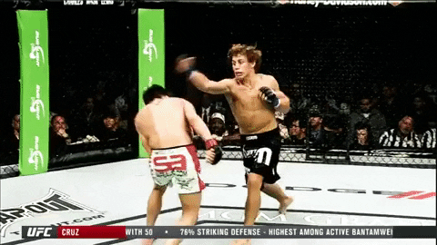
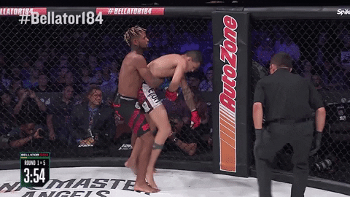
AC Separation

Slide 7
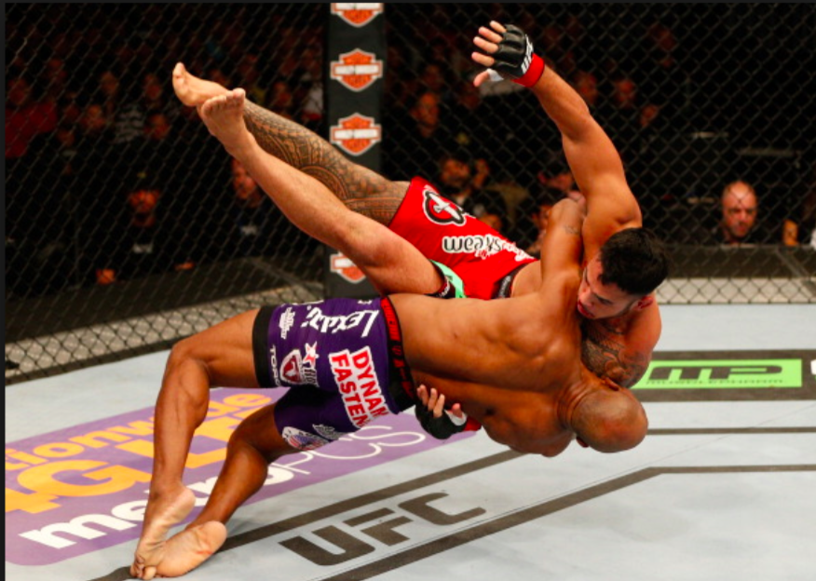
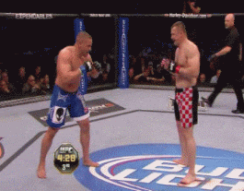
Clavicle Fracture

Slide 8
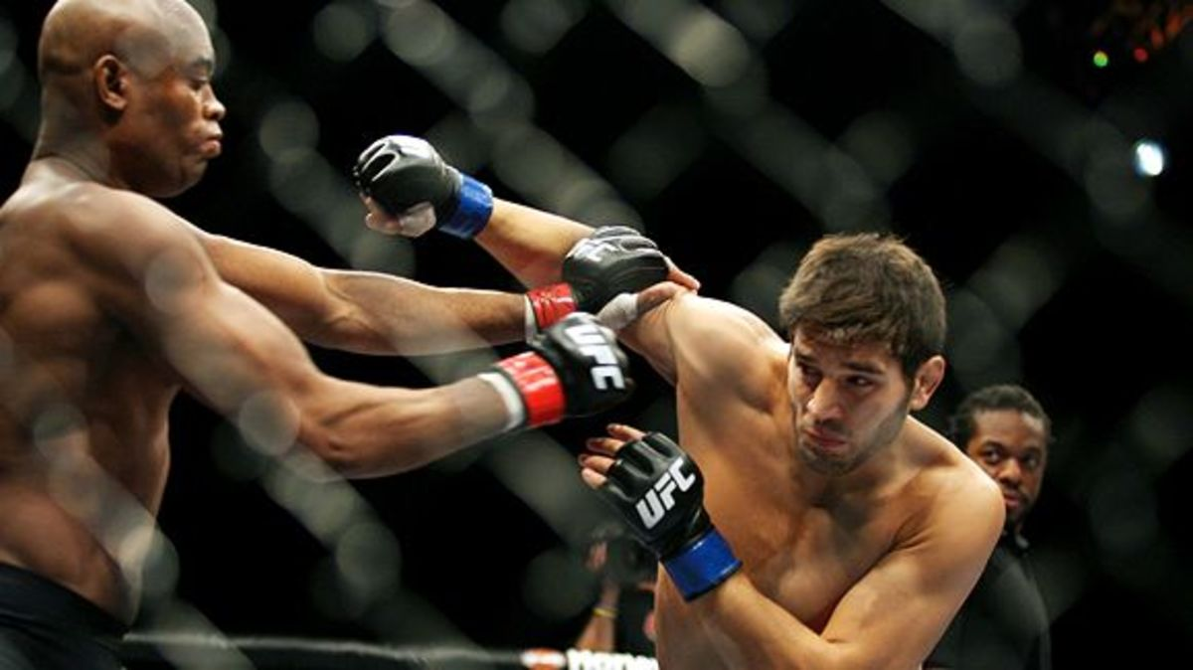
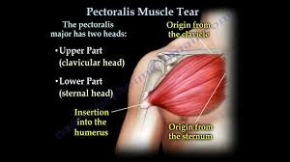
Pectoralis Tear

Slide 9
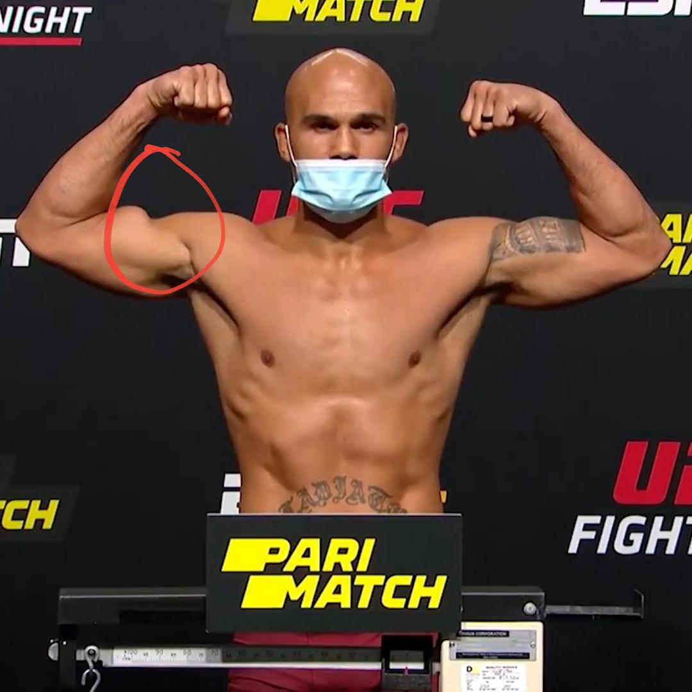
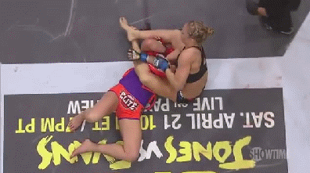
Proximal Biceps tear

Slide 10
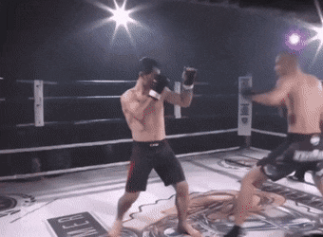
Glenohumeral Dislocation

Slide 11
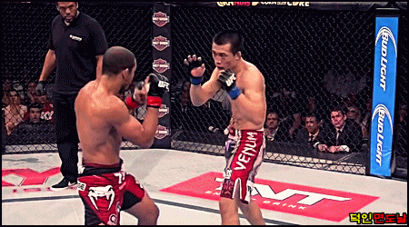
Glenohumeral Dislocation

Slide 12
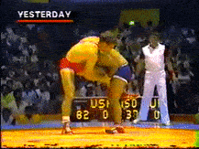
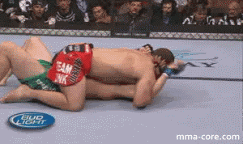
Kimura vs Americana

Slide 13
INSTABILITY
The term "shoulder instability" constitutes a spectrum of disorders that includes laxity, subluxation and dislocation.

Slide 14
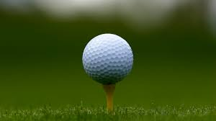
Static restraints
Negative intra-articular pressure
Ligaments and capsule
Labrum (increases concavity)
Articular surfaces/osseous anatomy
    (very little because surface area of humeral head is 3X glenoid)

Slide 15
Dynamic restraints
Rotator cuff muscles
Deltoid and biceps
  Concavity compression
Scapular position/stability

Slide 16
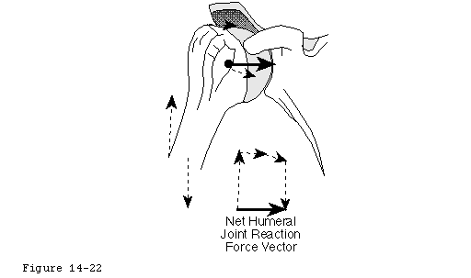
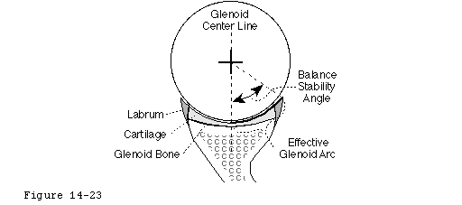
The maximal angle that the net humeral joint reaction force can make with the glenoid center line in a given direction is the balance stability angle

Slide 17
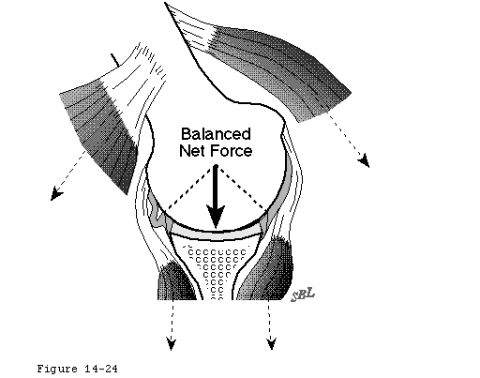
The humeral head will remain centered in the glenoid fossa if the glenoid and humeral joint surfaces are congruent and if the net humeral joint reaction force is directed within the effective glenoid arc.

Slide 18
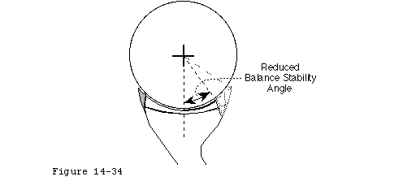
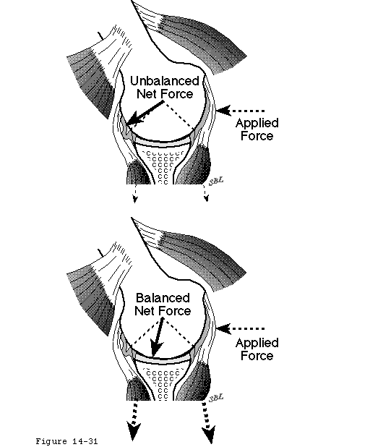
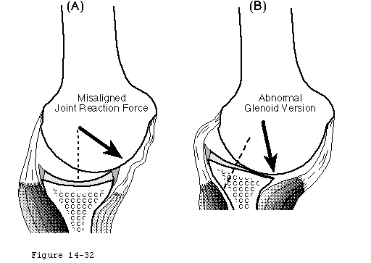

Slide 19
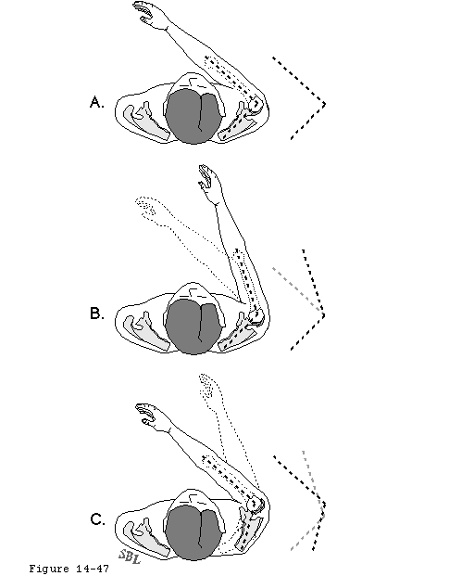
Ligamentous stabilization
Check reins
  balanced force exceeds balanced stability angle.

Slide 20
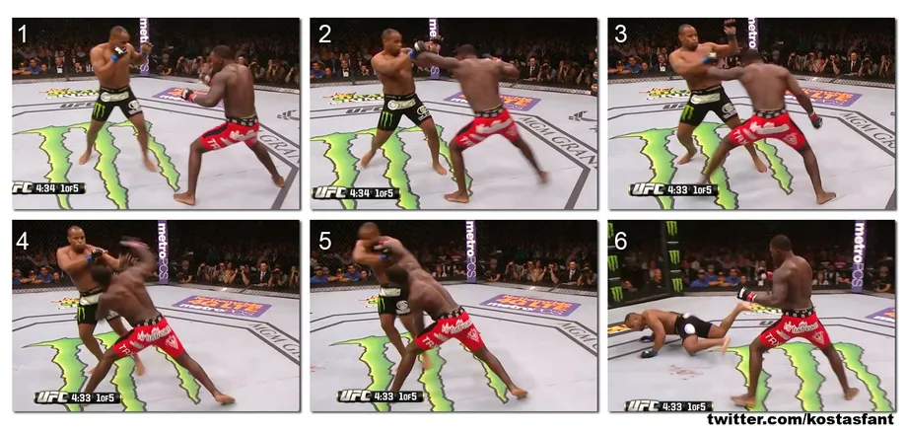

Slide 21
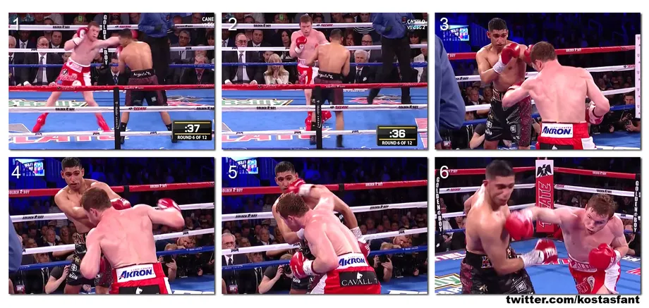

Slide 22
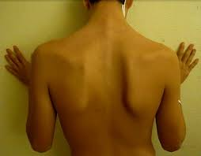
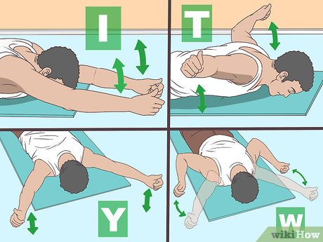
Scapular Assessment and Stability Exercises

Slide 23
Thank you!

