Slide 1
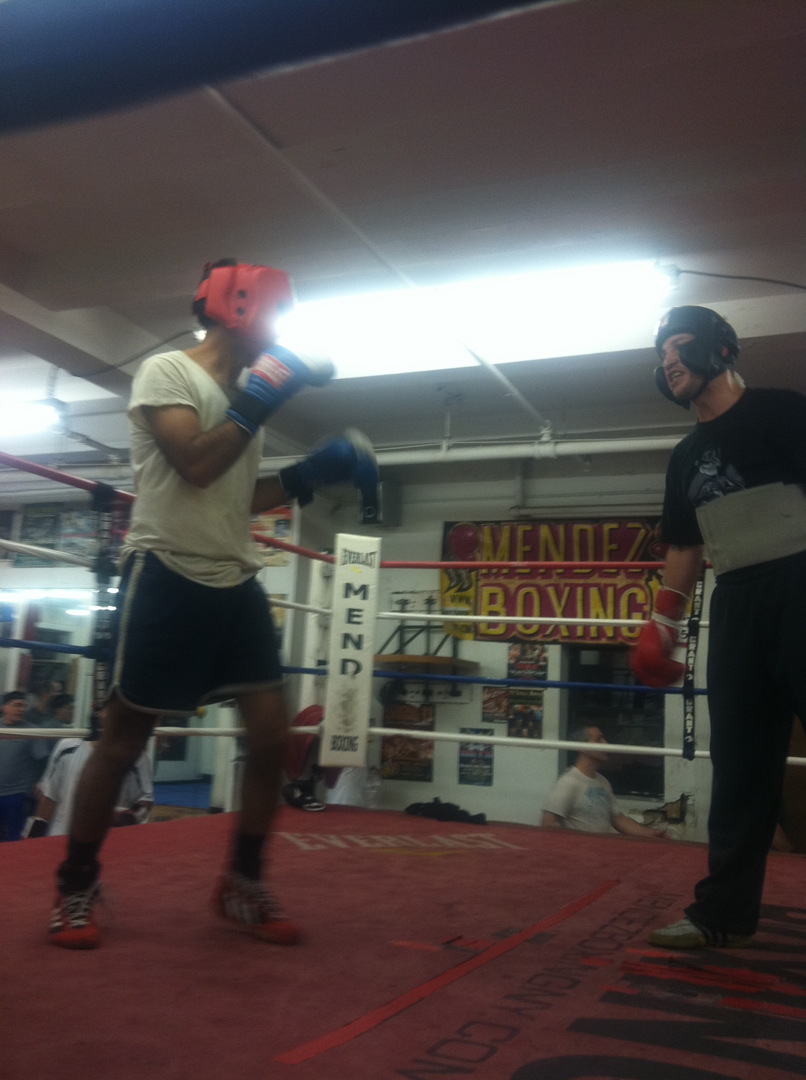
Safe Sparring Protocol: reducing head impact exposures during training in combat sports
Nitin K Sethi, MD, MBBS, FAAN
Director, Weill Cornell Concussion and Brain Injury Center
Chief Medical Officer, New York State Athletic Commission (NYSAC)
Secretary and Chief Scientific Officer, Association of Ringside Physicians (ARP)

Slide 2
Disclosures:
The views expressed are mine and do not necessarily reflect the views of the institutions and organizations I serve.
I disclose no other relevant financial interests.

Slide 3
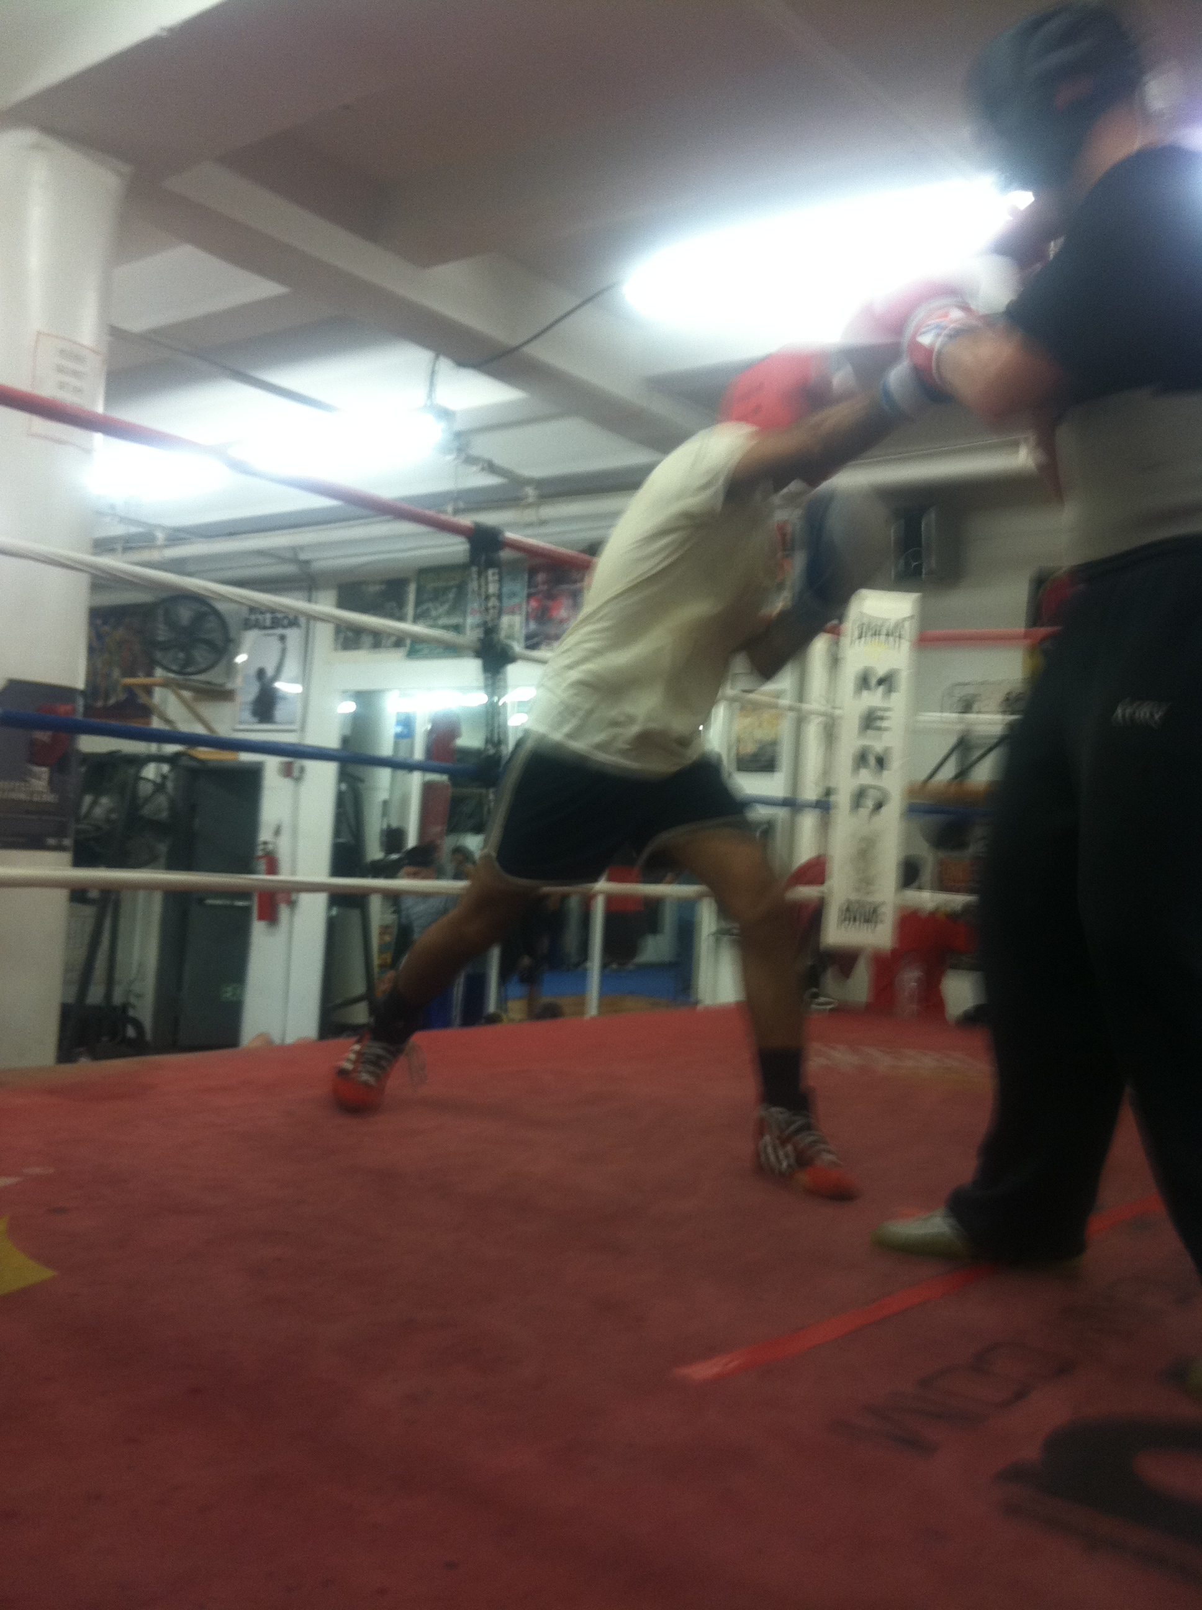
Background/why is a safe sparring protocol the need of the hour in boxing?
Concussions and head impact exposures (HIE) are common in professional combat sports of boxing and mixed martial arts (MMA).
Why?-every punch thrown at the head is thrown with the intention of winning by causing a knock-out (KO).
Concussions and HIEs are inevitable and unavoidable.
The incidence and prevalence of these injuries while the combatant is in training (camp) has not been systematically studied but is likely high.

Slide 4
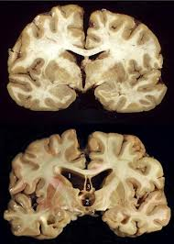
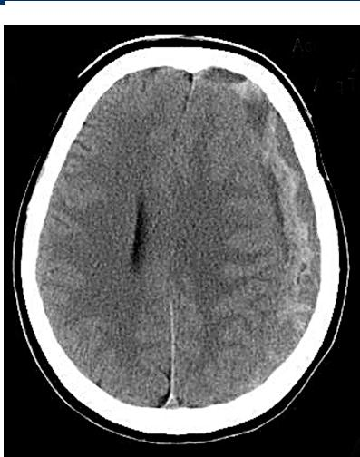
Goal/objectives of the Safe Sparring Protocol
Good practice guidelines are proposed and intended to identify, manage, and reduce HIEs during training camp.
These interventions will protect combatant’s neurological health and reduce the incidence of both acute and chronic neurological injuries associated with combat sports.

Slide 5
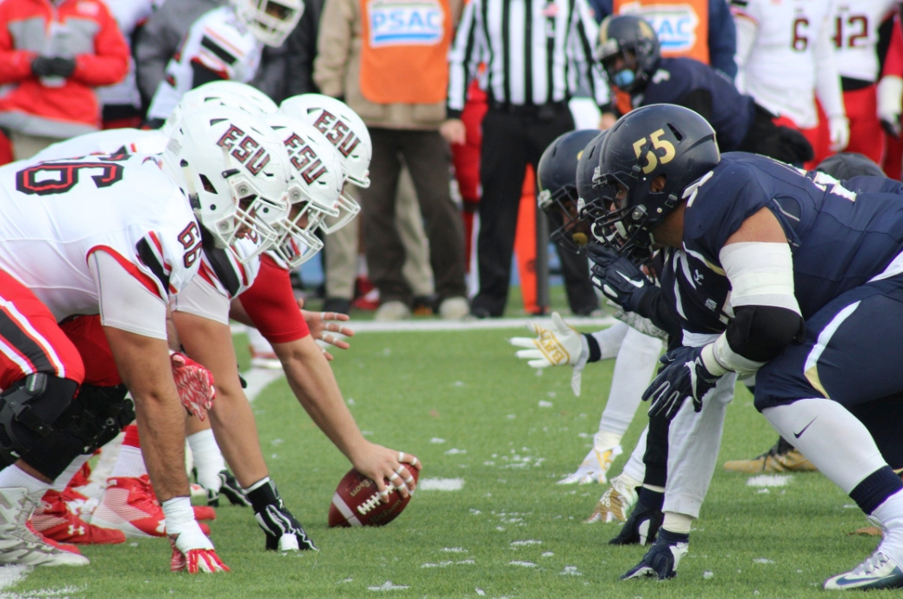
Data from American Football
McCrea et al. found that college football players still experience 72% of their concussions and 67% of their total head impact exposures (HIE) in practice.1
Commenting on the study Nowinsky and Cantu said “concussions in games are inevitable, but concussions in practice are preventable. Practices are controlled situations where coaches have almost complete authority over the HIE risks taken by players”.2
1. McCrea MA, Shah A, Duma S, Rowson S, Harezlak J, McAllister TW, Broglio SP, Giza CC, Goldman J, Cameron KL, Houston MN, McGinty G, Jackson JC, Guskiewicz K, Mihalik JP, Brooks MA, Pasquina P, Stemper BD. Opportunities for Prevention of Concussion and Repetitive Head Impact Exposure in College Football Players: A Concussion Assessment, Research, and Education (CARE) Consortium Study. JAMA Neurol. 2021;78(3):346-350.
2. Nowinski CJ, Cantu RC. Who Will Protect the Brains of College Football Players? JAMA Neurol. 2021;78(3):273-274.
(Image source: https://www.opromouthguards.com/news/post/american-football-british-audience)

Slide 6
Boxing is a dangerous sport
Combat sports such as boxing and MMA are associated with high risk of both acute and chronic neurological injuries.
Acute subdural hematoma is the most common cause of boxing related mortality.
The burden of chronic neurological injuries such as chronic posttraumatic headaches, chronic posttraumatic dizziness, posttraumatic cognitive impairment, posttraumatic Parkinsonism, posttraumatic dementia, dementia pugilistica, punch drunk syndrome, CTE and neuropsychological sequelae such as mood, behavioral changes and depression is likely much larger and hidden from view.
The risk of chronic neurological injuries increases with the number of HIEs a combatant sustains during his/her career.
While data with respect to boxing and MMA is lacking, it is likely that McCrea et al. findings apply to these sports as well.
Paraphrasing Drs. Nowinsky and Cantu, concussions in boxing and MMA are inevitable during a bout, but concussions in training and sparring are certainly preventable.

Slide 7

FACT-Sparring is done under little to no medical supervision
In most Commission jurisdictions, professional boxing and MMA bouts are fought under close medical supervision.
There is a qualified ringside physician in each corner watching for concussions and HIEs among other combat sports injuries.
Leading up to a big fight event, a fighter usually participates in a training camp. In preparation for the fight, the pugilist undergoes a grueling regime incorporating running, high-intensity interval training, strength and conditioning exercises, boxing drills and mitt/pad work.
Most training camps are 10-12 weeks long, though shorter and longer training camps may be held in preparation for a maximum of 36 minutes of actual competition.
Sparring is an important component of any professional boxer’s training camp.
The number of rounds of sparring a boxer puts in during a training camp vary with numbers ranging from 40 to 150 rounds.
There is little to no medical supervision of this sparring and likely concussions and HIEs are common.
(Image source: https://www.michiganradio.org/post/subscribe-your-doctor-new-model-medical-care-catching-doctors-attention)

Slide 8
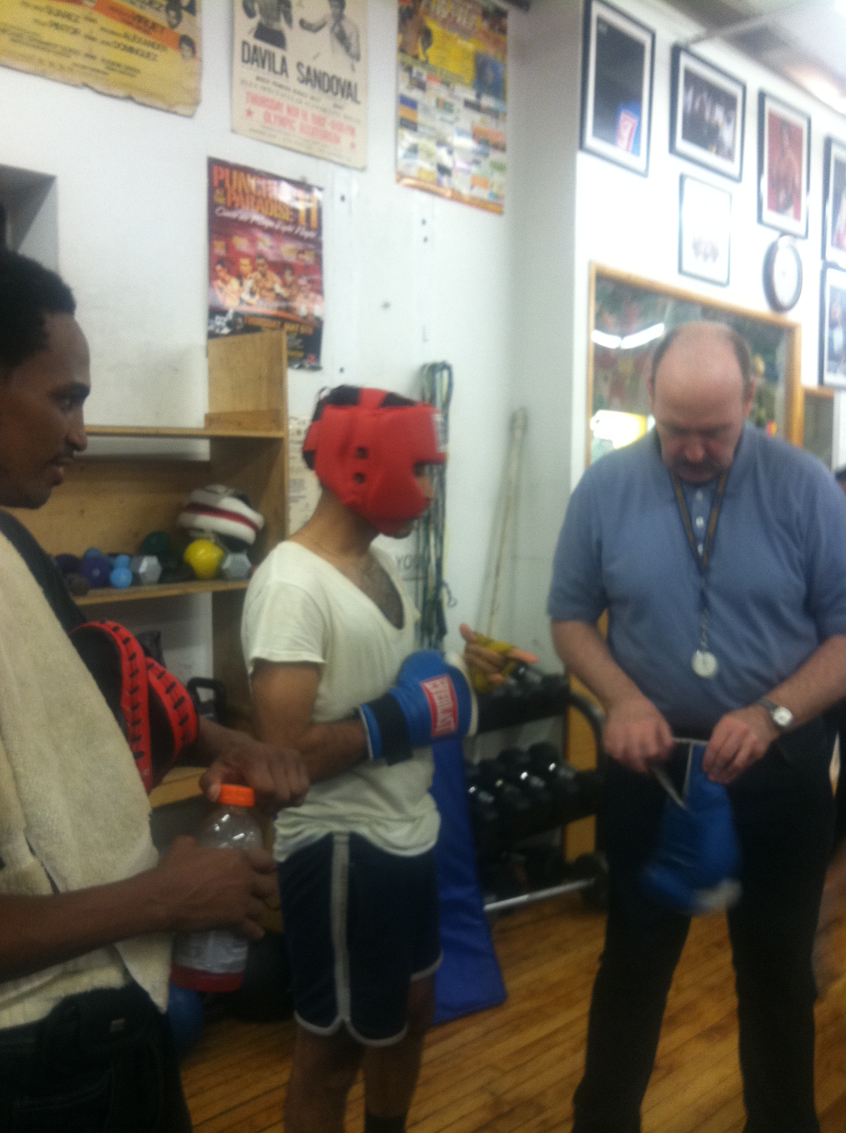
SAFE SPARRING PROTOCOL
1. Pre-assessment: it is recommended that the combatant’s neurological status be assessed prior to the start of the training camp. Evaluation by a neurologist or a physician trained in sports medicine is ideal and serves to establish the combatant’s baseline against which post-training camp or post fight evaluations can be compared.
2. Education: it is recommended that all members of the training camp be educated about concussion identification and management. This especially includes the combatant. It is also recommended that the head trainer and coach take a formal training course in concussion recognition and management such as the HEADS-UP ONLINE CONCUSSION TRAINING CERTIFICATION COURSE FOR COACHES developed by the Centers for Disease Control and Prevention (CDC). Symptoms of mild concussion are predominantly subjective with little to no objective signs. Headache, blurred vision, light and sound sensitivity, nausea, brain fog, attention or concentration difficulty, unsteadiness on feet after a HIE are all signs of concussion. Such a combatant should not be allowed to proceed with training and should be evaluated by a medical professional. If a concussion is documented, a period of cognitive and physical rest is advised. Once the acute post-concussion symptoms have abated, a return to fighting protocol is initiated. Sparring can resume after medical clearance by the physician.
3. Headgear: it is recommended that full headgear be worn by the combatant and his/her opponent (sparring partner) during sparring. Under close observation an exception may be considered for a boxer scheduled to make a professional debut. Some trainers choose to remove the headgear a few times towards the end of camp, so that the boxer can become accustomed to boxing without it. This practice should be limited and only attempted under close trainer supervision. The Amateur International Boxing Association (AIBA) rule change to remove headgear during fights has been controversial. AIBA has claimed that this rule change will actually reduce HIEs as head guards lead to weaponization of the head where boxers develop a style of competing with head more forward and more head-to-head contact. AIBA has further stated that headgear worn by professional boxers in practice are meant to prevent facial lacerations (cuts) and not concussions. Professional boxing organizations such as the World Boxing Council have pushed back aggressively against this AIBA rule change and recommended that headgear be worn during all sparring sessions.
4. Body protectors: it is recommended that body protectors be worn if there is a pre-existing injury.

Slide 9
SAFE SPARRING PROTOCOL
5. Gloves: it is recommended that sparring almost always be done with 16oz gloves. The exception to this is big heavyweights who may use 18oz gloves and combatants 150lbs or under may use 14oz gloves. Only gloves from a reputable manufacturer should be used for sparring.
6. Mouthpieces: it is recommended that mouthpieces custom made by a dentist be worn during sparring. Although studies involving football, rugby, and ice hockey players seem to show that mouthpieces may play a positive role in helping to reduce and/or prevent concussions, there are few to no studies studying the impact of wearing such pieces on reducing concussions and HIEs in combat sports. Mouthguards have been shown to reduce and/or prevent associated orofacial injuries, which may impact a fighter’s ability to defend themselves effectively and/or their future fight career.
7. Sparring: it is recommended that sparring be conducted only under the supervision of the trainer(s). There are three types of sparring that can occur in a camp.
  Sparring with boxers above the combatant’s level to “learn from them”.
  Sparring against boxers at par with the combatant to test ability against equally matched competition
  Sparring with boxers below the combatant’s level to allow combatant “to take chances and try new things”, without a great risk.
  During an eight-week training camp sparring usually occurs 3-4 times per week.
  If preparing for a ten-round bout, sparring usually will begin during the second week of camp and the combatant will start sparring six rounds a day working his way up to twelve rounds a day.
  The combatant tries to condition himself mentally and physically to spar more rounds than the scheduled bout. Usually there is no sparring on the first and last week of camp. Sparring may be limited on any day based on performance or other concerns.
  Sparring should be controlled and be used to work on offensive and defensive technique only.
  The selection of sparring partner(s) needs careful consideration. Sparring partners that are brought in to be nothing more than “punching bags” and to absorb punishment is strongly discouraged. Sometimes heavier sparring partners are brought in to make the combatant “work harder.” It is also thought that heavier sparring partner(s) can better absorb the punishment from a smaller combatant. This practice while understandable needs to be discouraged. Sparring partners should be limited to no more than 10-15 lbs. more than the combatant. When smaller sparring partner(s) are used to help condition the combatant for speed, the combatant should be instructed to “hold back” on punches. Protecting the sparring partners from concussions and HIEs is the responsibility of the trainer.
8. Hydration: it is recommended that the hydration and nutritional status of the combatant be closely monitoring during training. A qualified dietician and/or nutritionist can serve as a valuable member of the training camp.

Slide 10
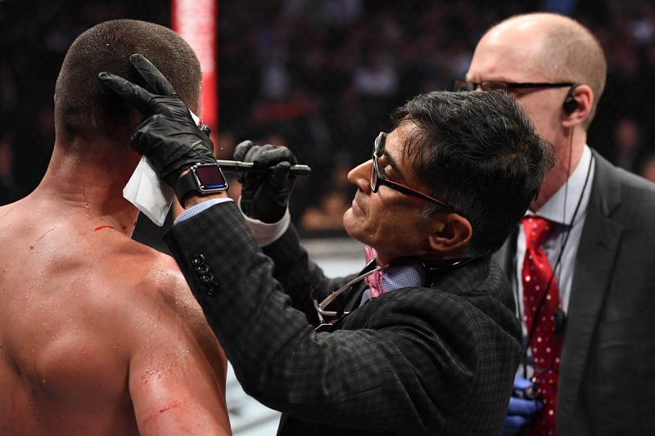

SAFE SPARRING PROTOCOL
9. Medical oversight of the training camp: it is recommended that a qualified physician serve as a consultant for the training camp. This physician can be the combatant’s primary care physician (PCP) with whom the combatant already has an established and trusting patient-doctor relationship. The physician can be consulted as needed if any medical concerns or HIEs arise during the training camp. Use of the standardized assessment of concussion test (SCAT5) is recommended for evaluation of concussion.
10. Training camp diary: it is recommended that a training camp diary be maintained by the trainer. All aspects of the training should be detailed in this diary from commencement until end of camp, which should include daily weight, hydration, and nutrition status, sparring details and concussions or HIE(s) during training. This should include knock downs and knock outs (if any) during sparring.

Slide 11
RATIONALE OF THE PROPOSED SAFE SPARRING PROTOCOL
The purpose of these guidelines is to decrease the risk of cumulative head trauma associated with sparring and training.
Cumulative head trauma may result in both short-term and long-term neurologic consequences.
Concussions fall at one end of the mild traumatic brain injury spectrum, however repetitive concussions and sub concussive HIEs contribute to the development of chronic neurologic injury.
Limiting the size of the opponent to his or her own weight class will limit the force generated by a blow to the head.
To dissipate some of this energy away from the brain, appropriate gloves and headgear should be used during sparring.
Neck strengthening helps transmit some of this energy away from the head.
An appropriately sized mouthguard also helps absorb some of this energy although the scientific literature on this is not as strong.
limiting the exposure to trauma will decrease the risk of neurologic sequelae. This may be done by limiting the number of rounds of sparring over the training period.

Slide 12

CHALLENGES AHEAD
If combatants, trainers, and coaches do not follow our recommendations, the changes we prescribe will have little effect.
(Image source: https://www.trainerslibrary.org/challenges-ahead/)

Slide 13
OVERCOMING THE CHALLENGES
Combatants may be more likely to follow the guidelines if they realize cumulative head trauma may hinder their athletic performance.
The consequences of “neurologic sequelae of multiple concussions and HIEs” should be made clear to all concerned parties. The sequelae include but are not limited to poor balance and decreased reaction time.
An NCAA study revealed that those athletes who were exposed to more sub-concussive head impacts during practice had a lower threshold for concussion in the game. In combatants, this translates to a “weaker chin.”
Allowing for more recovery between sparring sessions and after competition will allow for optimal performance.

Slide 14

APPEAL TO THE ARP MEMBERSHIP
Our proposed SAFE SPARRING PROTOCOL be debated vigorously by the combat sports community (professional combatants, trainers, coaches), professional boxing and MMA governing bodies and scientific RINGSIDE PHYSICIAN community.
Evidence based guidelines be developed and adopted by all concerned parties and organizations.
(Image source: https://aorp.wildapricot.org/)

Slide 15
Acknowledgements:
Codevelopers of the SAFE SPARRING PROTOCOL:-
Michael Lenihan, MD
Victor Khabie, MD
Richard G. Chang, MD, MPH
Thomas Aceto
Andrew Beaufort, MD

