Slide 4
World Anti-Doping Agency (WADA)
The World Anti-Doping Agency is a foundation initiated in 1999 by the International Olympic Committee (IOC) based in Canada to promote, coordinate, and monitor the fight against drugs in sports.
WADA puts a substance on its prohibited list if it determines that substance meets two of the following three criteria:
► It enhances, or could potentially enhance, an athlete's performance.
► It could pose a health risk for athletes.
► It "violates the spirit of sport.“
*Political organization where many rules are policy driven.

Slide 5
World Anti-Doping Agency (WADA) Code
WADA Code prohibited list established in 2004. Threshold for THC was 15 ng/ml
In 2011, Wada defended the ban on cannabis in a paper published in the journal Sports Medicine. Citing a study on marijuana's ability to reduce anxiety, Wada found cannabis could help athletes "better perform under pressure and to alleviate stress experienced before and during competition".
2013: WADA Code raises THC threshold level to 150 ng/ml

Slide 7
2015 Nick Diaz Suspension
NSAC collected 3 samples from Diaz at UFC 183 on January 31, 2015
Two samples sent to WADA accredited laboratory were under the 150 ng/ml THC threshold
Third sample sent to Quest Laboratories resulted in finding of ~300 ng/ml THC

Slide 10
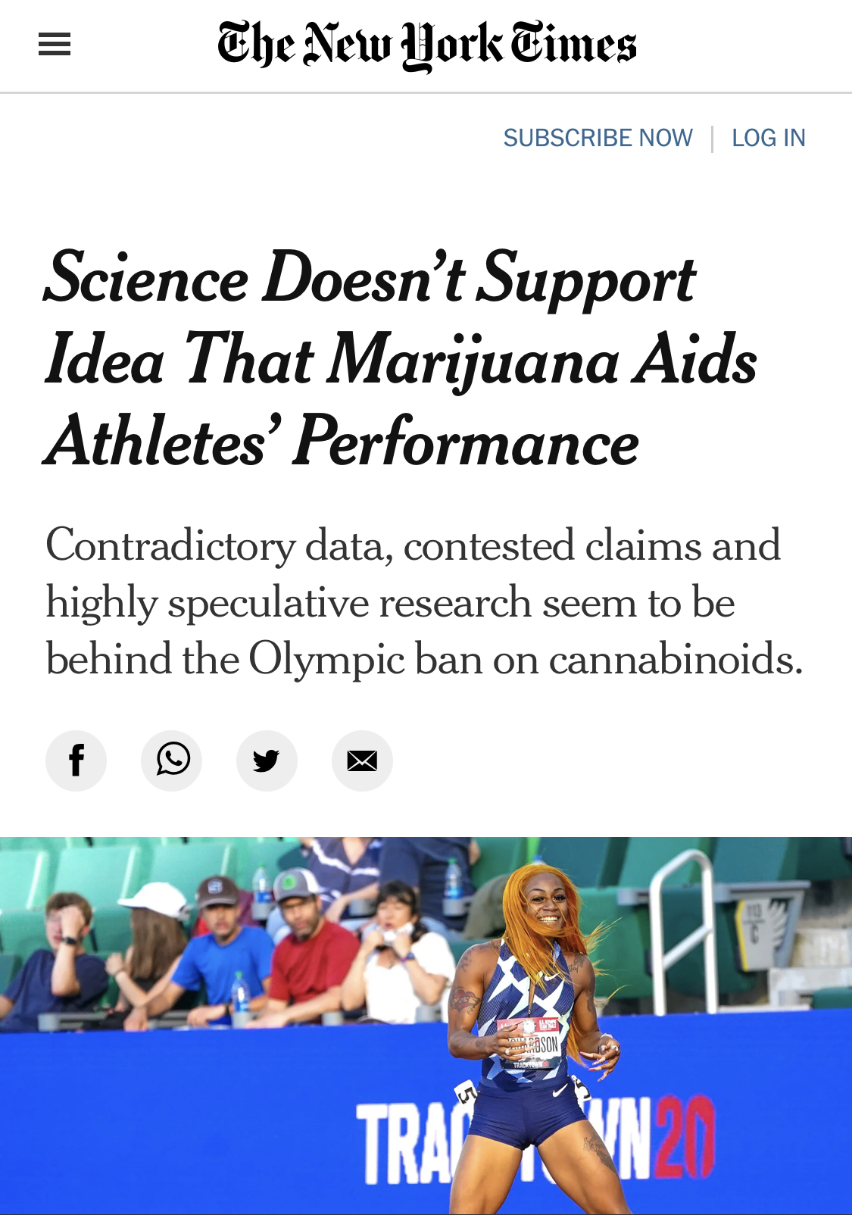

Slide 11
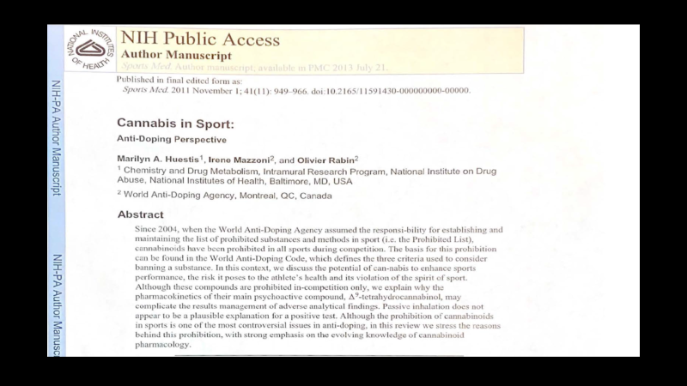

Slide 12
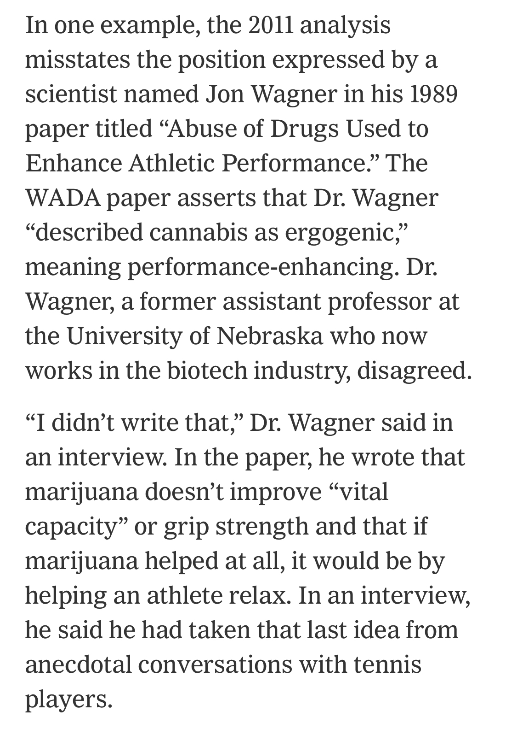

Slide 13
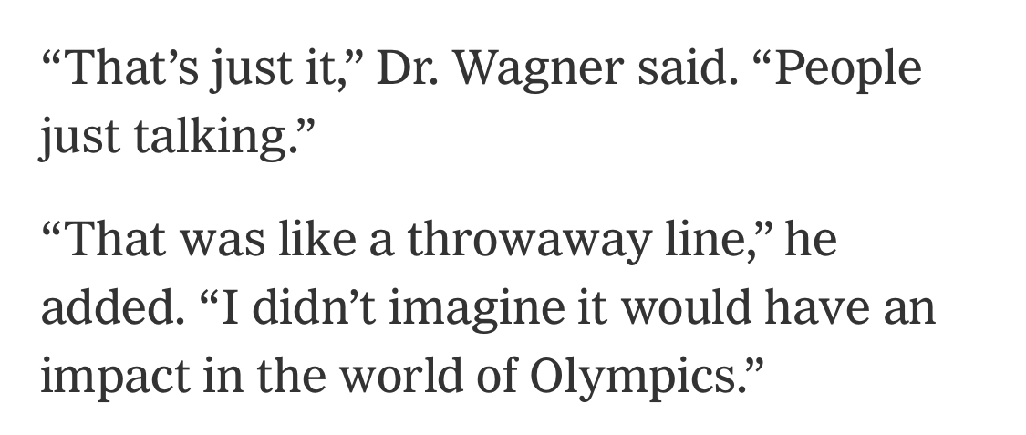

Slide 14
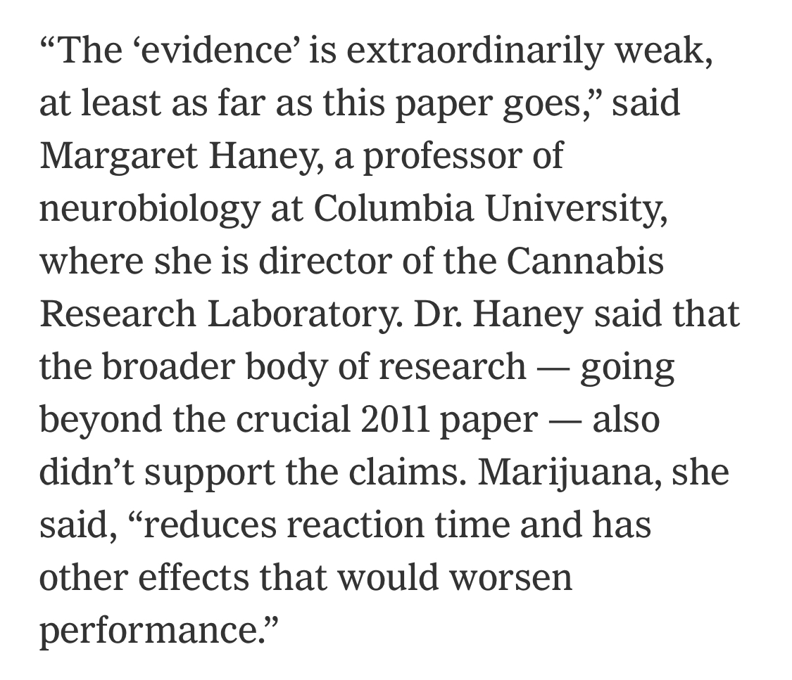

Slide 15
Athlete Number 1
May 2020 In Competition Test: 311 ng/ml THC
Athlete claimed discontinued use 30 days out.
February 2020 Out of Competition: 950 ng/ml THC

Slide 16
Athlete Number 2
March 2021 In Competition Test: 203 ng/ml THC
January 2021 Out of Competition: 1066 ng/ml THC
March 2021 Out of Comp (10 days before) 370 ng/ml THC

Slide 17
Athlete Number 3
Athlete signed by UFC 2 days before fight (stopped when signed)
September 2020 In Competition Test: 382 ng/ml THC
Out of Competition Test 9 days after fight: 1063 ng/ml THC

Slide 18
Athlete Number 4
June 2021 In Competition Test: 250 ng/ml THC
Athlete claimed stopped using 7 days prior
March 2021 Out of Competition Test 1746 ng/ml THC
Late April 2021 Out of Competition Test 655 ng/ml THC

Slide 19


Slide 23
Developments in Combat Sports Regulations
ABC Medical Committee (deemphasize marijuana sanctioning)
California Athletic Commission (deemphasize marijuana sanctioning)
Florida Athletic Commission (removed from prohibited list)
Nevada Athletic Commission (examine for visual signs of impairment/no longer predicated on testing/THC values)

Slide 24
