Slide 1
Combat Sports and Psychedelics
Matthew W. Johnson, Ph.D.
Susan Hill Ward Endowed Professor of Psychedelics
Department of Psychiatry and Behavioral Sciences
Johns Hopkins University School of Medicine
Matthew Peters, M.D
Frederick Barrett, Ph.D.
Albert Garcia-Romeu, Ph.D.

Slide 2
Disclosures of Advisory Relationships
AJNA Labs LLC
AWAKN Life Sciences Inc.
Beckley Psychedelic Ltd.
Entheogen Biomedical Corp.
Field Trip Psychedelics Inc.
Mind Medicine Inc.
Otsuka Pharmaceutical Development & Commercialization Inc.

Slide 3


Slide 4
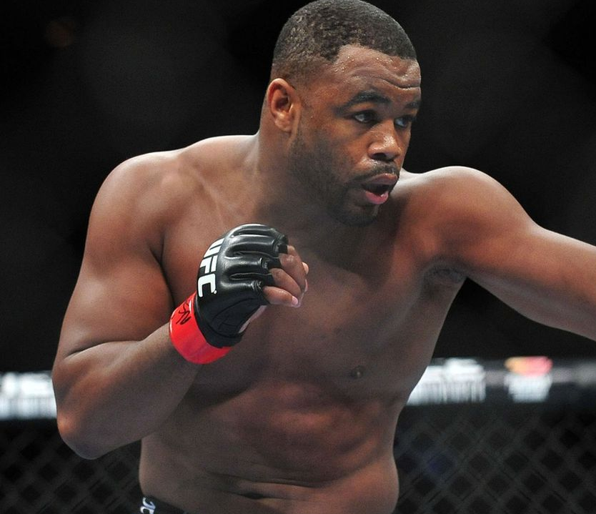
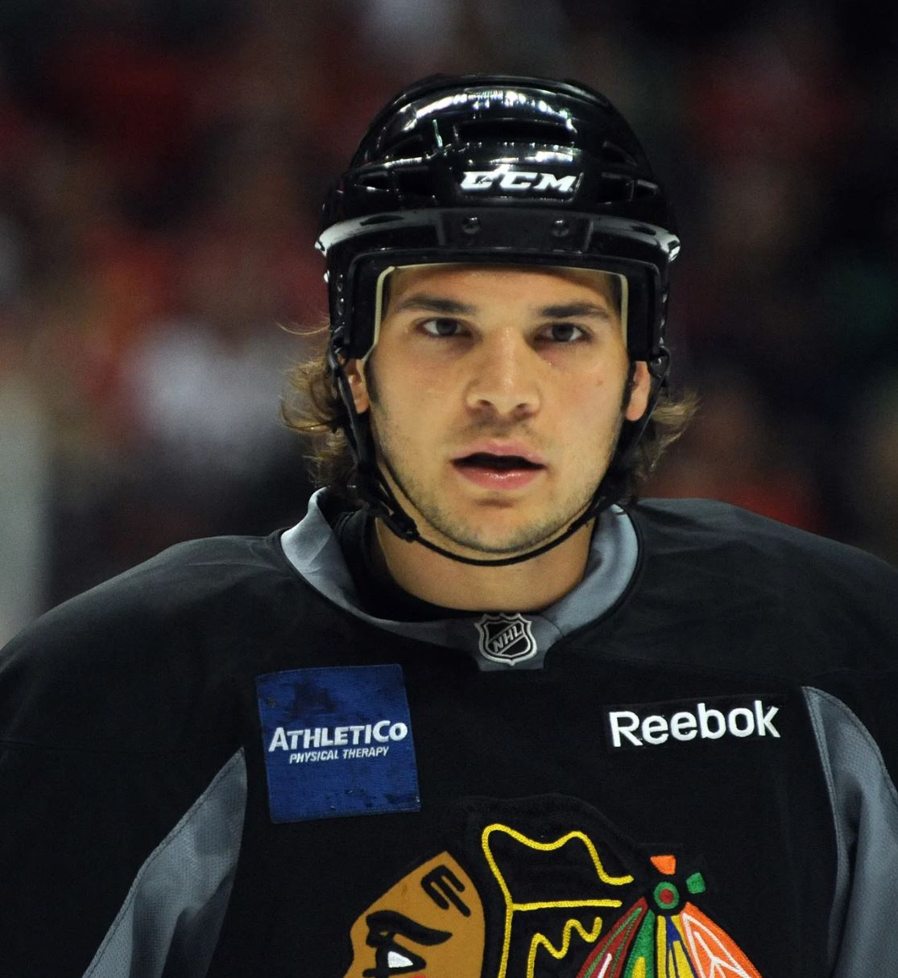
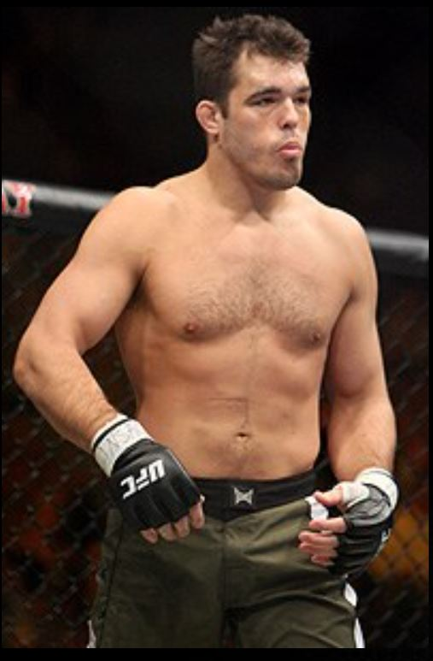
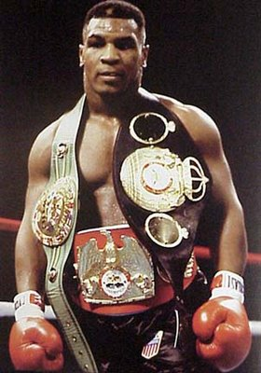
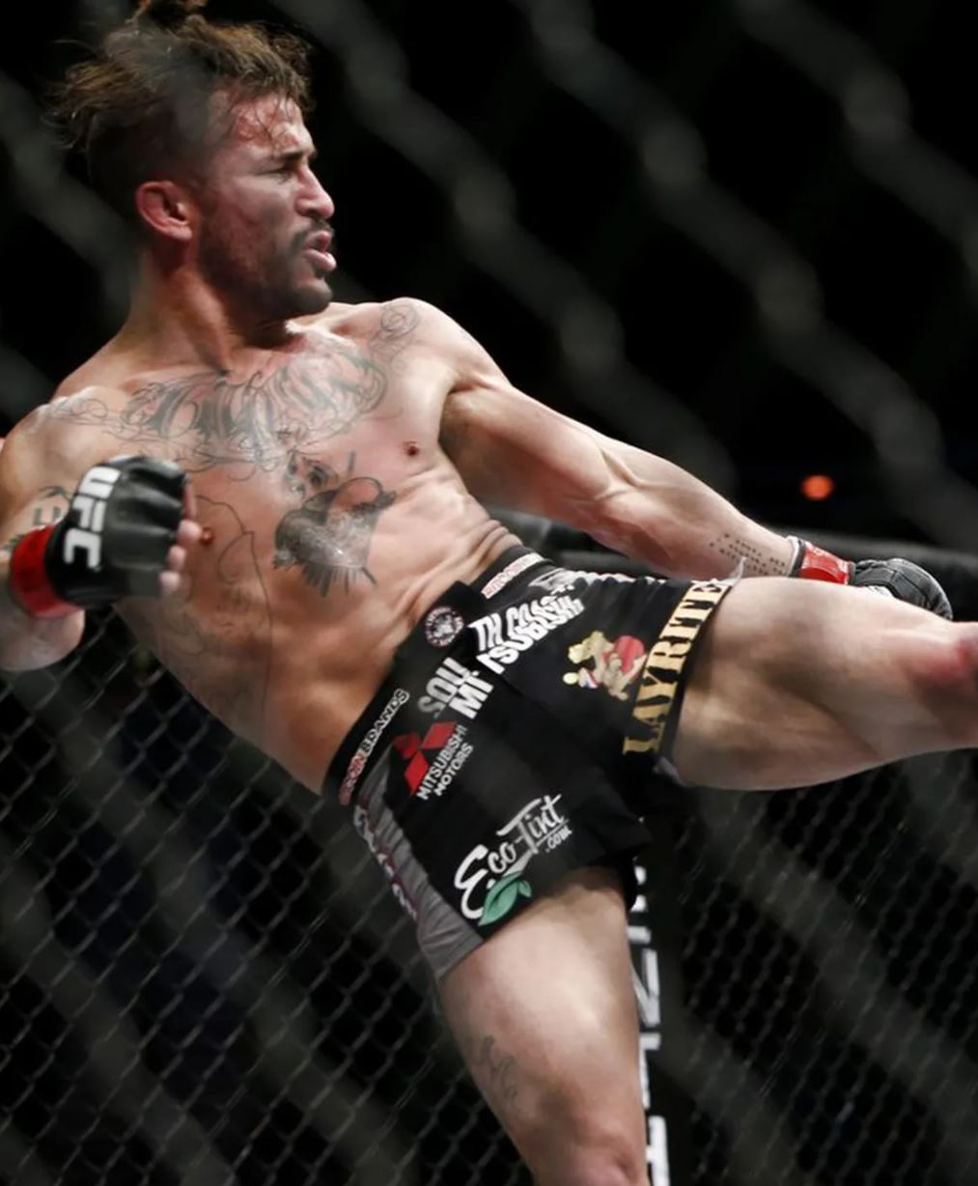
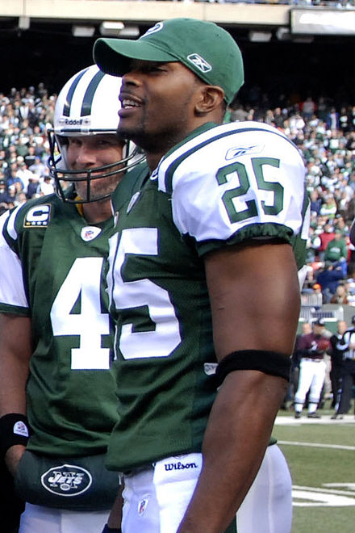

Slide 5
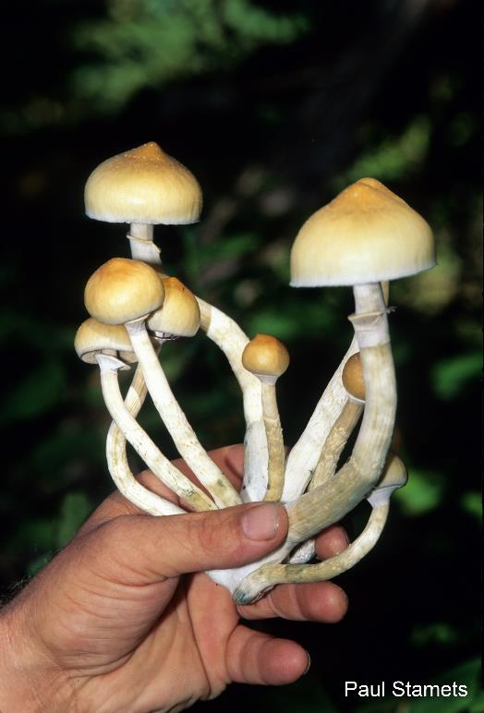
Psilocybin in >200 mushroom species
“Classic psychedelic”
Psilocybin
LSD
Mescaline (peyote)
DMT (ayahuasca)

Slide 6
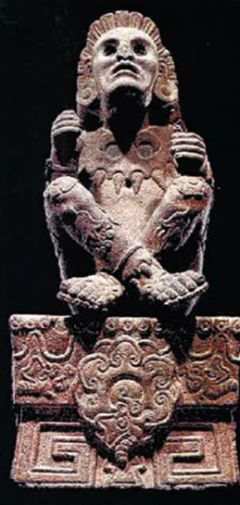
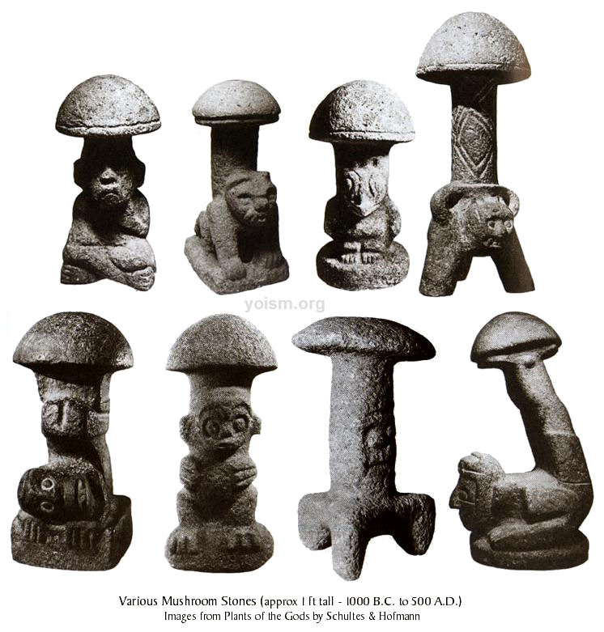
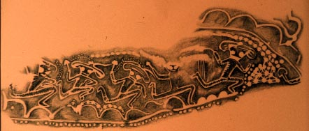
Ritualistic use dates back many millennia

Slide 7
1940s – 1970s
Psychedelics were intensely investigated as research tools and therapeutics
Promising findings for:
Cancer-related distress
Alcoholism

Slide 8

The Dark Ages
Despite promising preliminary findings
Dormancy
Reaction to casualties and to sensationalism

Slide 9
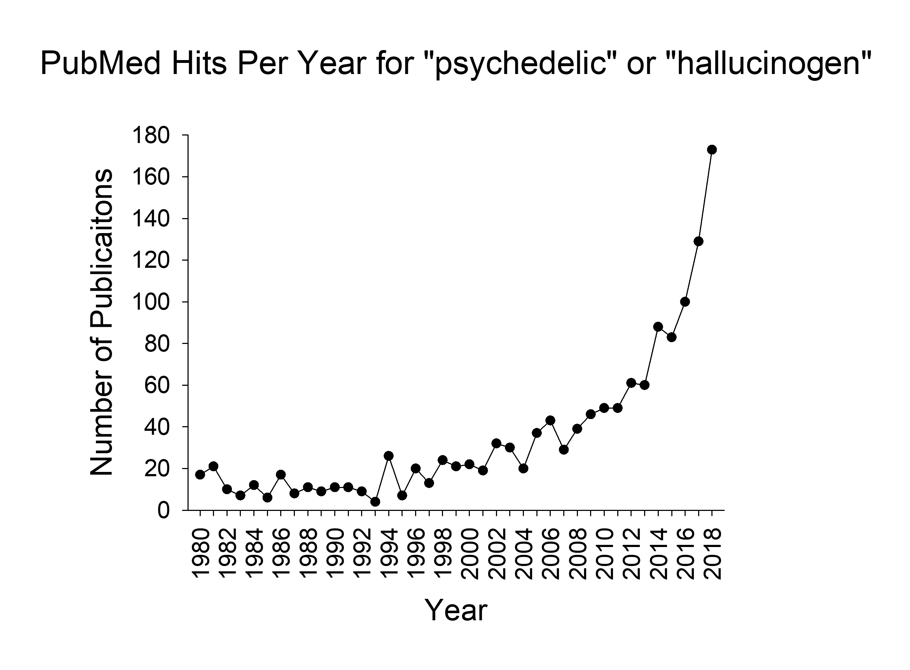
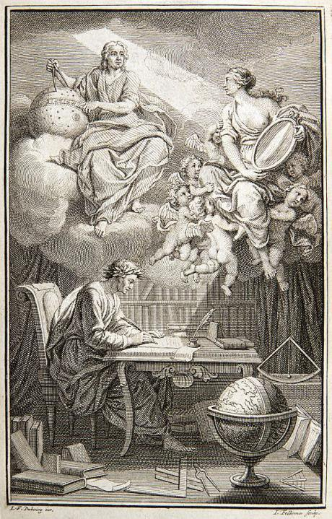
From Dark Ages into the Age of Enlightenment

Slide 10
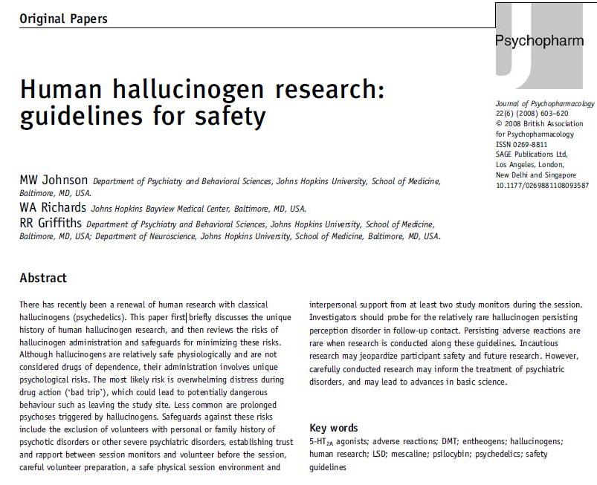
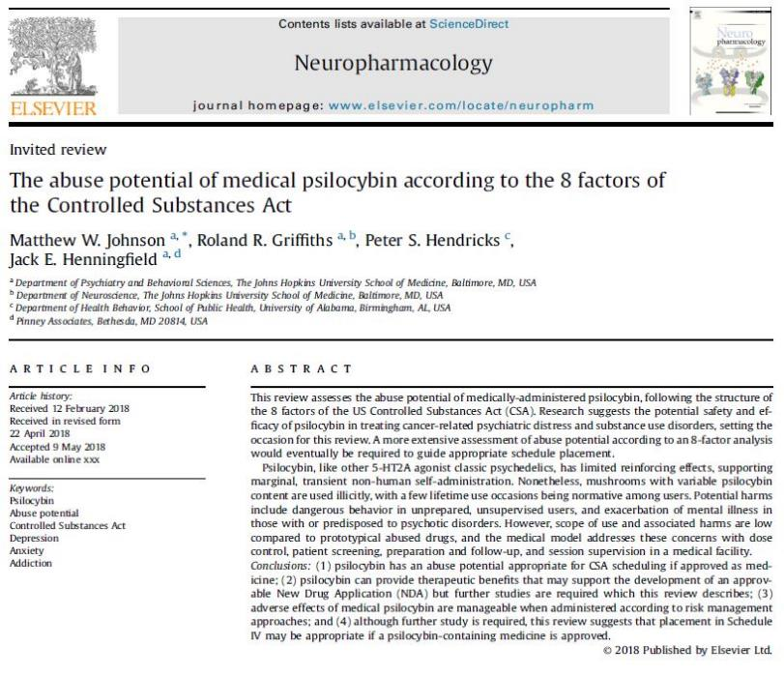

Abuse liability & Risks (2008 & 2018)
Can cause harm in people with psychosis or predisposition
Fear, panic, confusion & potentially dangerous behavior
Moderate elevations in pulse & blood pressure
Headaches in day following use
Persisting perceptual changes
Data suggest no addiction

Slide 11
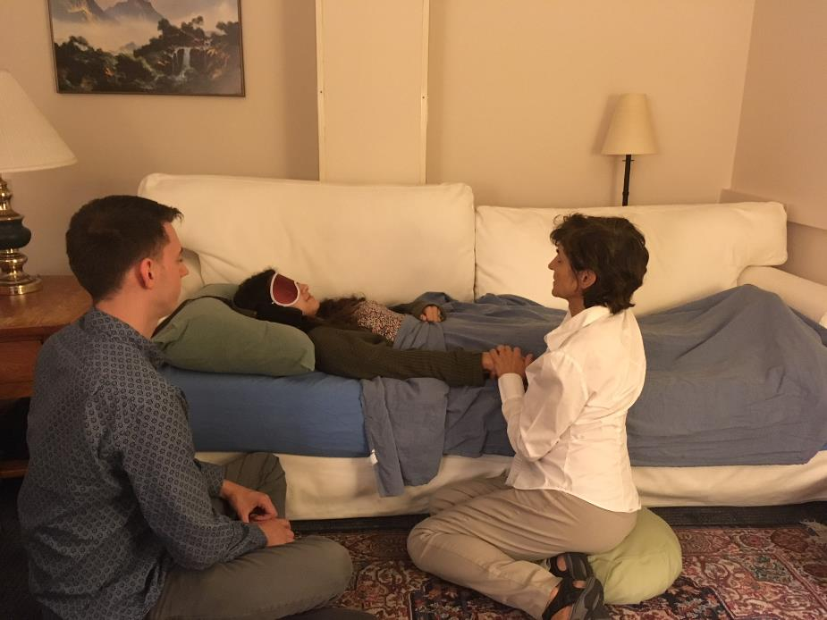

Slide 12
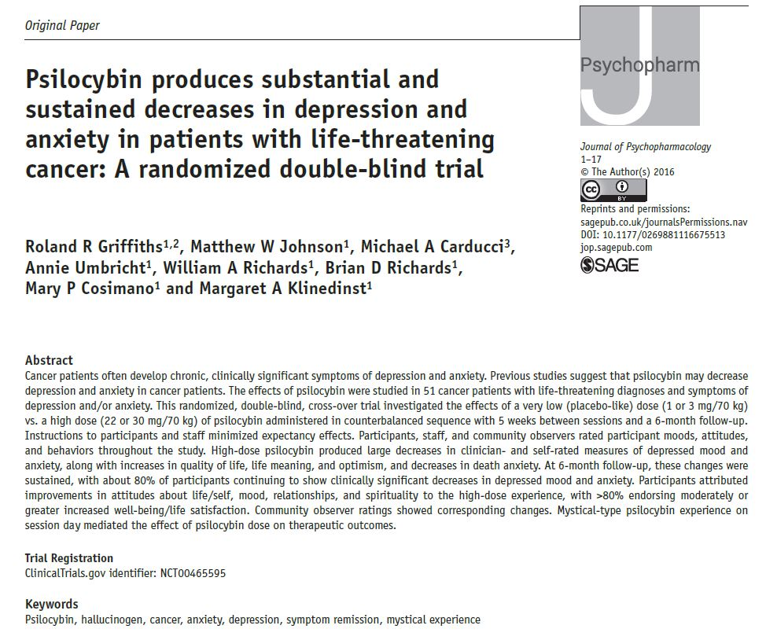
Cancer Existential Distress 2016
51 patients
Life threatening cancer
Depression and/or anxiety disorder

Slide 13
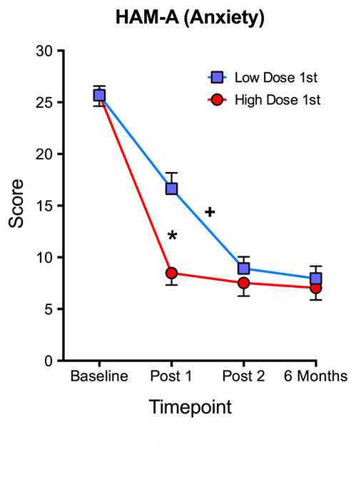
Lasting Antidepressant & Anti-Anxiety
* Cohen’s d= 1.30
+ Cohen’s d= 3.08

Slide 14
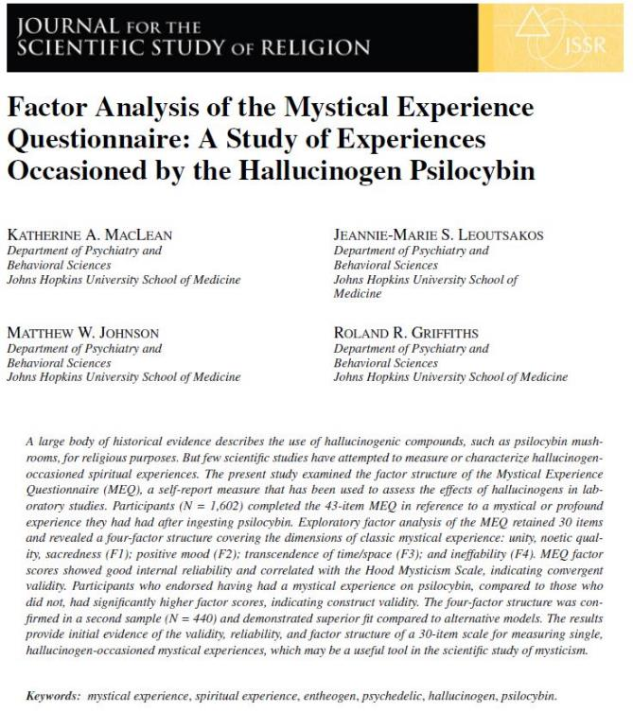
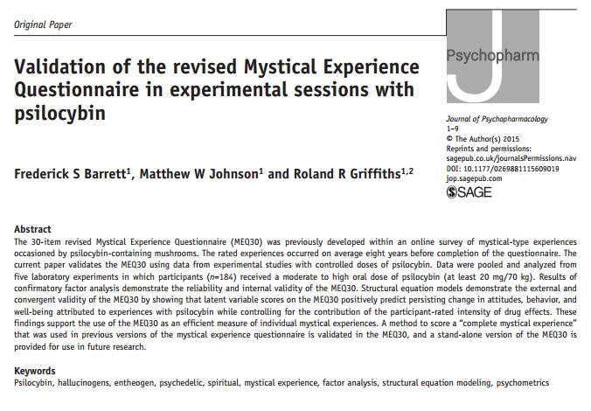
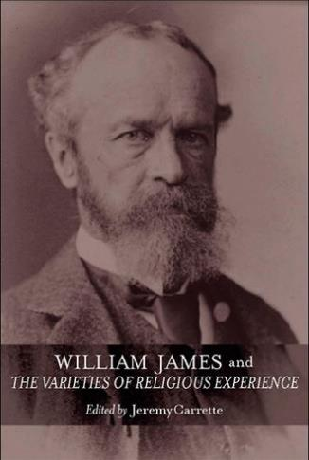
Mystical Experience
Factors: unity, positive mood, transcendence of time/space, ineffability

Slide 15
Mystical Experience Correlated with Therapeutic Effects
Notes:
In addition to the above measures, ME remained after controlling for intensity
HAM-D (Depression)**
STAI Trait Anxiety**
Brief Symptom Inventory**
Overall Well-Being and Life Satisfaction**

Slide 16
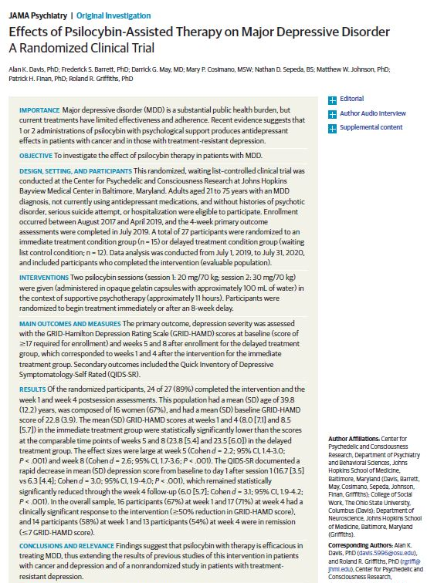
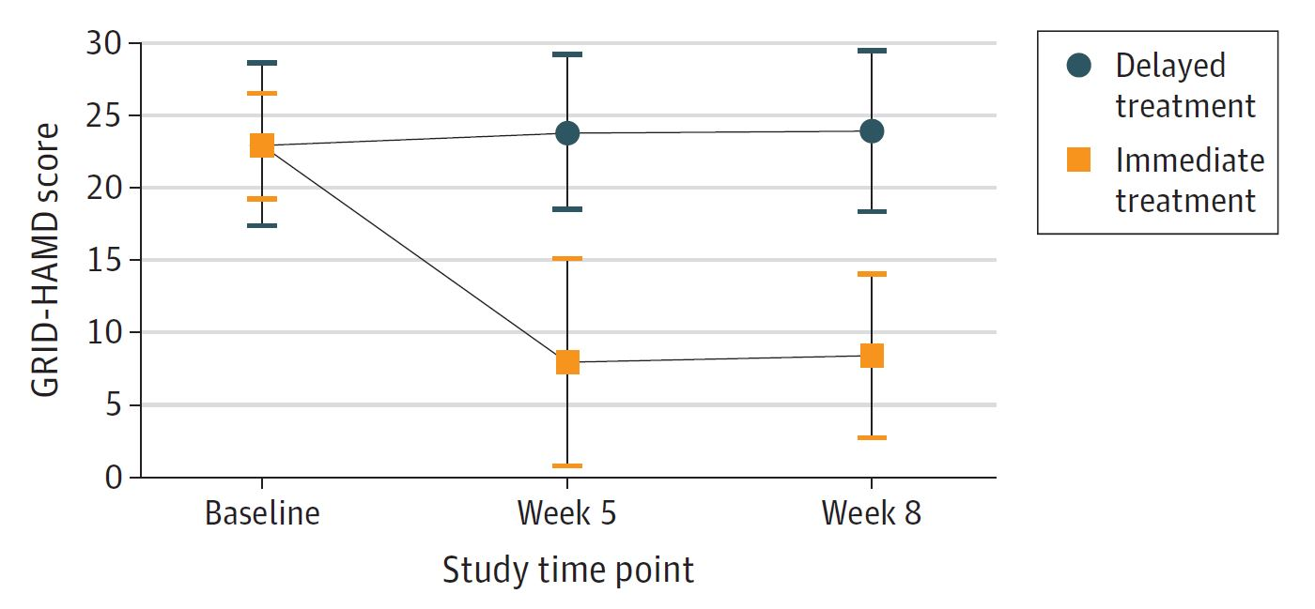
Major Depressive Disorder (2020)
27 patients
Randomized wait-list control
Two psilocybin sessions

Slide 17
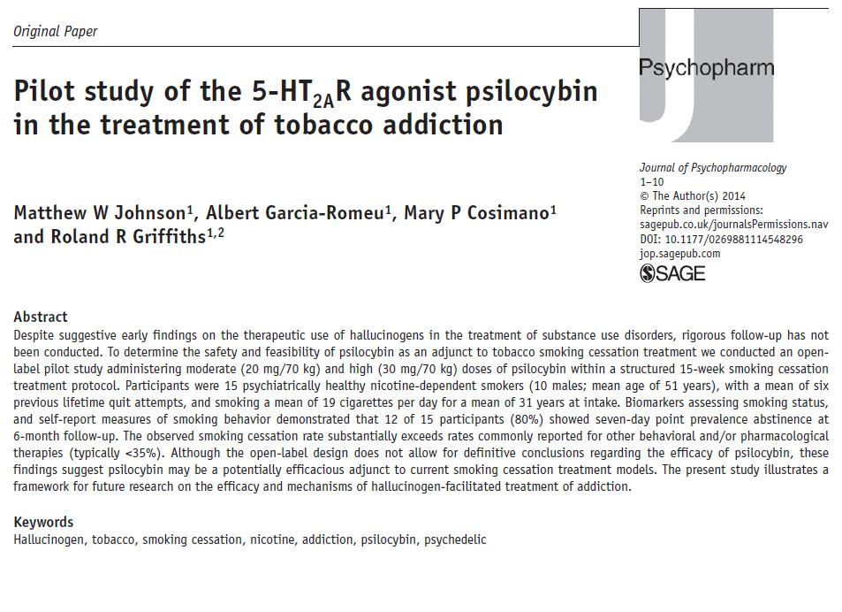
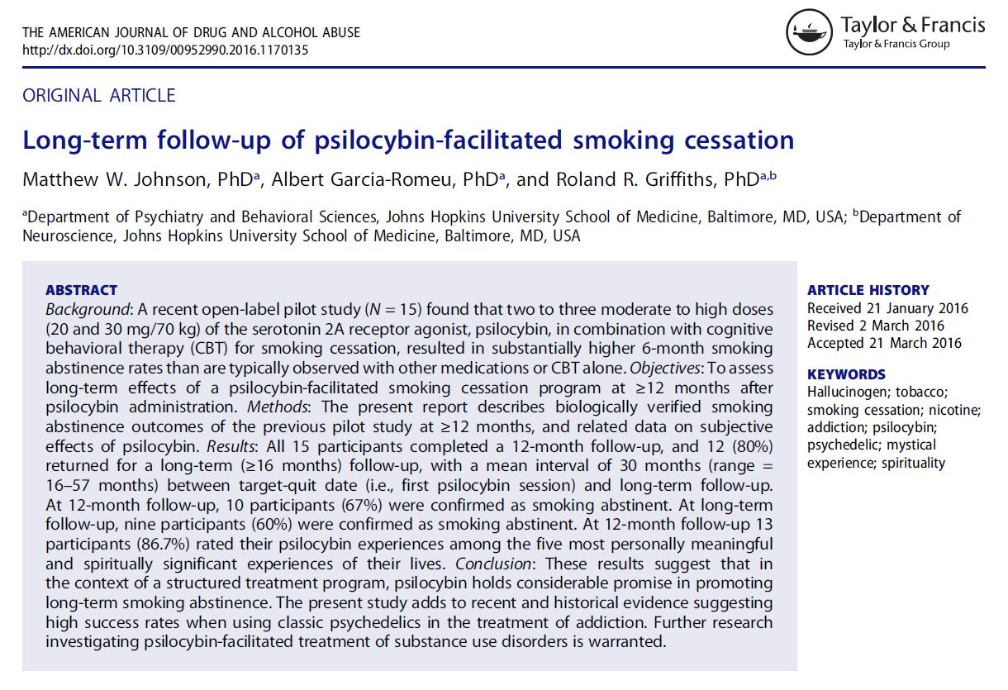
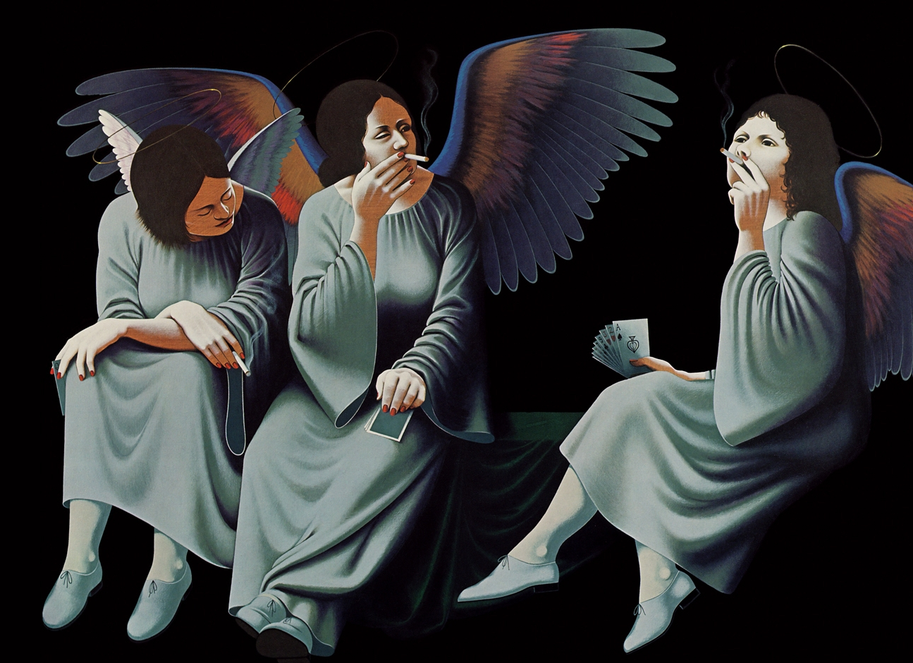
Smoking Cessation Pilot
Feasibility and safety
3 psilocybin sessions + cognitive behavior therapy

Slide 19
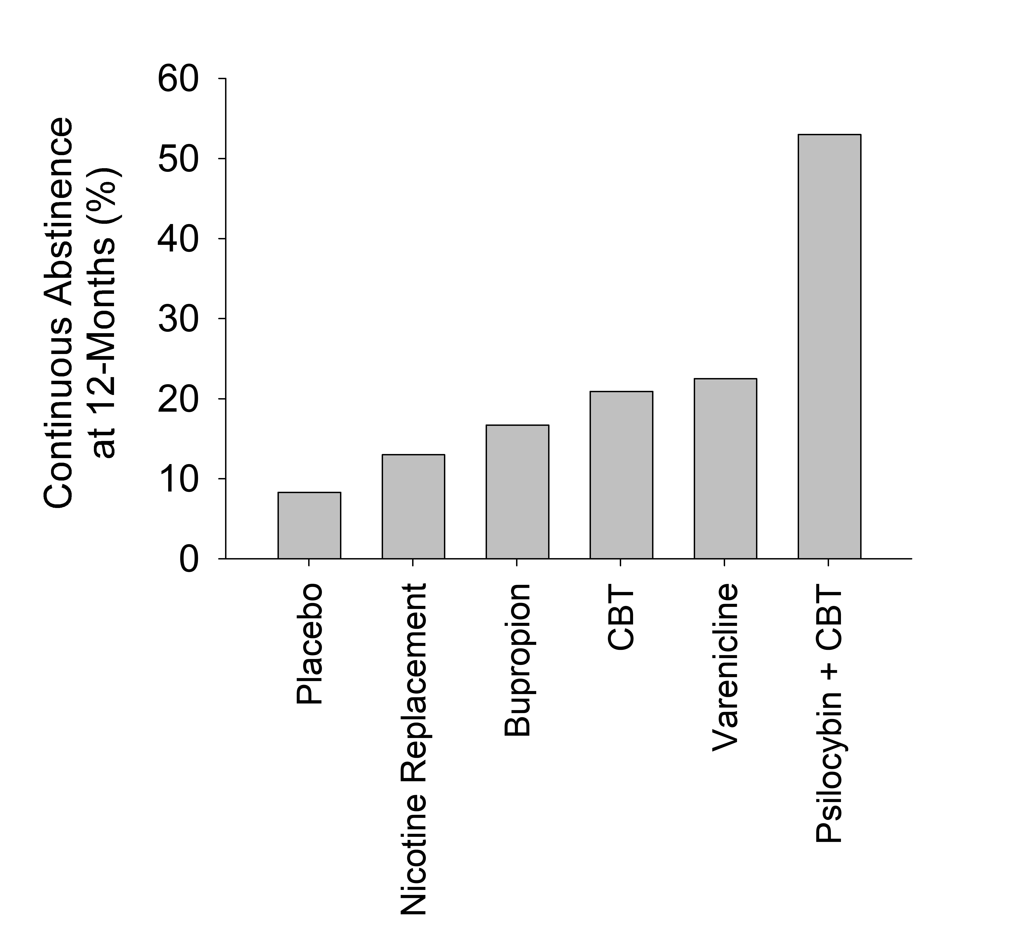
Jackson et al. (2019), Wittchen et al. (2011)

Slide 20
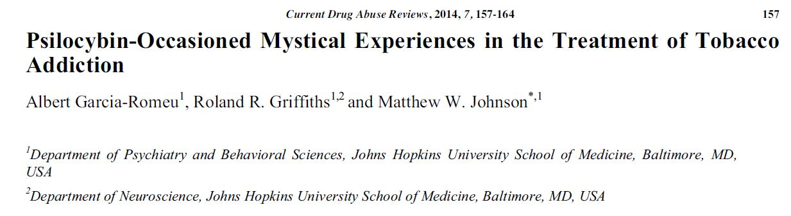
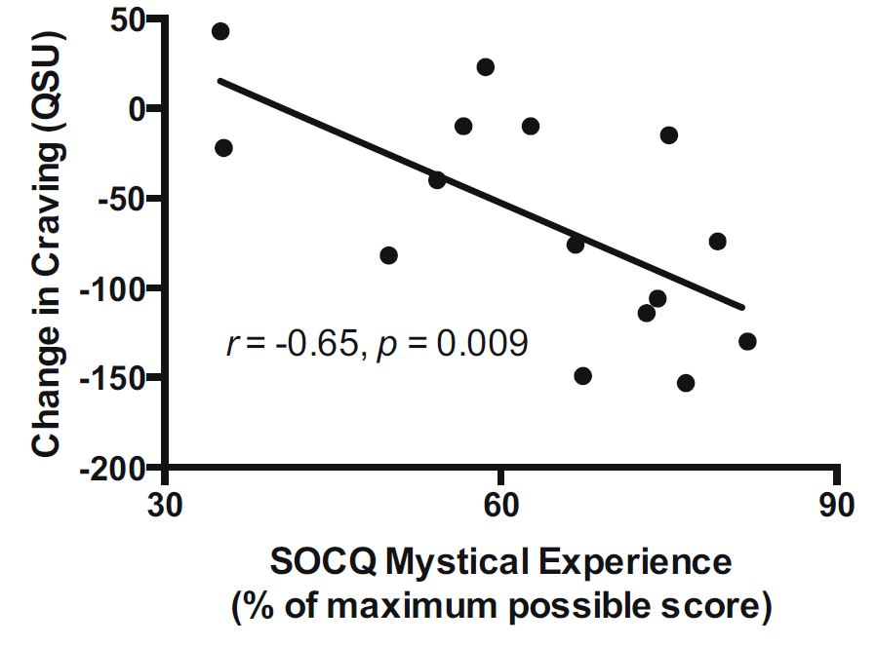

Mystical Experience in Smoking Cessation 2015
Greater success in those who had mystical experience

Slide 21
Randomized Comparative Efficacy Trial
80 treatment-resistant smokers
Randomized to psilocybin or nicotine patch
Same cognitive behavior therapy
1 psilocybin session

Slide 22
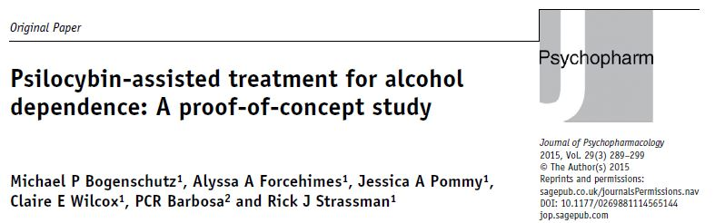
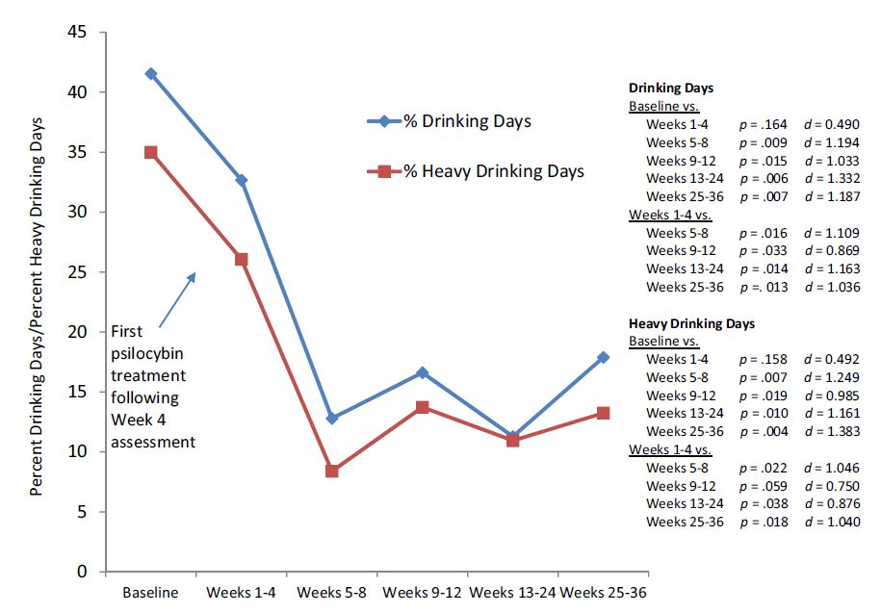
Alcohol Dependence Pilot
10 alcohol-dependent participants
Motivational Enhancement Therapy
2 sessions of .3 mg/kg and .4 mg/kg psilocybin

Slide 23
Ongoing studies
Smoking cessation
Quality of life in Alzheimer’s disease
Anorexia
Depression with co-occurring alcohol use disorder
Neurobiomarkers of psychedelic therapeutic response
Upcoming studies
Opioid addiction
PTSD
Creativity
LSD to treat chronic pain
Mood symptoms of post-treatment Lyme disease
Microdosing

Slide 24
But Why Psychedelics for Combat Sports & Other Athletes?

Slide 25
Personal reports
Professional athletes often suffer from the same disorders that have been shown to be improved by psychedelics:
Depression, anxiety, PTSD, addictions
Combat sports & other professional athletes often experience repetitive head impact with psychiatric and cognitive consequences
Psychedelics may prompt neurological repair

Slide 26
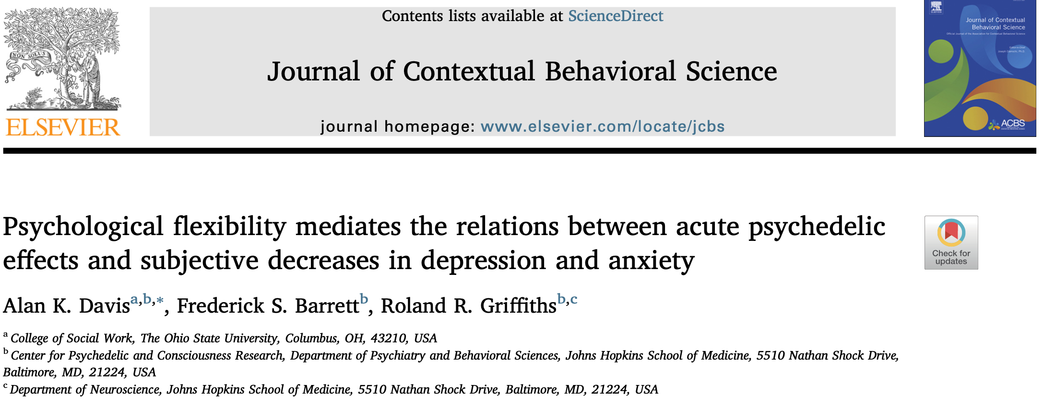
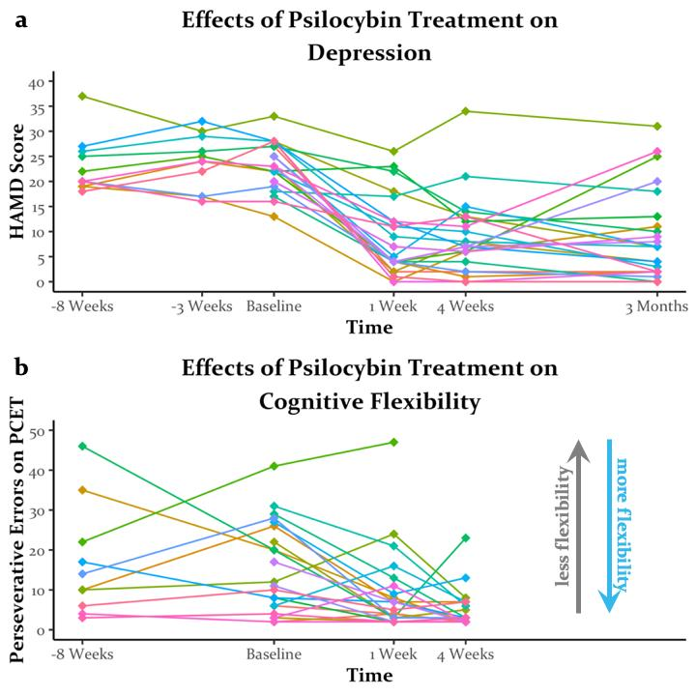
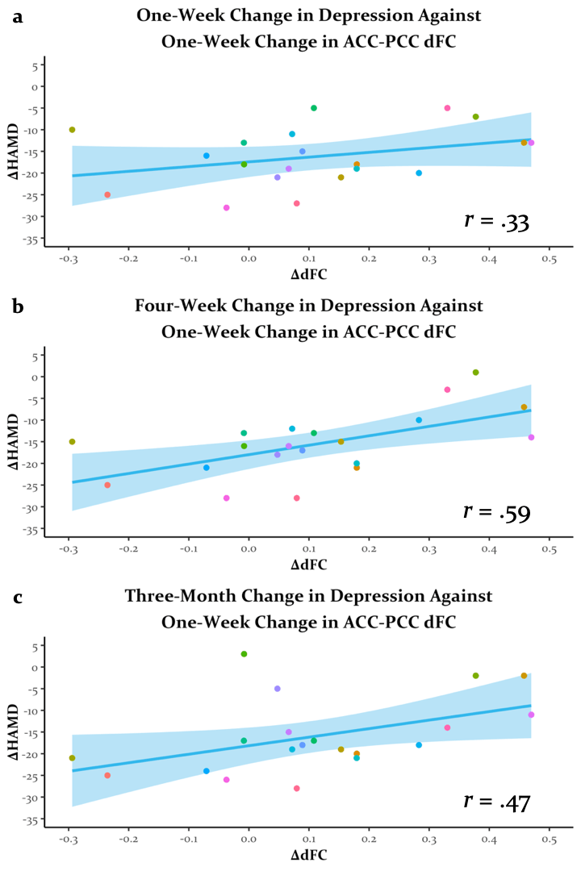
Psychedelics may restore psychological and brain flexibility
Greater psychological flexibility after psilocybin predicts greater reductions in depression
Cognitive flexibility increases for at least 4 weeks after treatment for depression
Greater neural flexibility (e.g. dynamic brain connectivity, or dFC) after treatment predicts decreases in depression
Doss et al & Barrett, in preparation

Slide 27
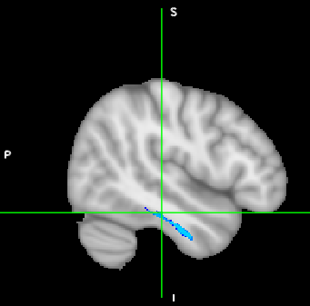
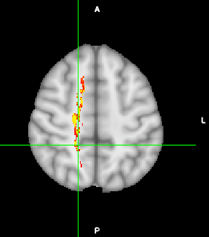
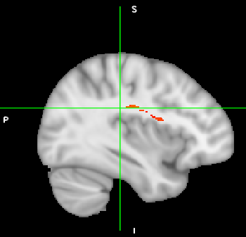
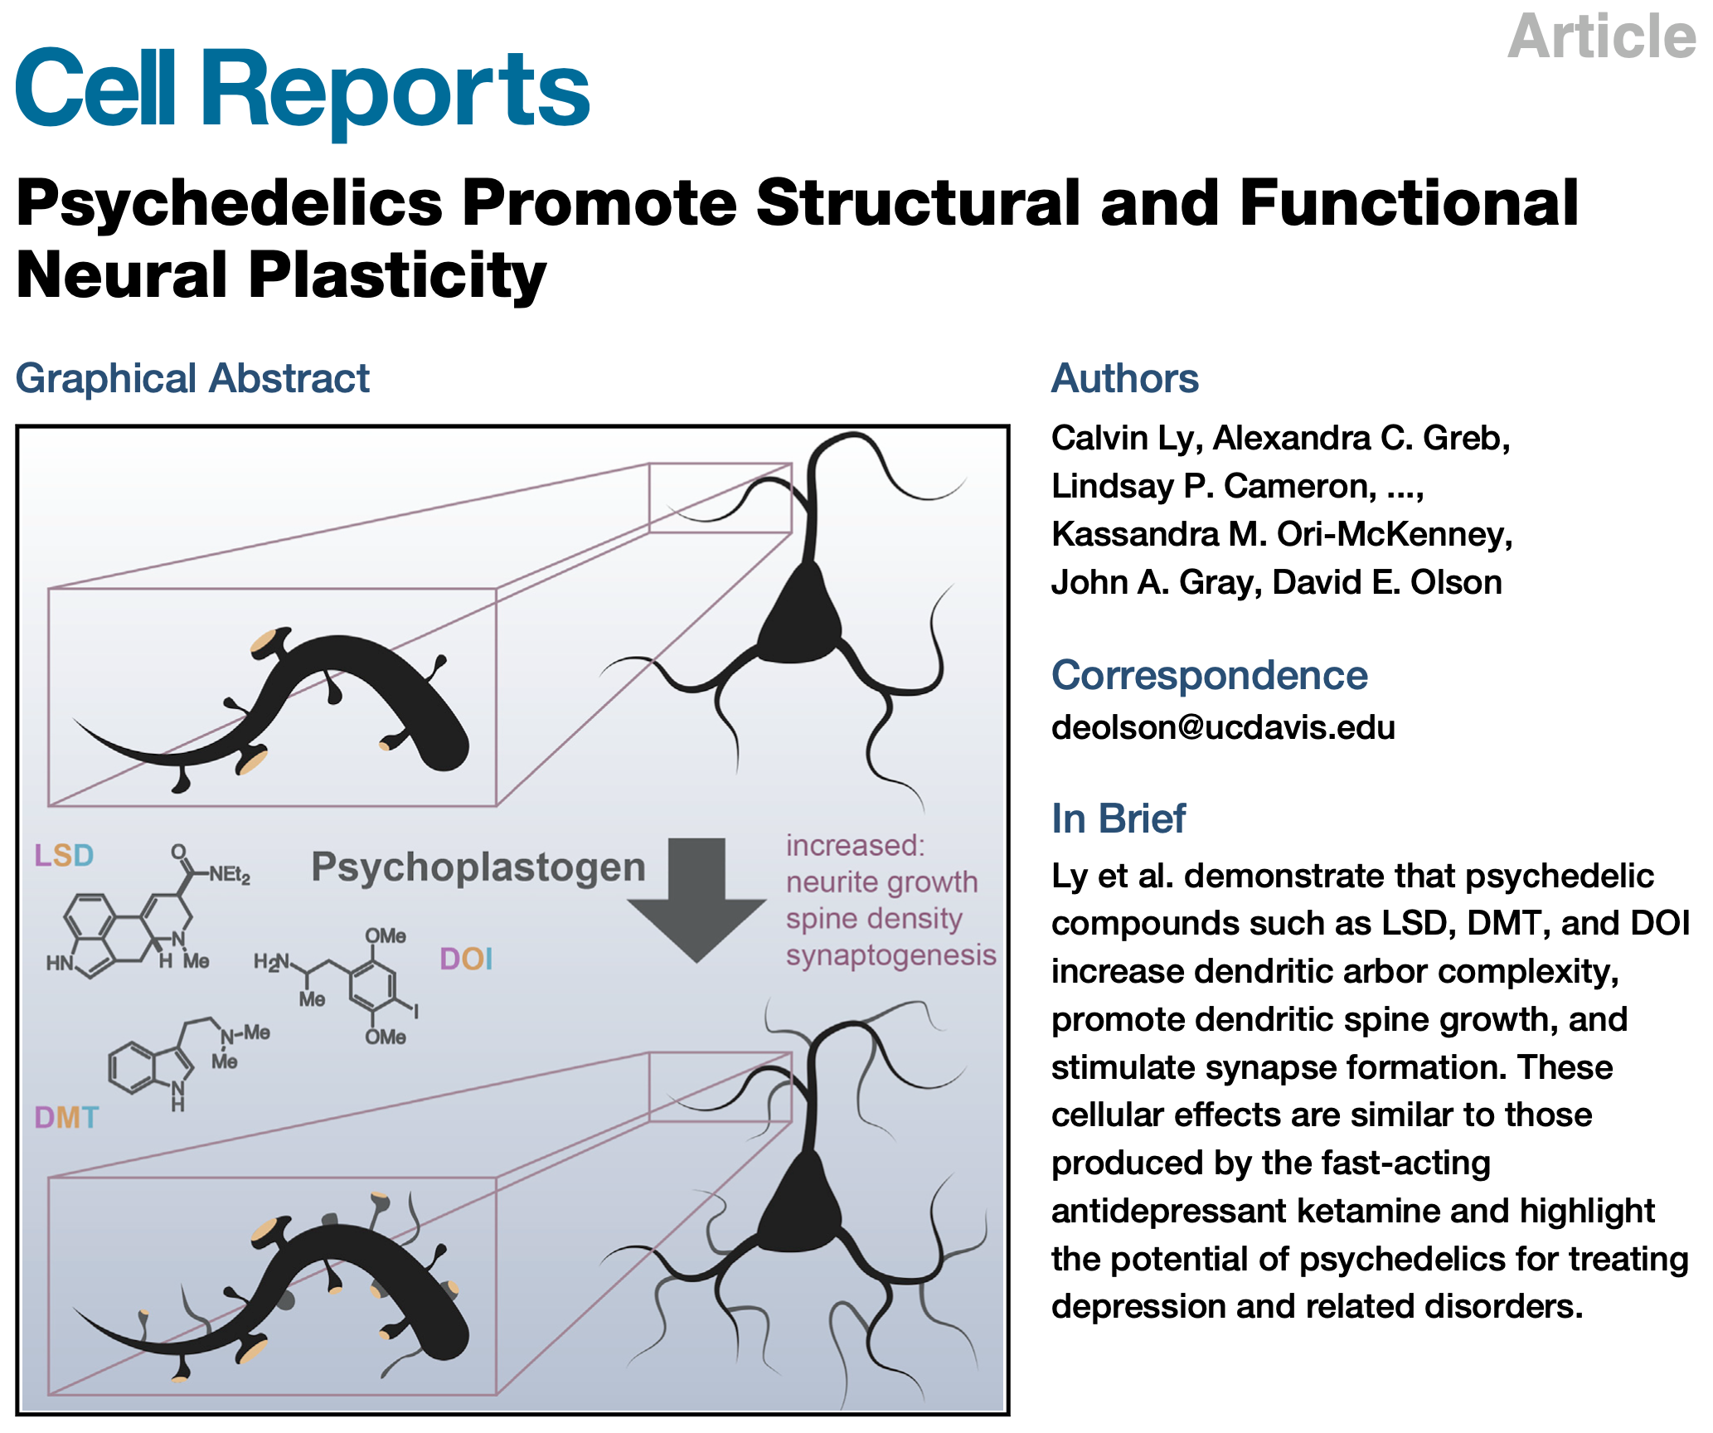
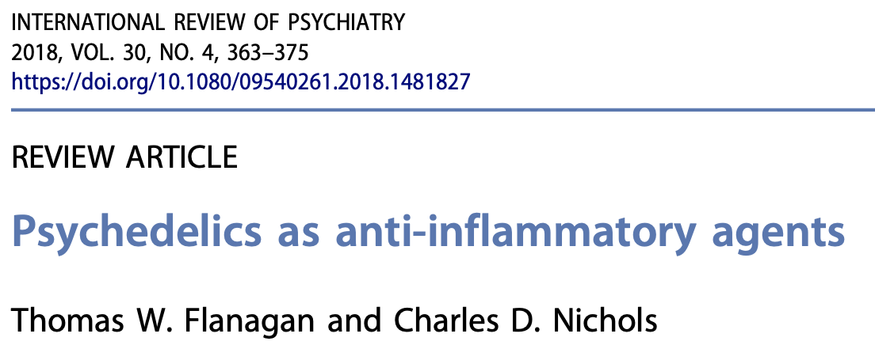
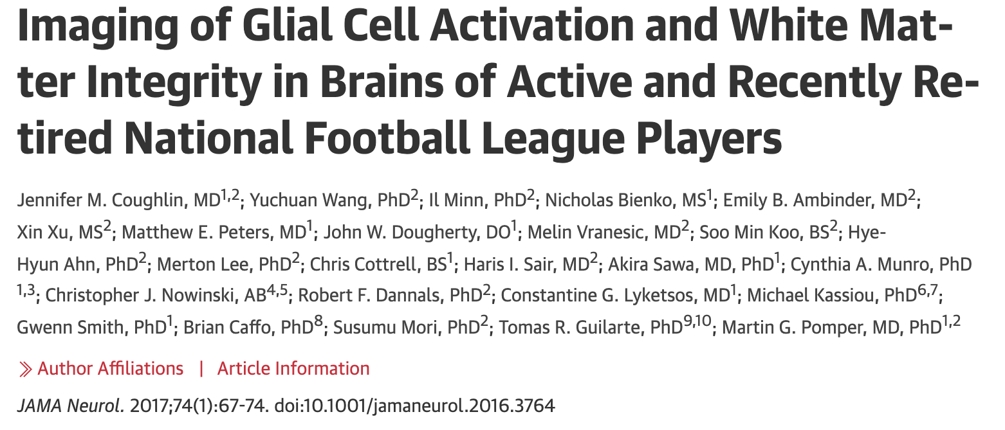
Evidence suggests that psychedelics are neuroplastogenic and anti-inflammatory
- Animal studies show psychedelics promote brain plasticity and reduce inflammation
- Psychedelics increase structural connections in white matter tracts that support attention, cognition, and healthy emotional functioning
Greater (red) and less (blue) white matter tract density in those with lifetime history of hallucinogen use (N=53)
Aharon-Almagor & Barrett, under review

Slide 28
We believe psilocybin may treat both the mental health disorders of retired athletes & possibly promote neurological healing of brain injury

Slide 29
Our Goal
Conduct study with retired combat sport & other athletes
Suffering from depression
May also suffer from addiction
MRI before and after
Primary hypothesis: Decreases in depression & addiction
Secondary hypotheses:
Improvements in cognition, e.g., memory, executive function
Improvements in brain health, e.g., white mater, structural & functional connectivity

Slide 30
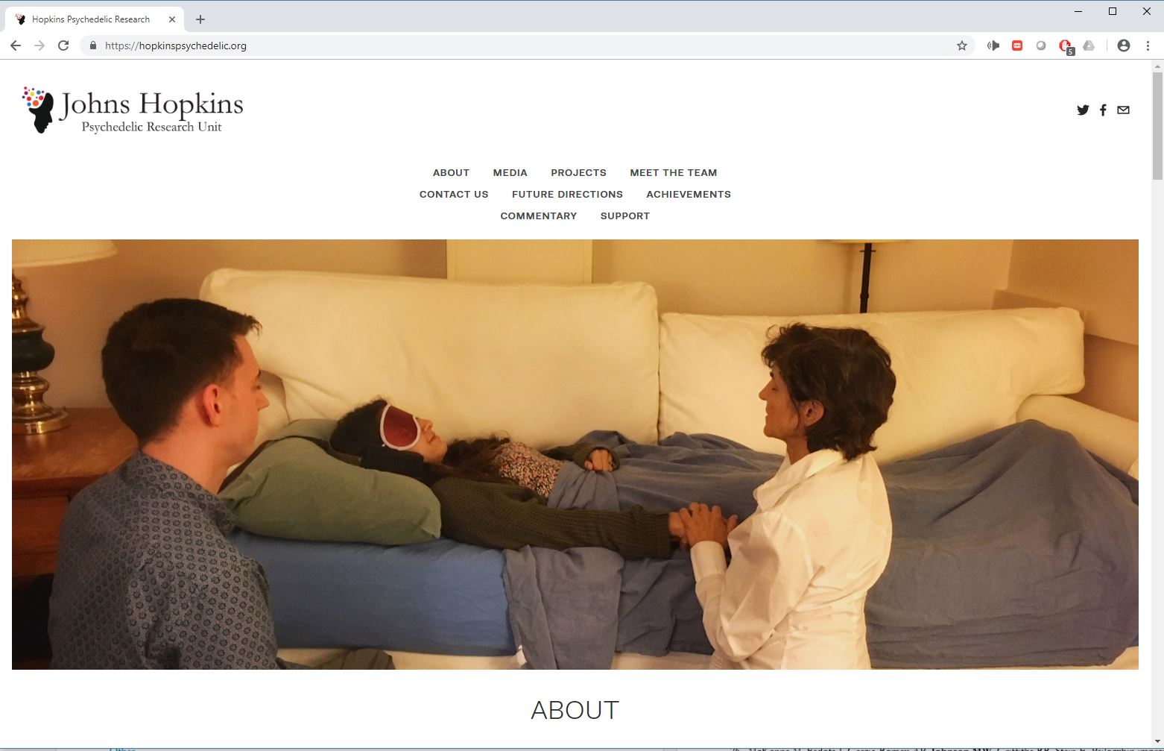
Acknowledgments
Albert Garcia-Romeu, Ph.D.
Frederick Barrett, Ph.D.
Matthew Peters, M.D.
Sandeep Nayak, Ph.D.
Roland Griffiths, Ph.D.
Jack Henningfield, Ph.D.
Mary Cosimano, M.S.W.
Maggie Klinedinst
Robert Jesse
Bill Richards, Ph.D.
Brian Richards, Psy.D.
Annie Umbricht, M.D
Chad Reissig, Ph.D.
Peter Hendricks, Ph.D.
Katherine MacLean, Ph.D.
Haley Sweet
Samantha Gebhart
Toni White
Fred Reinholdt, M.A.
Leticia Nanda, N.P.
Eric Richter
Grant Glatfelter
Janna Bonesteel
Crystal Barnhouser
Theresa Carbonaro, Ph.D.
Patrick Johnson, Ph.D.
Jenna Cohen
Marylyn Clark
Daniel Emory
Eric Jackson
Heather Cronin
Una McCann, M.D.
Debbie Allan
Kim Nelson
T. Cody Swift, M.A.
Lilian Salinas
Laura Doyle
Nathan Sepeda
John Clifton
Nora Belblidia
Dan Evatt, Ph.D.
David Nichols, Ph.D.
Charles Nichols, Ph.D.
Tehseen Noorani, Ph.D.
Funding
Heffter Research Institute
Beckley Foundation
Counsel on Spiritual Practices
Betsy Gordon Foundation
William Harrison
National Institute on Drug Abuse
Funding for the Center for Psychedelic and Consciousness Research was from Tim Ferriss, Matt Mullenweg, Craig Nerenberg, Blake Mycoskie, and the Steven and Alexandra Cohen Foundation.
https://hopkinspsychedelic.org
Email: mwj@jhu.edu
Twitter: @Drug_Researcher

