Slide 1


Pre-bout hypertension in the combat sports athlete: clearance recommendations. A Position statement from the ARP.
Kevin deWeber, MD, FAMSSM, FAAFP, FACSM
Director, SW Washington Sports Medicine Fellowship
Affiliate Associate Professor, Oregon Health and Science University
Clinical Assistant Professor, University of Washington

Slide 2
Disclosures
No conflicts of interest

Slide 3
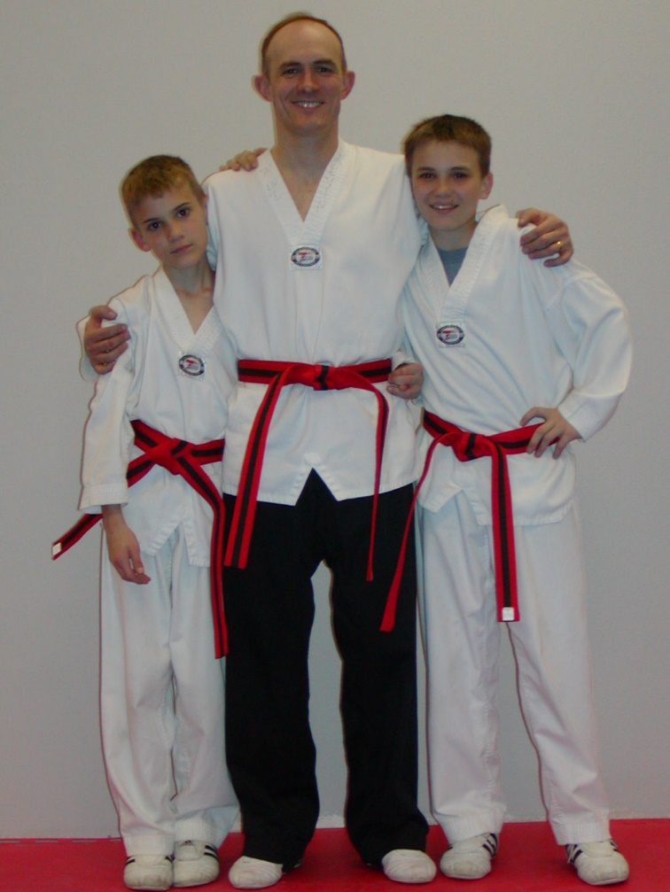
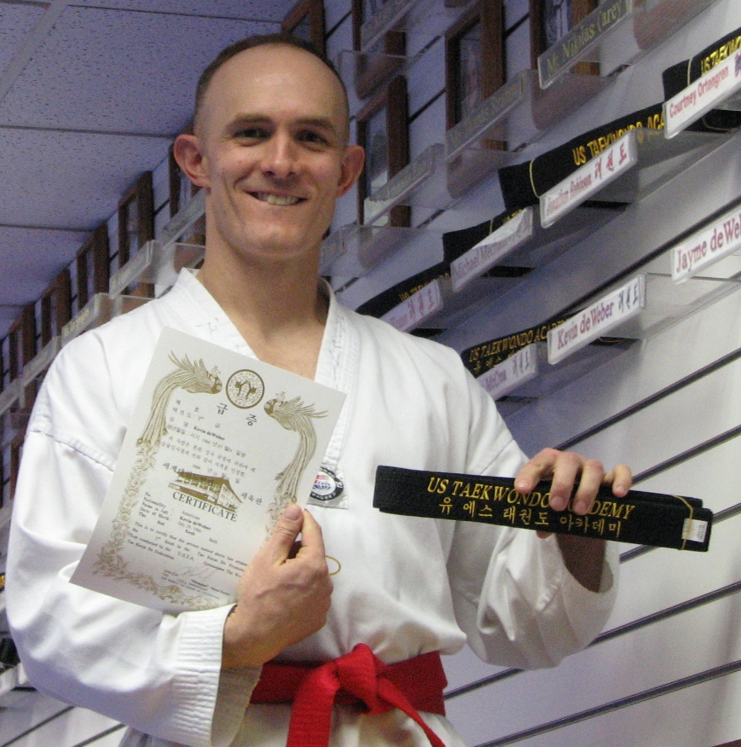
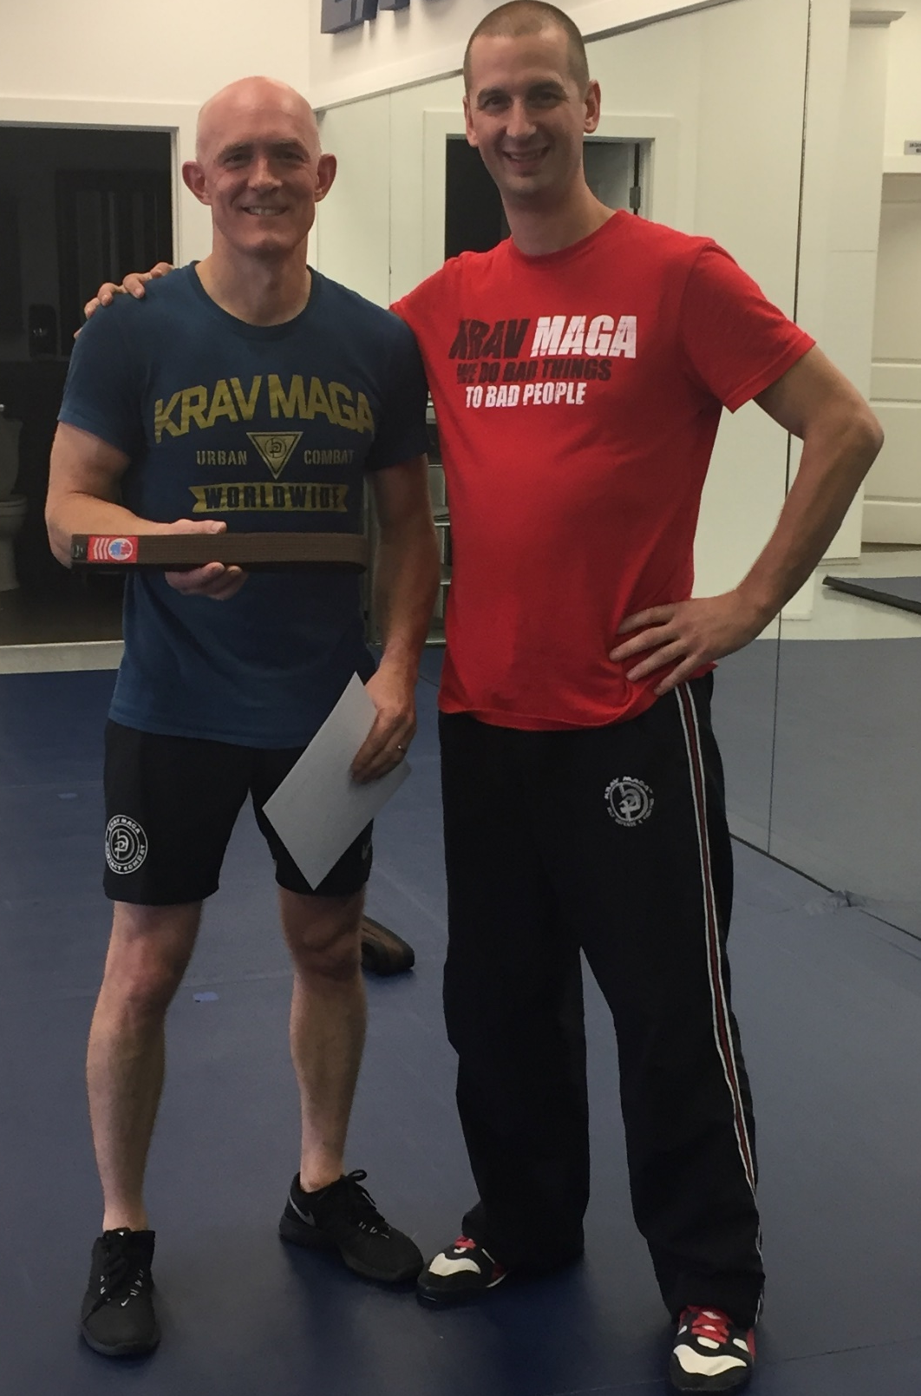
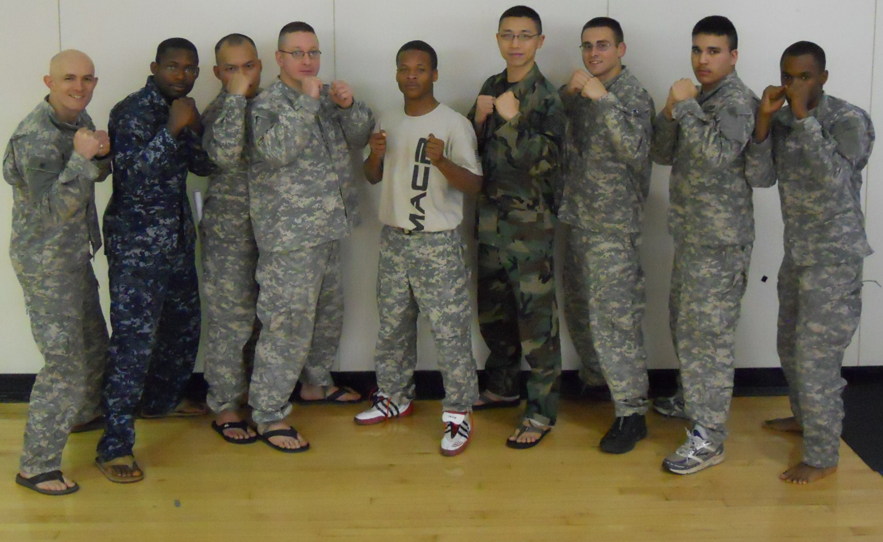

Slide 4


Slide 5





My Background
Family Medicine, with Sports Medicine CAQ
Fellowship Director
Army 29 years, combat veteran, retired Colonel
Elite military athletes: international competitions in boxing, wrestling, TKD, Judo
Olympic athletes: 2012/2016 boxing, wrestling, TKD, judo
Pro-MMA/Boxing, Washington & Oregon

Slide 6
Bottom line up front (BLUF)
Hypertension is a risk factor for cardio-/cerebro-vascular disease
Hypertension plus Trauma compounds risk of brain hemorrhage
STRONGLY CONSIDER DISQUALIFYING athletes ≥160 SBP or ≥100 DBP
ACSM, AHA, ACC all recommend disqualification
Athlete safety is paramount and is YOUR responsibility

Slide 7
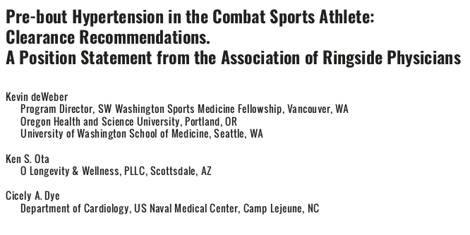
2021 Position Statement

Slide 8
Position Statement (abbreviated)
“It is strongly recommended that a ringside physician consider disqualifying a combat sports athlete with severe pre-bout hypertension (systolic BP ≥160 mm Hg and/or diastolic BP ≥100 mm Hg) from that bout, should it persist despite rest and repeat evaluation with accurate equipment.”

Slide 9
Development of the Position Statement
BP is a VITAL sign and should be approached as if it has life/death implications
Clearance decisions about BP are highly disparate
Scientific bodies larger than ours already have position statements on BP and sports/exercise
America College of Sports Medicine
American Heart Association
American College of Cardiology

Slide 10
Definitions in Hypertension (JNC 8)
Normotensive: BP <120/80
Elevated BP: 120-129 / 80
Stage 1 Hypertension: 130-139 / 80-89
Stage 2 Hypertension: ≥140 / ≥90
Severe Hypertension: ≥160 / ≥100
Hypertensive Emergency: severe Htn with symptoms of acute end-organ damage (MI, stroke, dissection, etc)

Slide 11
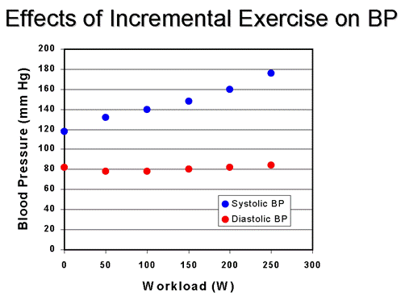
Physiology of Blood Pressure and Exercise
Blood pressure rises during exercise
SBP >> DPB
What’s high pre-bout will be MUCH HIGHER during bout
Men: SBP >210 is ABnormal
Women: >190 is ABnormal

Slide 12
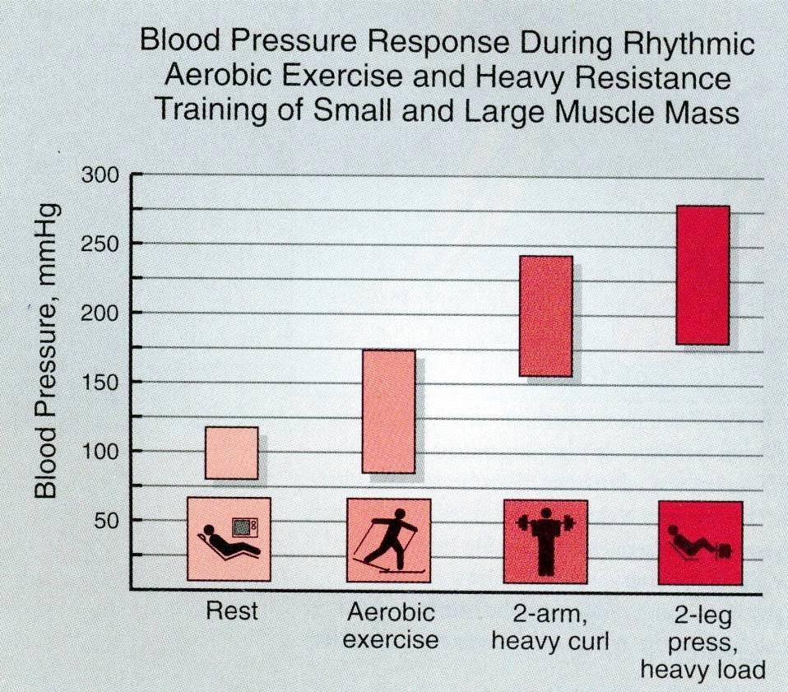
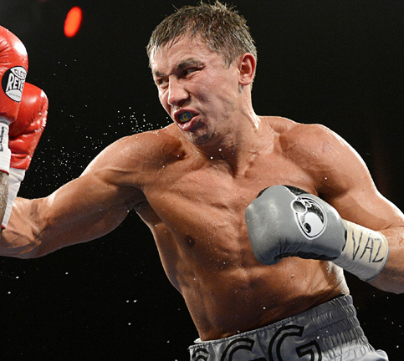
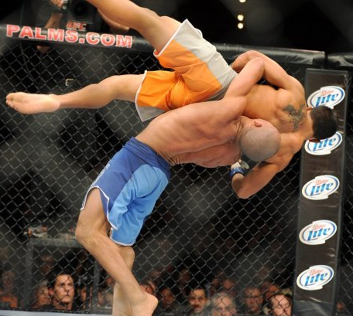
Dynamic vs Static Exercise
Levine BD et al. JACC 2015, 66(21)

Slide 13

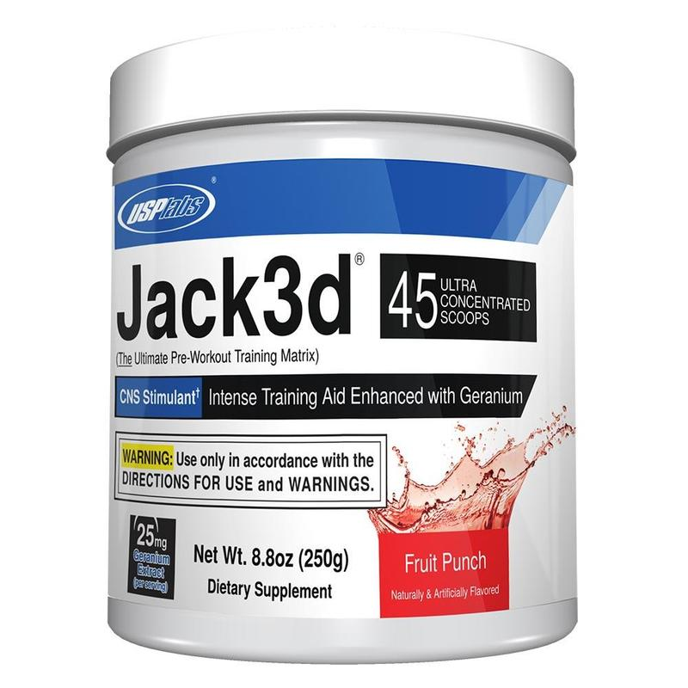
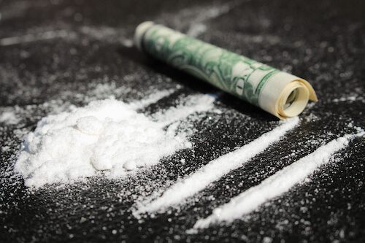
Epidemiology of High Blood Pressure
MOST COMMON finding during cardiovascular PPE in athletes
More prevalent in athletes
90% is “essential”
10% is “secondary”
Drugs, renal, Drugs, vascular, Drugs, endocrine, Drugs

Slide 14
Pathophysiology of Elevated BP
Elevated BP is a/w acute and chronic vascular morbidity/mortality
Myocardial infarction, heart failure, peripheral vascular dz, AAA
Ischemic stroke, Intracerebral hemorrhage, subarachnoid hemorrhage
Compounded by other risk factors
Smoking, diabetes, dyslipidemia, obesity, CKD, genetics, AGE, male, OSA, stress
Exercise increases the risk
Data for risk in athletes is limited

Slide 15
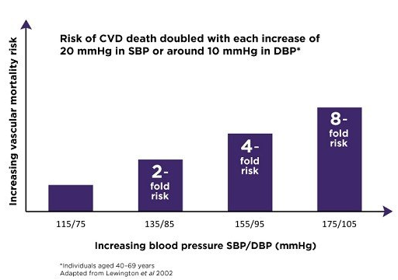
Pathophysiology of Elevated BP
Elevated BP has a log-linear relationship with risk of CCVD
Starts at SBP 115, DBP 75

Slide 16
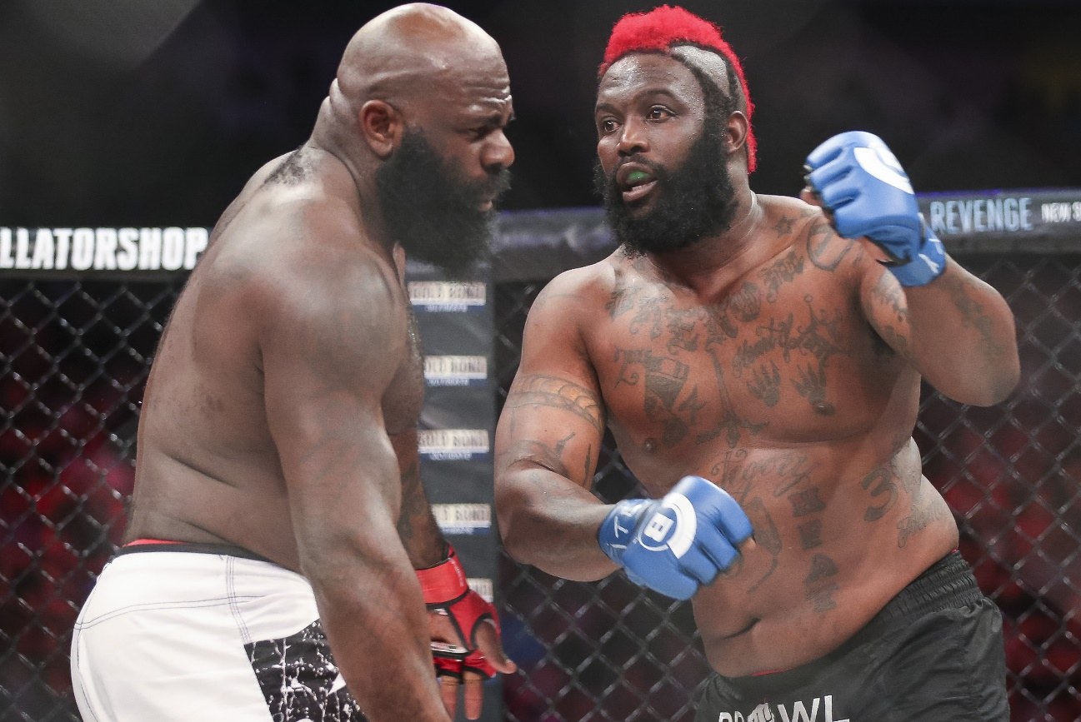
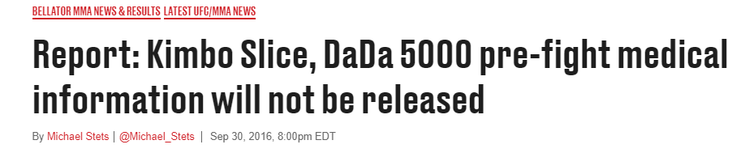
Myocardial Infarction
Dhafir Harris (Dada 5000)
Bellator 149, Feb 2016
Claims he had two MI’s
Hospitalized 2 weeks with AKI

Slide 17
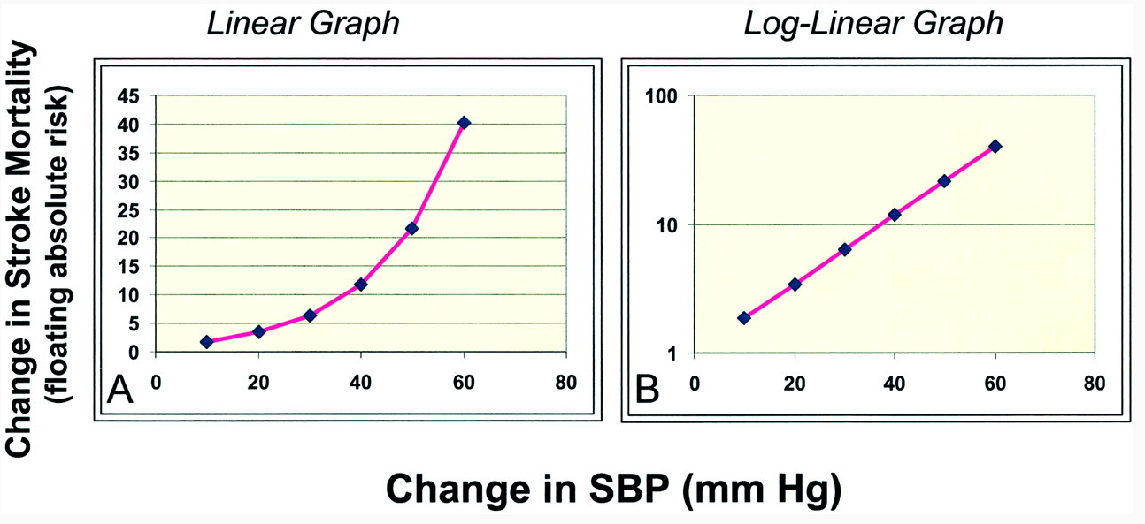
Pathophysiology of Elevated BP
Elevated BP has a log-linear relationship with risk of Stroke
Starts at SBP 115, DBP 75
SBP mmHg: 115 125 145 165 185
115 125 145 165 185

Slide 18

Intracranial Hemorrhage
Subdural hemorrhage (75% of boxing deaths)
Risk Factors: trauma, anticoagulants, cerebral atrophy
Htn and Exercise worsen neurological outcomes
Intracerebral hemorrhage (ICH)
RF: Htn, smoking, alcohol, diabetes, cerebral amyloid angiopathy, ?trauma
Risk = 9x when BP >160/>100
Ikram at al, Curr Atheroscler Rep 2012
Exact risk in Athletes is unknown
Subarachnoid hemorrhage
Aneurysmal: RF = Htn, smoking, FHx, trauma, exercise
Non-aneurysmal: RF = Htn, trauma, exercise
Trauma + Exercise + Hypertension = Trouble
Gary Whittom, died Mar 2018

Slide 19
American College of Sports Medicine recommendations
Individuals with severe hypertension (SBP ≥ 160, DBP ≥ 100) or with target organ disease…must not engage in any exercise…prior to a medical evaluation and adequate BP management.
ACSM’s Guidelines for Exercise Testing and Prescription, 10th Ed. 2018:280.

Slide 20
American Heart Association and American College of Cardiology recommendations
AHA/ACC Scientific Statement, Eligibility and disqualification recommendations for competitive athletes with cardiovascular abnormalities.
It is reasonable that athletes with severe hypertension (SBP>160 or DPB >100), even without evidence of target-organ damage, should be restricted, particularly from high static sports, such as weight lifting, boxing, and wrestling, until hypertension is controlled….
Black HR et al. JACC 2015, 66(21)

Slide 21
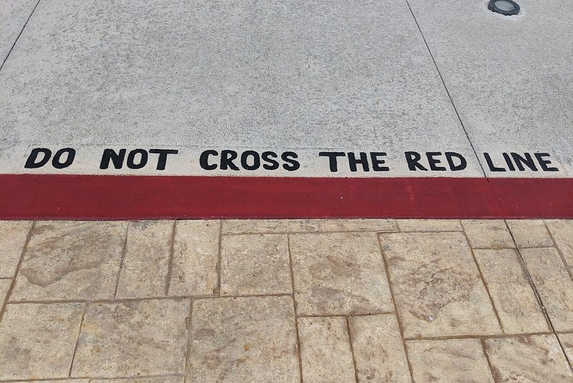
This is where we should draw the red line for BP
>160/>100

Slide 22
Categories of Pre-Bout Elevated BP
Spuriously elevated BP
MOST COMMON
Hypertension secondary to supplements or drugs
Essential Hypertension
Hypertensive emergency
RARE

Slide 23
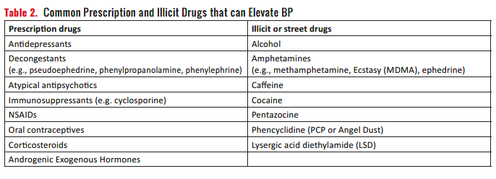
Pre-Bout BP Elevation as a Marker for Drug Use

Slide 24
But…but…but…what if…?
What if it’s just situational (spurious) hypertension? Fighter’s BP was ok on licensing physical, but it’s now 165/105.
How do you know this isn’t new-onset, severe Hypertension?
Does the heart/brain care what that cause of the hypertension is?
BP will only go UP from there during exercise
What if I’m comfortable with BP of 165/105?
Is the heart/brain comfortable with it?
Is it prudent to go against several major scientific bodies?
ACSM, AHA, ACC
Could you defend yourself in a courtroom?
What if the fighter feels fine despite BP of 165/105?
See above

Slide 25
Do your job, protect the heart & brain
Ringside physicians are not there to just take vitals, but also to interpret them and to courageously make the hard decisions
We should err toward caution when the herat/brain are at risk, just as we do with other vulnerable organs:
E.g. Uncorrected vision 20/200 or worse: DISQUALIFIED

Slide 26

Management of Pre-bout BP Elevation
Recheck with manual cuff of adequate size
Recheck after 5 minute rest, sitting, relaxed, in quiet place
Recheck after 20-60 minute rest and relaxation
If still ≥160 or ≥100, strongly consider disqualification

Slide 27
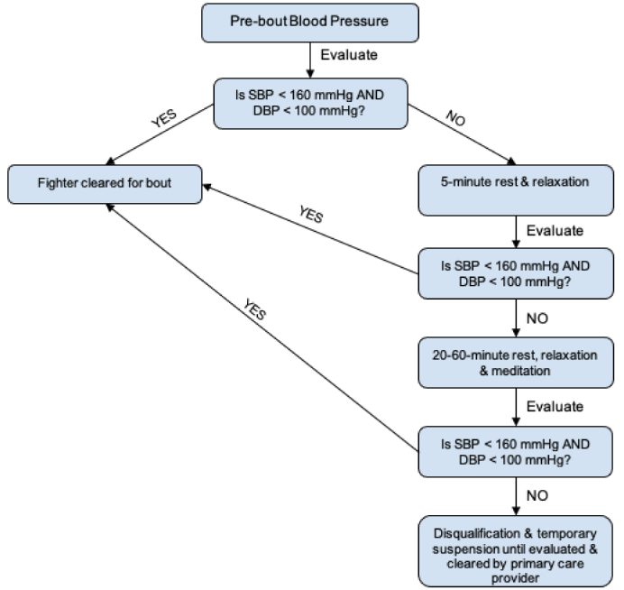

Slide 28
Questions

