Slide 1
Protecting the Long Term Brain Health of our Fighters
Charlie Bernick

Slide 2
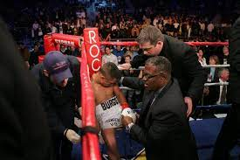
Call to Action
Previous focus has been on keeping fighters safe within the ring
No policies aimed at long term brain health
What can we learn from PABHS?

Slide 3
Professional Athletes Brain Health Study
Goals
Understand natural history of cumulative head trauma
Identify early markers/predictors of disease
Identify risk factors
Provide tools for regulatory agencies & participants to assess risk
Design
Longitudinal, subjects seen yearly
Subjects choose us
Three groups
Control (age/education matched)
Active pro fighters ( boxers, MMA)
Retired Fighters (>10 professional fights)
Began enrollment in 2011

Slide 4
Procedures
Demographics
Education
Medical and Family Hx
Drug use
Exposure
Amateur (est) and professional (verified) fights
Fight outcomes (rounds, W/L, (T)KOs)
Sparring time
Other exposure
Cognitive testing
Speech sample
Blood sample
(NFL, pTau 231, DNA)
Balance
MRI
Subset with PET Tau imaging

Slide 5
Natural Hx of RHI
Brain damage is occuring in Active Fighters
Can be detected:
Cognitive testing
MRI
Blood biomarkers

Slide 6
Cognitive
Greater the exposure, greater the impairment

Slide 7
DTI and # of Fights

Slide 8
DTI by Age, # of Fights

Slide 11
Developing a Classifier

Slide 12
Regions that contribute to Classifier
Hippocampus
Corpus callosum
Amygdala
Thalamus
anterior cingulate

Slide 13
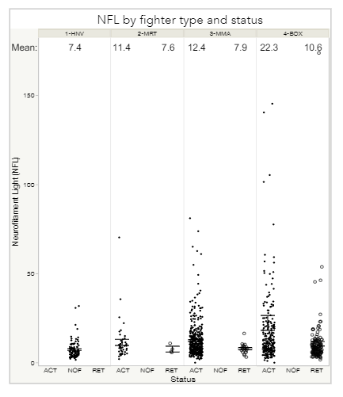
NFL
NFL values increase in those who are actively fighting and boxers>MMA.
Active boxers>Active MMA>Retired boxers>Retired MMA
Active boxers have mean NFL levels 3x healthy controls

Slide 14
How much damage occurs during a fight?
Video review of 60 fights
Assessed for # of concussion
Agreement between physician/non physician
When should fight have been stopped

Slide 15
How much occurs during a fight?
Concussion frequency: 1/ 12 min.
Fighter with 1st concussion loses > 95%
Losing fighter often sustains multiple concussions
Fights often go too long, esp. boxing

Slide 16
Transitioning
Cognitive function can improve
Volumes stabilize
NFL declines

Slide 17
Traumatic Encephalopathy Syndrome
Core Features
Extensive exposure to RHI
Cognitive impairment and/or Behavioral Dysregulation
Progressive Course
No other condition that could otherwise explain symptoms

Slide 18
TES
In participants>35 years of age, 43% individuals have TES
More likely to be boxers
Have higher exposure to repetitive head trauma (more fights, more times KO’d, longer careers, and started earlier)
Show regional differences in imaging measures
 | Not TES | TES | P value
N | 93 | 71
Percentage Boxers | 51(47/93) | 84 (60/71)
Age | 43.06 (7.5) | 47.55 (8.48) | 0.0006
Active Fighter | 37/93 | 9/71 | NA
Education | 13.69 | 12.68 | 0.0338
Years Pro | 9.933 | 12.75 | 0.0046
Age Started | 18.78 | 13.98 | 0.0001
Number of bouts | 23.15 | 38.89 | <0.001
Number of times KO’d | 4.08 | 2.548 | 0.0056
PHQ9 | 4.3 | 8.3 | 0.0002
Volumetric MRI (<p<0.001)
- lateral ventricles
-thalamus
-amygdala
-hippocampus
White matter tracts <0.001
Fornix

Slide 19
Progressison toward TES

Slide 20
Recommendations
Adoption of longitudinal cognitive testing required for licensure
Concussion protocol for combat sports:
If concussion occurs, mandatory exam by ring
physician
Training of ringside personnel on concussion
recognition
Reduction of 8 count to 4 sec in boxing
Heightened surveillance of fighter with 1st
^{concussion}

