Slide 1
Dr. Heather Linden, DPT
Clint Wattenberg, RD
Matthew Crawley, MS, CSCS, RSCC
Holistic Interdisciplinary Care for Return to Sport After Concussion

Slide 2
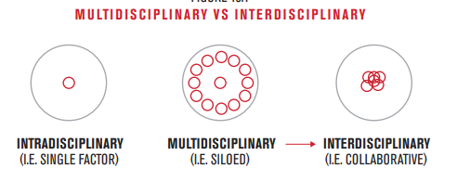
UFC Performance Institute:
Interdisciplinary Objectives
Notes:
Moving from a medical model to a "true" interdisciplinary approach

Slide 3
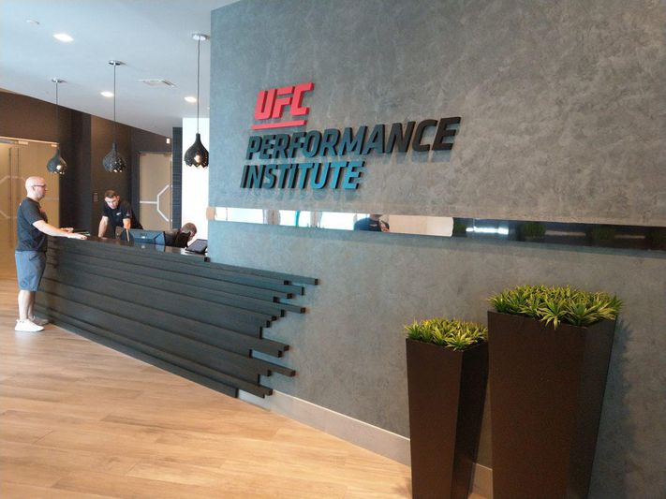
Interdisciplinary Objectives
Concussion Identification
  Symptoms
  Diagnostics
  MD management
Concussion Evaluation
Concussion Treatment
Return to Sport

Slide 4
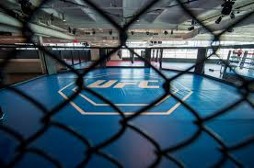
Concussion Identification
What is a concussion?
    Complex pathophysiological process affecting the brain
    A clinical syndrome of biomechanically induced alteration of brain function, typically affecting memory and orientation, which may involve loss of consciousness
Types of Concussions
  Vestibular
  Ocular-motor
  Cervical (cervicogenic)
  Migraine/Headache
  Anxiety-Mood
  Cognitive
Notes:
Vestibular (inner ear > vestibulocochlear n > cerebellum > nuclei to brain stem)- type of concussion cause trouble w/ balance, motion, & vision. interpret motion, coordination, head/eye movements, steady or balance vision upon head movement.
Ocular-motor (cerebellum > vision)- trouble w/ visual tasks like-reading long passages, looking @ computer screen or cell phones, affect tandem eye movements (bringing eyes together or moving one's eyes to track motion)
Cervical-stress or pressure on neck, spine, or spinal cord-could lead to headaches, slouching/carrying a bag could make worse
Migraine (chemical activity in brain)- changes in your normal routine, such as sleeping or avoiding loud concerts or sporting events-HAs, nausea sensitivity to light or noise
Anxiety-Mood-(neurotransmitters > neuropeptides > limbic system > brain stem > higher cortical brain areas-hard to turn off thoughts, causes excessive worry or concern
Cognitive- trouble with prolonged or complex mental tasks, complex subject matters and long days-can increase fatigue as day goes on
Cognitive issues include; decrease concentration, increase distractability, trouble learning/retaining new info, decreased ability to multi-task

Slide 5
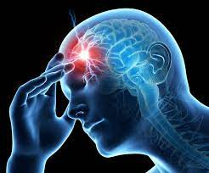
Concussion Identification (cont)
Normal/Expected Symptoms/what to look for
  Headache
  Dizziness
  Fatigue
  Irritability
  Sleep disturbances
  Memory impairment
  Anxiety
  Sensitivity to noise and light
  Depression
  Blurred vision
  Feeling like in a fog/just don’t feel right

Slide 6
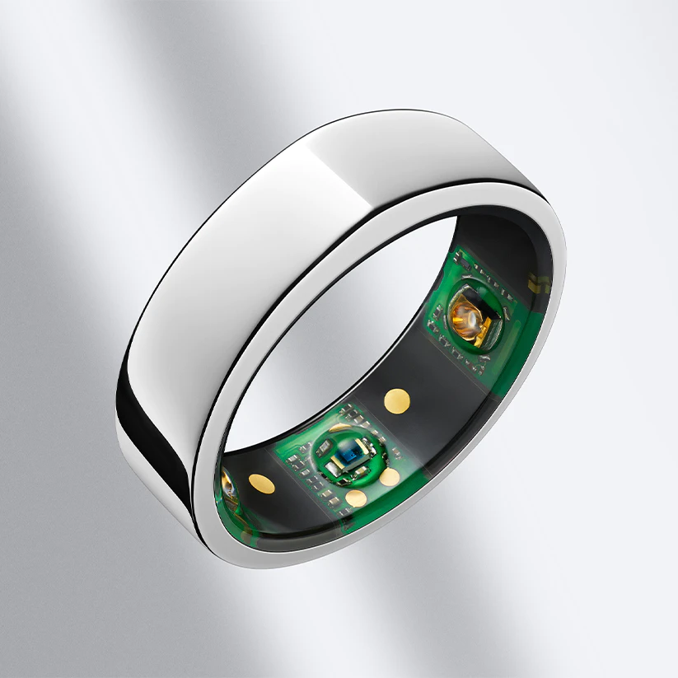
Initial Symptom Management
    Medications
      Acetaminophen/Tylenol/Paracetamol ONLY (headache and pain)
    Sleep Disturbances
      Sleep hygiene
      Oura Smart Ring Sleep Metric Monitoring
    Nutrition & Supplementation
          Anti-inflammatory fueling & supplementation
          Melatonin (nutrition) 3-12 mg melatonin/d 30 minutes pre sleep
    Depolarization of Brain
      Fueling to drive B-Oxidation => mitigate acute energy Crisis
      B-Oxidation fueling + Flavonoids => mitigate Inflammatory Cascade

Slide 7
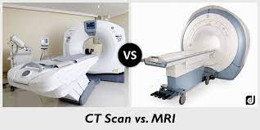
Are Diagnostics Appropriate?
  CT-gold standard to detect intracranial bleeding or macro-structural injury
  MRI-has value in cases with atypical or prolonged recovery
    Advanced multi-modal MRI technologies are used more in research protocols to understand neurobiological effects and recovery
  PET
  Biomarkers
    Show promise for r/o intracranial bleeds and structural damage-reduce utilization of head CTs in ED
      Glial fibrillary acidic protein (GFAP)
      Ubiquitin carboxy-terminal hydrolase L1 (UCHL1)
      S100 calcium binding protein *
Notes:
After events- athletes will be referred to the hospital to get a CT brain scan- released after being "cleared"-this terminology can confuse athletes bc they assume they are cleared from having a concussion-this is where EDUCATION is extremely important. Ring side physicians can suggest they follow up with a medical provider upon their return-
If an athelte is being referred due to KO we can assume they should follow up with a medical provider at home.

Slide 8

MD Management/Referring Out
  Red flag symptoms
    Sudden, intense headaches
    Difficulty talking or finding the right words-slurred speech
    Unusual behavior-increased confusion, cannot recognize people or places
    Difficulty swallowing
    Loss of consciousness
    Seizures
    Vomiting
    Weakness and numbness in any part of the body
    Looks very drowsy/can’t be awakened
    Discharge from nose and/or ears (watery or bloody)
    Pupillary abnormality
    Suspected open, depressed, or basal skull fracture
  Symptoms persisting greater than 10-14 days
Notes:
Physicians drive "acute care" and red flag phases- but the collaboration and hand offs are extremely important to keep an individualized approach to athlete health and recovery.
This is the first phase in developing a framework for interdisciplinary care

Slide 9

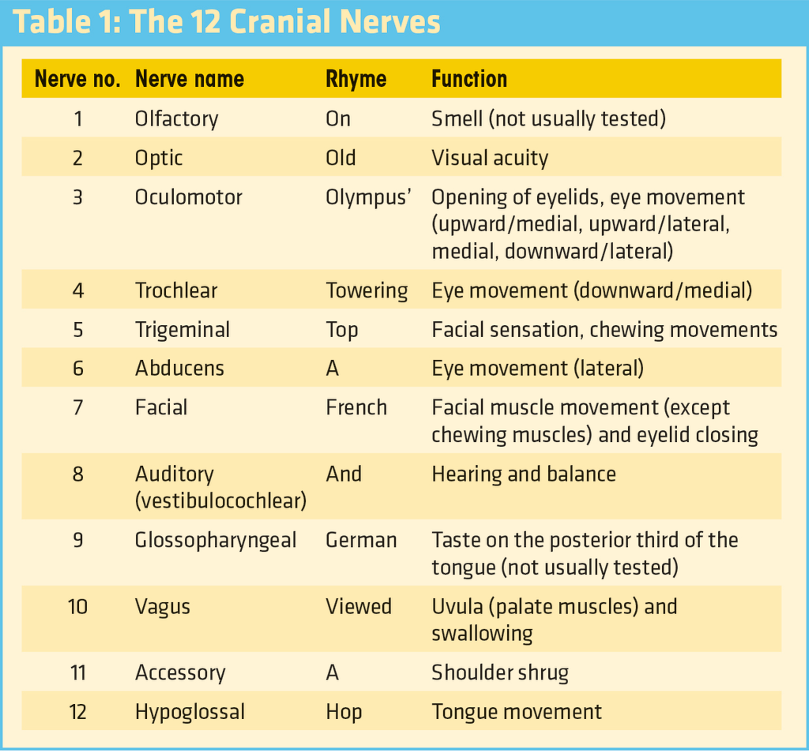
Concussion Evaluation
    Medical
      Detailed history
        Injury Mechanism
        Past concussions (number, recovery course, and time between injuries)
        Presence of premorbid/comorbid conditions
          Learning disabilities
          Attention deficit disorder
          Motion sickness/sensitivity
          Mood disorders
          Migraines/headache disorders
          Current medication use
      Cranial Nerve Exam
      Cervical Spine Evaluation
      Neurocognitive Testing
          C3 Logix, SCAT, IMPACT
      Eye Test-Synaptec
      Symptom tracking
        Significance 24-48 hours
        Reduction in symptoms for RTP progression
Notes:
Important reason to do a thorough eval after incident- provide more patient-centered care that's individulared and interdisciplinary
C3 Logix-ipad based application-assesses for neurocognitive ability in several domains
1. symptomatology (same as SCAT 5)-graded symptom checklist
2. reaction time
3. working memory
4. information processing
5. neuromotor function
6. balance-quantitative mapping of postural stabiltiy over 6 BESS stances
7. visual acuity
8. vestibular function
VOMS-vestibular ocular motor screening-looks at the system in charge of integrating, balance, vision, and movement
Need tape measure and metronome
90% accurate in diagnosis of concussion-5 areas 1. smooth pursuit 2. rapid eye movement 3. near point convergence 4. balance vision reflex 5. visual motion sensitivity

Slide 10
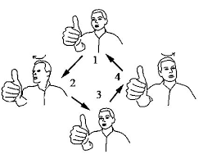
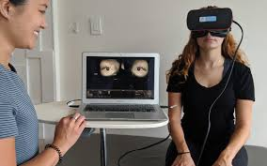
Further Evaluation
        Vision
          Senaptec (compare baselines if avail)
          King-Devick
          Visual Fields
          H testing
          Gaze Holding
          Static Visual acuity (snellen eye chart-monocular/binocular)
          Brock strings
          Depth perception
          Vision recognition memory
          Visual reaction time
          Stroop test
        Cognitive
          Reaction time (C3)
          Working memory (C3)
          Memory retrieval (C3)
          Visual spatial capacity
          Information processing speed
          Short term memory
          Attention
Vestibular
Bertec Posturography-connected to BVA system
BPVV-Dix Hallpike Maneuver
BESS
Dynamic Gait Index (FGI)
Functional Gait Assessment (FGA)
Visual Vestibular Mismatch
Ocular-motor/Vision
Smooth Pursuit-Hor/Vertical
Saccades-Hor/Vertical
Antisaccades (vol, top down, cognitive
Accomodation
VOR-hor/vertical
Visual Motion Sensitivity Test
Dynamic Visual Acuity Test
Migraine/Headache
Detailed CS and head eval
TMJ evaluation
Cranial work-temporalis, frontalis, eye m, subocciptals
        Audiology Exam
          Videonystagmography (VNG)
            Ocular mobility
            Optokinetic nystagmus
            Positional nystagmus
            Caloric testing
          Frequency Following Responses (FFRs)
Notes:
Bertec- dynamic posturography and immersive virtual reality
Func gait index- simple eval of balance and ability to perform several activities and can help monitor the status of patient's with vestib conditions
Functional gait assessment-is a modification of the dynamic gait index-uses higher-level tasks to increase the applicability of the test to people with vestibular disorders- used to assess postural stability during walking and assesses an individual's ability to perform multiple motor tasks while walking
Visual Vestibular Mismatch-feeling is a result of a conflict in your brain where the visual info coming from your eyes does not match the vestibular info coming from your ears- "motion sickness feeling"-fix balance ex with eyes closed to desensitization visual stimulation
-Ocular motor/Vision-do VOMS test
Smooth pursuit-eye movement used when tracking objects- (eyes remain fixated on a moving object)
Saccades-small rapid jerky movement of one eye esp as it jumps from fixation on one point to another (as in reading)
Antisaccades—have you fixate on a central target, and when a new target comes up, we ask you to move your eyes in a spot opposite to where the new target appeared (injury to frontal lobe
Accomodation-strategies that support balance
VOR-Vestibulo-ocular reflex-reflex acting to stabilize gaze during head movements with eye movement due to activation of the vestibular system-acts to stabilize images on the retina
Visual Motion Sensitivity test-when busy roads, walking down supermarket aisles visually overwhelm due to sensory conflict btwn visual, vestibular and somatosensory systems caused by concussion
Dynamic Visual Acuity Test-provided instrumented, objective, behavior assessment of vestibulo-ocular reflex function in response to rotational or functional head movement stimuli-DVAT assesses visual acuity during hea dmovement relative to baseline static visual acuity
Audiology-
Videonystagmography test that measures a type of involuntary eye movement called nystagmus. Happens when the brain gets conflicting messages from your eys and the balance system in the inner ear-" cause dizziness"
You can get nystagmus when you move your head a certain way or look at some types of different patterns- if you get it when you don't move your head and it lasts it can be a disorder of the vestibular system.
-ocular mobility-audiologists will look for slowness or inaccuracies in your ability to follow visual targets-indicative of a central or neurological problem or problem in pathway connecting vestibular system to the brain
-optokinetic nystagmus-view a large continuously moving visual image to see if your eyes can track the movements-indicative central or neurological problem or problem w/pathway connecting vestibular system to brain
-positional nystagmus-move head and body in various positions to make sure that there are no inappropriate eye movements (nystagmus) when your head is in different positions-looking inner ear system and the condition of your endolymph fluid in your semicircular canals (verifying small calcium carbonate particles called otoconia are not suspended in fluid and causing disturbances
-caloric testing-stimulate both inner ears (one at a time) with warm and cold air-they will monitor movements of eyes using goggles to make sure that both of your ears can sense stimulation-confirms vestibular system is working can decipher btwn unilateral and bilateral loss
Frequency following Responses-tendency for our mind and body to be affected and synchronized by an external source-sounds and rhythms-
Vision
King Devick-baseline measure and concussion sideline screening assessment test of rapid number naming that requires eye movements, language function and attention in athletes (86% sensitivity, 90% specificity for detecting concussion) 2 minute rapid number naming assessment in which an individual quickly reads aloud single digit numbers and evaluates impairments of eye movements, attention, and language function
Visual field testing-measures how far the eye sees in any direction whithout moving and how sensitive the vision is in different parts of the visual fields (visual part of the nervous system-retina, optic nerve, and brain
Gaze holding-evaluate the presence of nystagmus in the absence of a vestibular stimulation-instructed to look straight aheas and fixate on a target 30 degrees to R, L, Up, down-fixation is maintained for 30 sec
Brock strings-designed to test and treat visual perception problems. Important bc these problems can contribute to headaches, blurry vision, balance problems and more-looks at convergence and suppression
Convergence-simulataneuously inward movement of both eyes toward each other-mediated medial rectus muscle-innervated by cranial nerve III
Depth perception-visual ability to perceive the world in 3D
Vision recognition memory-recognize patterns
Visual reaction time-if brain can quickly process visual info or not
Stroop test-measure of working memory and attention-when colors and words are conflicting, the brain must work hard to filter out competing signals (I.e reading is an automatic task that the brain needs to actively inhibit it and direct its attention instead to saying the color of the letters, this resulting delay is called the Stroop effect
Cognitive
Working memory-cognitive system with a limited capacity that is responsible for temporarily holding information available for processing
Memory retrieval-recovery of stored information
Visual spatial capacity-to understand and idealize visual symbolizations and spatial associations in learning
Information processing speed-the amount of time it takes to perceive information
Short term memory-memory process that deals with the storage, retrieval and modification of information received in mind in an active, readily available state for a short period of time
attention

Slide 11
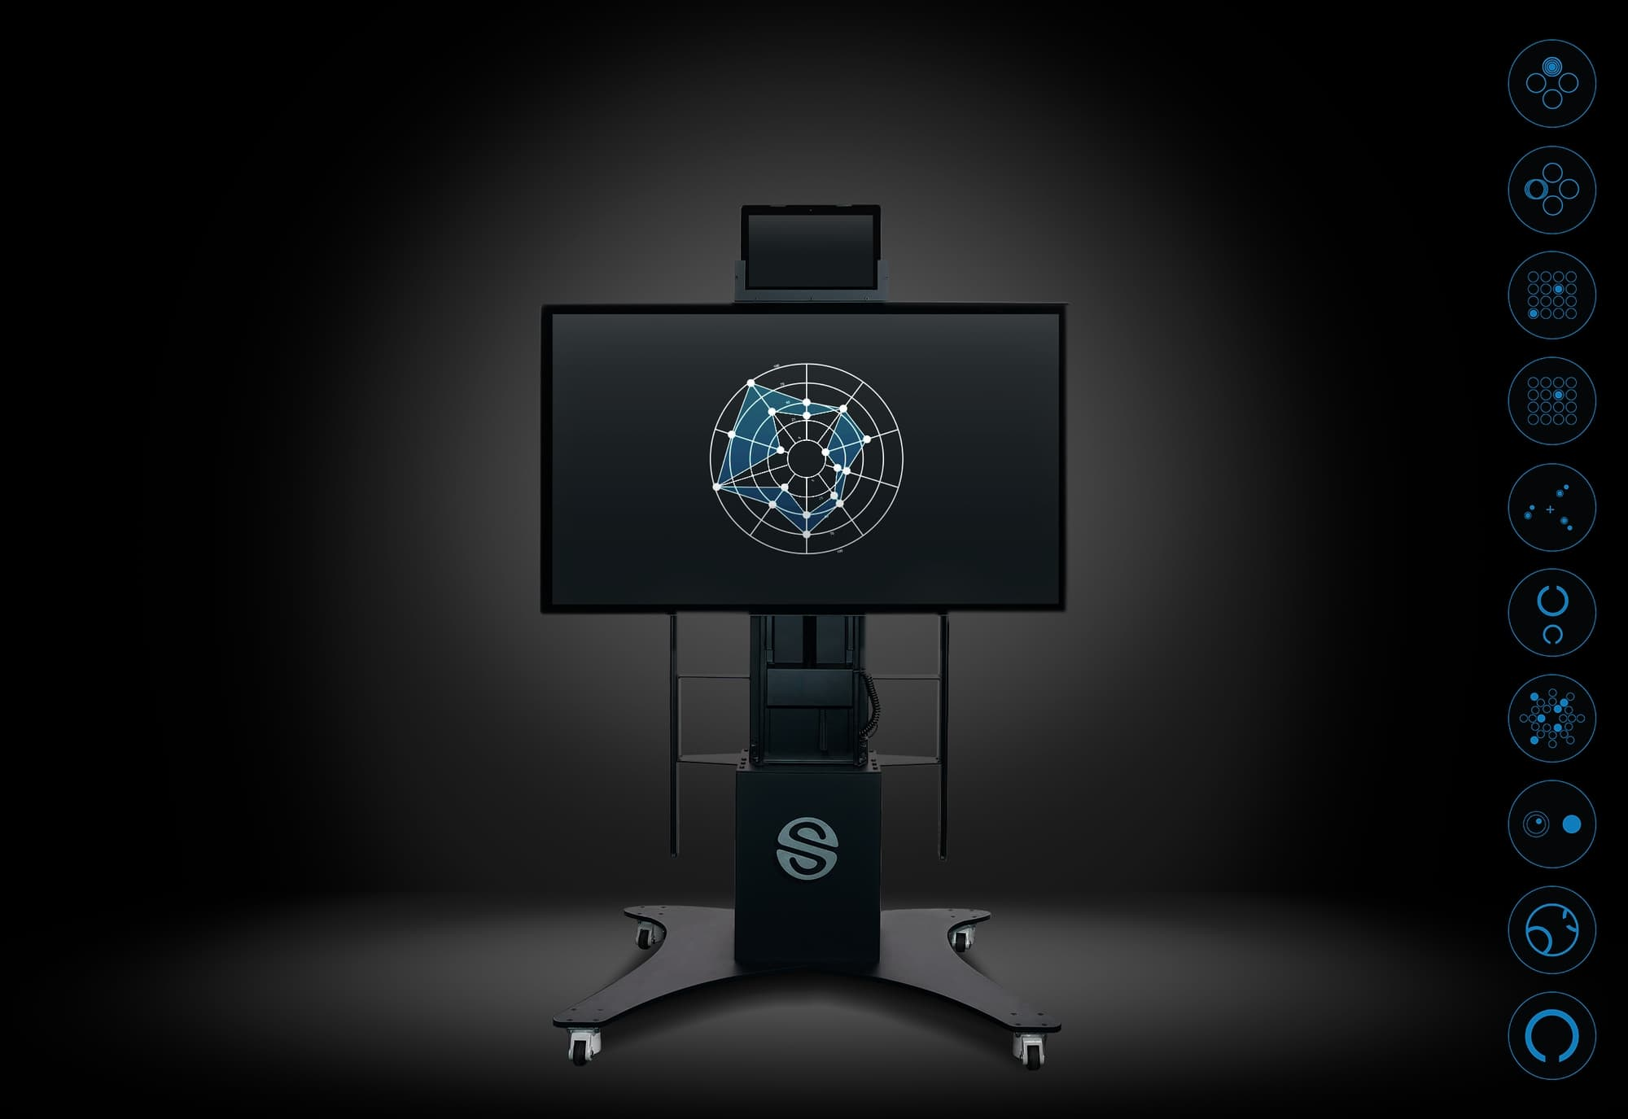
Further Evaluation (cont'd)
Senaptec Sensory Station
Evaluation of visual and sensorimotor skills
Report (data analysis)
Program design and implementation
Notes:
-The Senaptec sensory station is a tool that we use for performance testing, but offers an evaluation that can be used a baseline to help with concussion return to sport
-The evaluation has 10 visual and motor skills tests, takes about 20 minutes
-After giving the report we analyze the data to customize an improvement program for the athlete, the real value comes in vestibular training drills such as dynamic vision, perception training and near far shift

Slide 12
Nutrition Considerations with Concussion
Energy Crisis
Neurogenesis
Inflammation
Sleep & Circadian Rhythms
Gut-Brain Axis

Slide 13
Nutrition Considerations with Concussion
    Pre-Existing Nutritional Status
      Omega-3 Status
      Current Energy Availability Status
      Inflammatory Status (& history of mediation strategies – NSAID’s)
    Other Nutrition Factors
      Previous specialty diets (& tolerance)
      Supplementation (& tolerance)
      Appetite & response to periods of inactivity (under/overeating?)
      Gastrointestinal issues (including food intolerances)
      Current medications/NSAID’s
    Other Contributing Factors
      Mood/Mental Health Status
      Sleep history & any hx of sleep aids
    Ongoing Considerations
      Concussion History (& recovery)
      Training Phase / Fight Status
      Social / Environmental Support Structure
      Historical Appetite Response to training shifts
      Nutrition & Supplement Plan Tolerance
      MEDICAL & TRAINING PROGRESSIONS

Slide 14

How to Manage at Home
  Brain and Physical rest 24-48 hrs.
    Reduce electronic screen time
    Limit exposure to bright lights and loud sounds or anything that exacerbates symptoms
    Avoid alcoholic beverages and excessive caffeine
    Add in meditation, deep breathing, yoga
  Stress management
    Sports psychology (mindfulness, relaxation techniques)
    Breathing techniques
    Parasympathetic hobbies (reading, meditation)
  Sleep
    Observe and monitor day-and night-time sleep behavior
      Limit electronic screen time 1-2 hours before bed
      24-hour circadian shift
      Sleep diaries and/or sleep questionnaire
      Nutrition (Melatonin supplementation)
  Nutrition
    Hydration
    Food and Nutrient Recommendations
      PI concussion protocol-food (omega 3, protein, antioxidants)
Notes:
Esp impotant with this population due to the after event celebrations

Slide 15
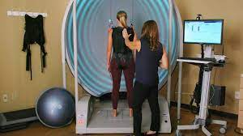
Specialized Treatments at Therapy
    Vestibular
      Gaze Stabilization Exercises
      Walking with Head Turns (side-to-side, or up and down)
      Canalith Repositioning Maneuvers
      Habituation Exercise
      Aerobic Exercise
      Bertec Posturography-connected to BVA system
      Rocker Board/BOSU/Airex Pads
      Shuttle Balance Board
      BESS
    Ocular-motor
      Colored lenses
      Number Cross Test
      Letter Cancellation
      Visual-Spatial Midline
      Mannequin Projections
    Cervical (cervicogenic)
      Soft tissue mobilization/myofascial release
      Manipulation
      Release therapy (occipital and cs muscles)
      Dry Needling Techniques
      Supine Deep Neck Flexor Stabilization Exercises
      Side-lying Deep Neck Flexor Stabilization Exercises
      Prone Deep Neck Flexor Stabilization Exercises
      Therapy Ball Deep Neck Flexor Stabilization Exercise
      Laser Target Training
Notes:
Gaze stabilization Exercises - These are exercises aimed at improving vision while the head is moving, generally while viewing an earth stationary object.
Habituation Exercises - The goal of habituation exercise is to reduce the dizziness through repeated exposure to specific movements or visual stimuli that provokes patients’ dizziness. These exercises are designed to mildly, or at the most, moderately provoke the patients’ symptoms of dizziness. Over time, with good compliance and perseverance, the dizziness intensity can reduce due to the brain learning to ignore the abnormal signal.
Bertec Posturography – connected to BVA system – Bartec Vision Advantage (BVA) is a software based system that evaluates vision problem resulting from head movements that can cause or complicate balance performance.
BESS – an outcome measure of postural stability, more commonly used in patients with a TBI/Concussion
Colored Lenses – Shown to reduce visual discomfort in TBI/concussion cases
Number Cross Test -
Vision
Pegboard exercise – Improves fine motor control and strengthens visual perception skills.
Brock String – Helps the patient learn to see with both eyes simultaneously while working on convergence insufficiencies.
King devick test – Based on measurement of speed of rapid number naming to capture impairment of eye movements, attention, language, and other correlates of suboptimal brain function
Cognitive
Brain game apps – There is currently little strong evidence that these work but they have the potential to improve problem solving and critical thinking.
Virtual reality training – Makes it possible for the athletes to train in “real” conditions while collecting data to optimize technique. Can allow the athlete to get unlimited reps in the most realistic conditions besides the match to be prepared.
Cervical
Laser target training – Allows for visual feedback during motor control training, thus improving accuracy and athletic performance.
Ocular Motor
?Mannequin Projections –….Maybe you project an image of your opponent to get used to his body shape and size?
Visual Spatial Midline – After a concussion you can have a visual spatial midline shift causing you to feel like your body center of balance is off. Ocular motor training utilizing mirrors/midline can recenter the shift.
Letter cancellation – The letter-cancellation task targeted the sustained attention. The average time taken (in seconds) to cancel the two target letters and the average number of errors committed were calculated for each week.
single letter cancellation test allows the therapist to evaluate the presence and severity of visual scanning deficits, and is used to evaluate unilateral spatial neglect

Slide 16
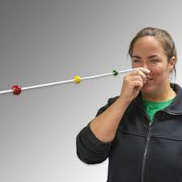
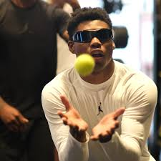
Specialized Treatments at Therapy
Migraine/Headache
  Soft Tissue Mobilization
  Release Therapy (deep neck flexors, occiput m, temporalis, masseter
Vision
  Pegboard exercise
  Wearing sunglasses
  Tracking moving objects (laser pointer/flashlight-dark room)
  Brock strings
  Senaptec Sensory Station and strobe glasses
  King Devick Tests
Anxiety-Mood
  Diaphragmatic Breathing
  Aerobic Exercise
Cognitive
  Brain game apps
  Virtual Reality Training

Slide 17

UFCPI: Return to Sport Protocol
Stage 1-Initial Period of Rest: Recovery
      24-48 symptom management
      IDA approach
        Nutrition (Food & Supplementation) =>
        Sports Psych
        Coaches
        Support Staff
        S & C (Open communication with sports medicine and medical provider)
        Sports Science
        Sports Medicine-daily check in
      Acetaminophen (Tylenol/Paracetamol ONLY: NO Ibuprofen
      Mental/Physical Rest
      Allowed to Sleep
      Symptoms worsen or increase-red flag symptoms, send athlete to ER
      No activities (screen time) should exacerbate symptoms
      If symptoms are below 3 for every category or matching baseline, progress to Exercise Intolerance Assessment.
        If symptoms are remaining static after 48 hrs, medical team can decide to do a monitored cardiovascular session (perform buffalo treadmill or bike concussion test.
  Exercise tolerance assessment considerations

Slide 18
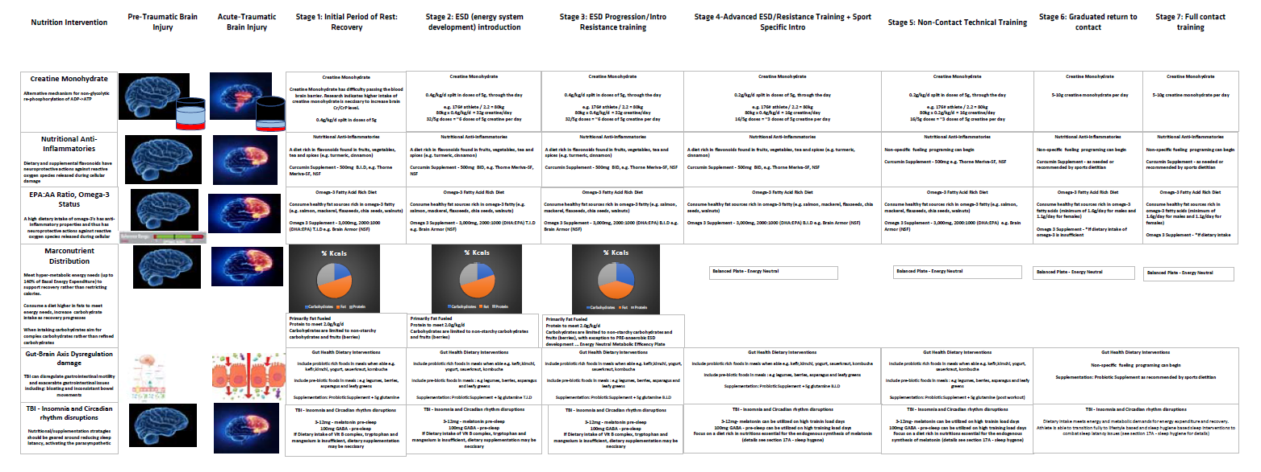
Overall Nutrition Intervention & Progression

Slide 19
Concussion - Nutrition Recovery Paradigm (target of interventions)
Energy Crisis
Neurogenesis
Inflammation
MCT’s
Ketone Esters (BHB)
Sleep & Circadian Rhythms
Ketogenic Diet
Gut-Brain Axis
Omega-3 Fatty Acids
Creatine
B-Vitamin Complex
L-Glutamine
Probiotic
Vitamin E
GABA
Vitamin D
Flavonoids / Phytonutrients
(Fruit-rich diet)
Prebiotic
Curcumin(Meriva)
Melatonin

Slide 20
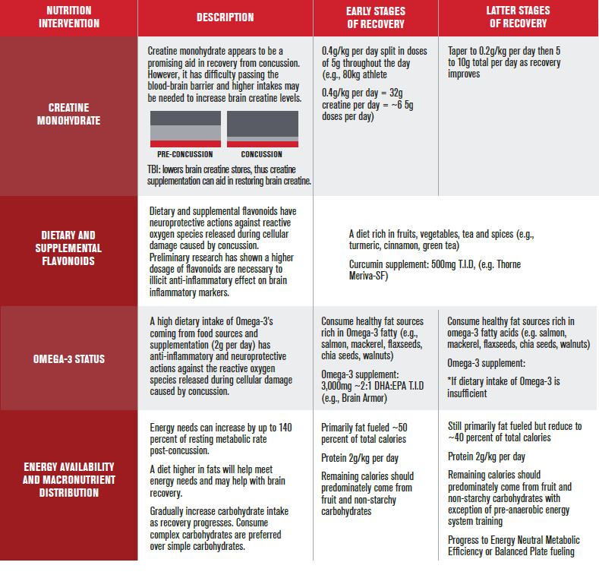
1*
Nutrition Interventions

Slide 21
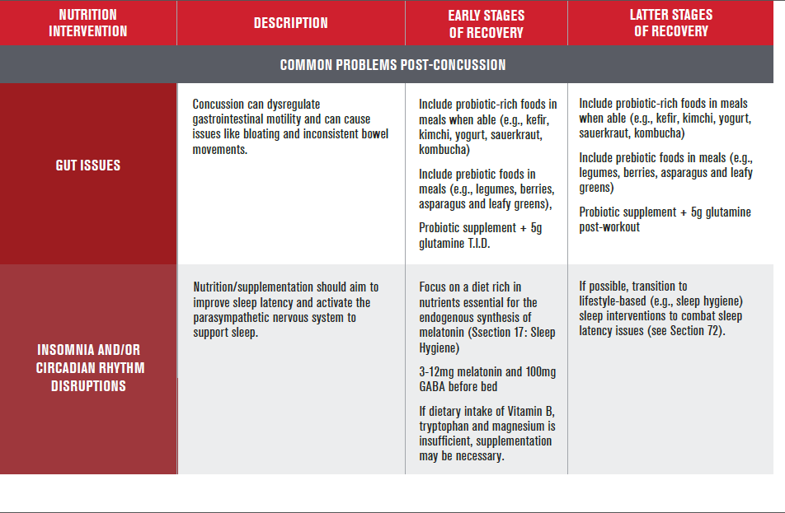
2*
Nutrition Interventions

Slide 22
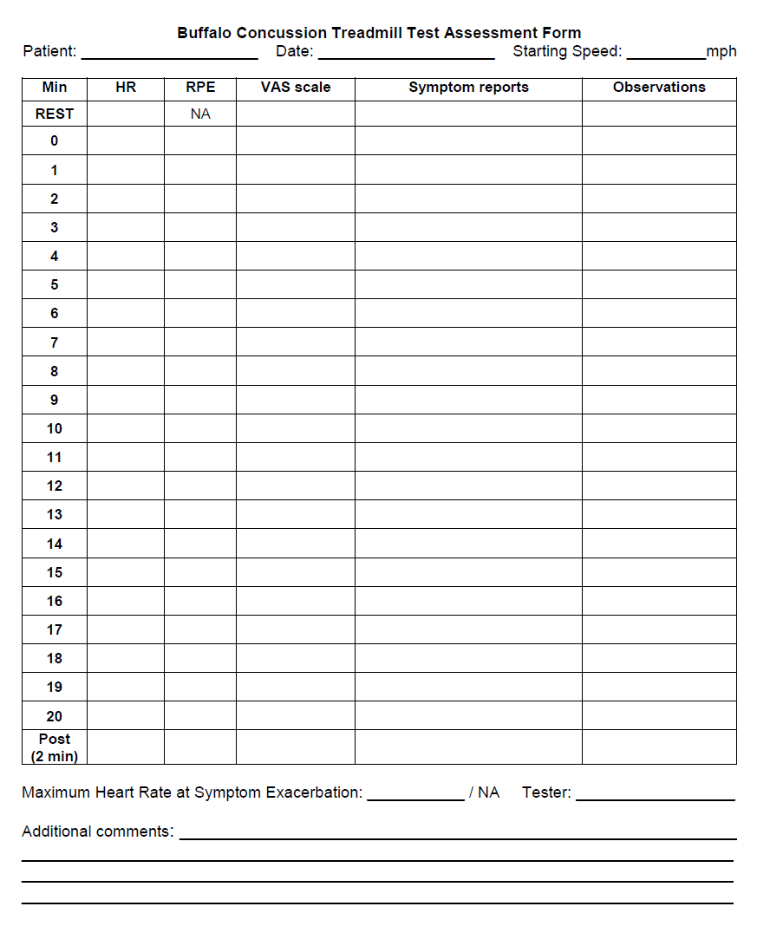
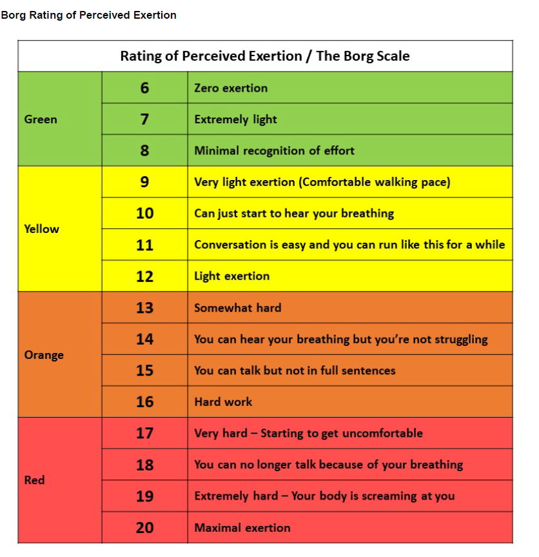
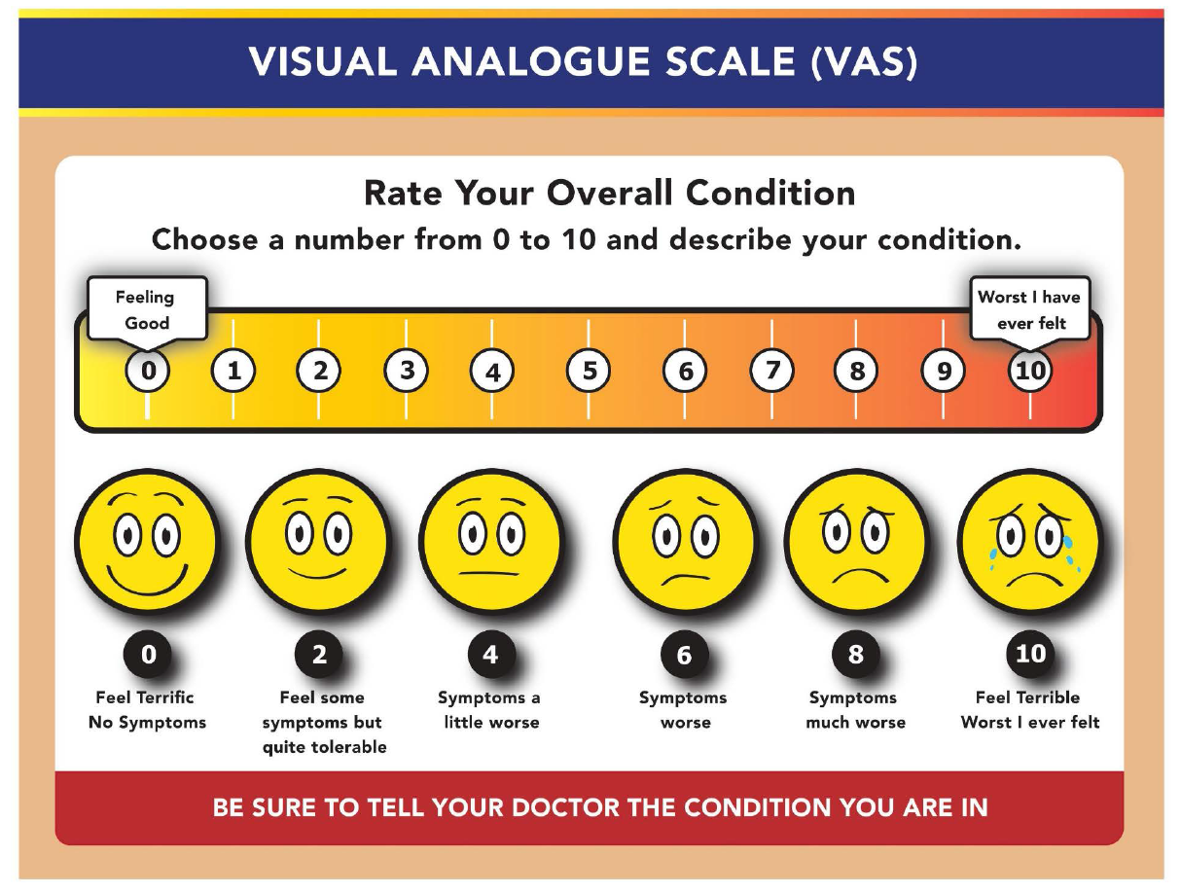
Exercise Tolerance Assessment Considerations
Begin aerobic exercise tolerance upon clearance from sports medicine
Identify test that is the best practice for individual case
  Buffalo Concussion Treadmill Test (BCTT) (Haider et al., 2019)
    https://cdn-links.lww.com/permalink/jsm/a/jsm_2020_01_28_haider_19-313_sdc1.pdf
  Buffalo Concussion Bike Test (BCBT) (Haider et al., 2019)
    https://cdn-links.lww.com/permalink/jsm/a/jsm_2020_01_28_haider_19-313_sdc2.pdf

Slide 23
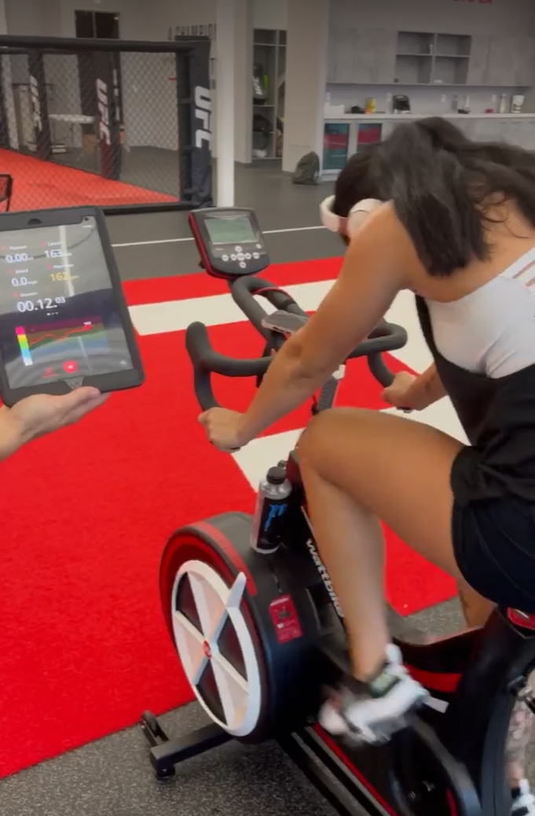
UFCPI: Return to Sport Protocol
Stage 2-ESD (Energy System Development) Introduction
    Check daily symptom score
    IDA approach
      Nutrition
        Maintain & monitor tolerance/compliance
      Sports Psych
      Coaches
      Support Staff
      S & C – Continue communication with sports medicine and medical provider, conduct aerobic exercise training sessions
      Sports Science
        Sports science monitoring-HR variability (HRV)
        Sleep efficiency and duration
    Rehab based on type of concussion- 5x/week
    Mild symptom can start activity (scores below 3)
    Stage 2.1: Introduce Aerobic Exercise
      Low intensity, duration of ~15-20 min
      Stationary cycling, elliptical, treadmill (include adequate warm up and cool down)
      Use HR monitor for individual HR range (target HR <70% HR max or RPE below 3/10)
    Post exercise symptom check/RPE
    If symptom free, progress to Stage 3
Notes:
-Matt: goal is to increase heart rate and core temperature with an introduction of aerobic exercise

Slide 24
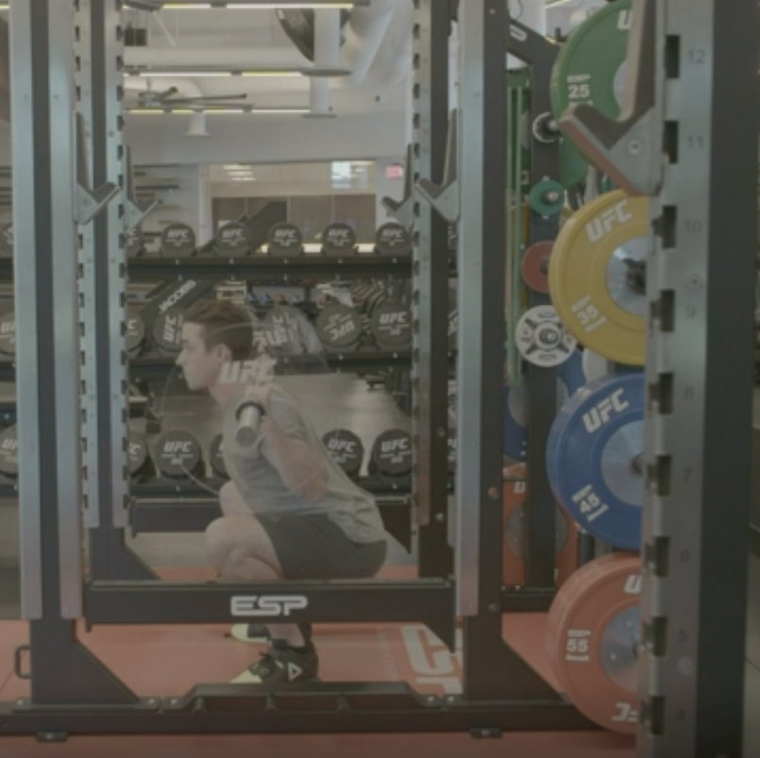
UFCPI: Return to Sport Protocol
Stage 3-ESD Progression/Intro strength training
    Check symptom score daily
    IDA approach
      Nutrition
        Maintain & Monitor
        Initiate phase down O3, Probiotics, reintroduce whole grains (if eliminated)
        Sleep supplements moving toward PRN
      Sports Psych
      Coaches
      Support Staff
      S & C – Continue communication with sports medicine and medical provider, increase aerobic exercise, introduce strength training
      Sports Science
        Sports science monitoring-HRV
    Rehab based on type of concussion- 5x/week
Notes:
-Matt: goal is to increase levels of intensity and duration in aerobic exercise for capacity of cardiovascular development AND introduce strength training

Slide 25
UFCPI: Return to Sport Protocol (S3 cont.)
Stage 3 -ESD Progression/Intro strength training
    ESD Progression
      Reduction in symptoms progress à progressive overload in S & C (no maximal effort EXS or plyometrics)
    If possible: schedule two separate sessions- ESD followed by resistance training & seek optimal training time preference
      ESD progression flow chart (under medical team supervision & HR monitor observation)
        A. Moderate continuous aerobic exercise: HR @ 70-80% or sRPE or RPE ~moderate on RPE scale for 30-45 total min (biking, running)
      Strength Training (with objective/subjective intensity measurement)
        Participate in 30-45 min total min strength session
        Stage 3.1: low intensity strength training, 50-75% 1RM (loaded multi-joint, auxiliary & core exercises)
        Stage 3.2: moderate intensity strength training, ~75-85% 1 RM (loaded multi-joint, auxiliary & core exercises)
      Post exercise symptom check/RPE below moderate on CR-10 scale for monitoring intensity
      No sports specific training and no head contact. No inversion activities
Notes:
-Matt: goal is to increase levels of intensity and duration in aerobic exercise for capacity of cardiovascular development AND introduce strength training

Slide 26
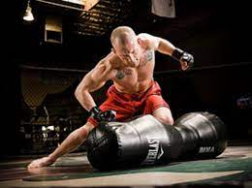
UFCPI: Return to Sport Protocol
Stage 4 -Advanced ESD/Resistance Training + Sport Specific Intro
    Check pre-intervention symptom score –asymptomatic, improvement noted or equal to baseline, progress to high intensity ESD/ resistance training + MMA intro.
    IDA approach
      Nutrition
        Maintain & Monitor
        Initiate phase down O3, Probiotics, reintroduce whole grains (if eliminated)
        Sleep supplements moving toward PRN
      Sports Psych
      Coaches
      Support Staff
      S & C
      Sports Science
        HRV
    Rehab based on type of concussion- 3-5x/week (based on symptoms)

Slide 27
UFCPI: Return to Sport Protocol (S4 cont.)
Stage 4-Advanced ESD/Resistance Training + Sport Specific Intro
    ESD Progression
      Reduction in symptoms progress à high intensity S & C (progress intensity of strength training, intro plyos)
      ESD progression flow chart (under medical team supervision & HR monitor observation)
        Stage 4.1: Introduce high intensity interval training (30-45 sec on, 1:3 W:R), 80-90% HRmax, RPE of 5 (air bike, versa climber, treadmill), 30 min total
      Strength training (with objective/subjective intensity measurement)
        Participate in 45-75 total min strength session
        Stage 4.2: high intensity strength training, ~85-95% 1 RM (loaded multi-joint, auxiliary & core exercises)
Phase 1 MMA: Light sports specific drills with no risk of head contact of any kind
    60% Perceived Intensity Level-30-45 mins total (RPE-below 6) of any or combo of activities below:
      Shadow-boxing
      footwork drills, skipping
      jujitsu warmup movements with no partner (no front or backwards rolls, Gramby’s etc)
      No WRESTLING
      If fighter can tolerate above without symptoms, and is able to tolerate going from back to standing and stomach to standing he can progress to MMA phase 2
    Post-exercise symptom check/RPE
      If symptomatic with anything above, rest and review symptoms with your medical team to decide next steps

Slide 28
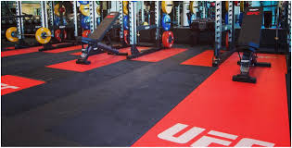
UFCPI: Return to Sport Protocol
Stage 5-Non-Contact Technical Training
      Symptom check: If symptom free, follow up with C3Logix, medical exam, neuro exam
        Symptom score must be at or below baseline
      Rehab continues if needed (should be asymptomatic at this point, if new stages trigger symptoms, a thorough re-evaluation is required before you progress to next step)
      IDA approach
      Nutrition
      Nutrition
        Maintain & Monitor
        Carbs to meet training demands
        Anti-Inflammatory & O3 supplement move to maintenance dosing
        Sleep & Gut Health supplements moving toward PRN
      S & C /sports science testing
        Exercise tolerance retest consideration
        Strength and conditioning returns to normal
        Schedule combined strength AND ESD sessions (totaling ~ 75 min @80% HR Spike-Use HR monitor as if there are no limitations (return to action prior to concussion)
              Air bike 30 sec
              Shadow box 1 min

Slide 29
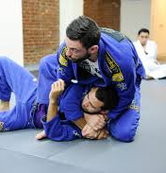
UFCPI: Return to Sport Protocol (S5 cont.)
Stage 5 -Non-Contact Technical Training
Phase 2 MMA:
      60-70% Perceived Intensity Levels (HR/RPE below 7)
        Bag work (as long as vibration doesn’t increase symptom score).
        Jujitsu drills with controlled partner no resistance
        Wrestling partner pummeling with no resistance or takedowns
        Sprawls & jujitsu getups can be incorporated if tolerated
        Post-exercise symptom check/RPE
        If all above can be tolerated without symptoms progress to MMA phase 3
Phase 3 MMA:
      75% Perceived Intensity Levels-
        Striking begin mitt work with coach
        Position Jujitsu no scrambles when start position results in an escaped, sweep, or submission stop and return the start position-be conscious of not letting the work become too long
        Jujitsu rolling
        Drill wrestling takedowns from standing to ground
        Post-exercise symptom check/RPE
        If all above can be tolerated without symptoms progress to MMA phase 4

Slide 30
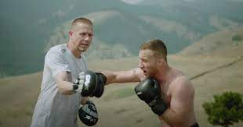
UFCPI: Return to Sport Protocol
Stage 6-Graduated return to Combat
    Symptom free, C3Logix, Senaptec, and medical exam MUST be at or below baseline
      Appropriate medical clearance needed for contact
    Symptomless with full training no contact
    IDA approach
      Nutrition
        Maintain & Monitor
        Balanced Plate/Fuel for the work required
      Sports Psych
      Coaches
      Support Staff
      S & C
        Routine training continued
      Sports Science

Slide 31
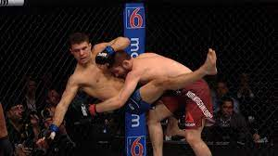
UFCPI: Return to Sport Protocol (S6 cont.)
Stage 6 -Graduated return to Combat
    Phase 4 MMA:
    80-85% Perceived Intensity Levels-
      Mitts, bag work, footwork, partner drilling (controlled one for one drills)
      Wrestling drilling at high intensity but not live.
      Jujitsu live on ground. No scrambling to feet or back down
      Post-exercise symptom check/RPE
      If all above can be tolerated without symptoms progress to MMA phase 5
    Phase 5 MMA:
    90% Perceived Intensity Levels
      Striking-stay drilling but with more speed and for longer periods
      Fwd and bkwd rolling (very important with vestibular concussion)
      Wrestling drilling-progress time
      Jujitsu live rolls
      Post-exercise symptom check/RPE
      If all above can be tolerated without symptoms progress to MMA phase 6

Slide 32
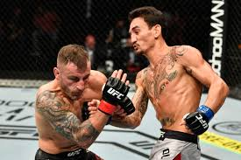
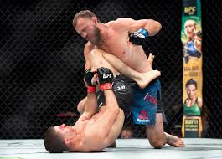
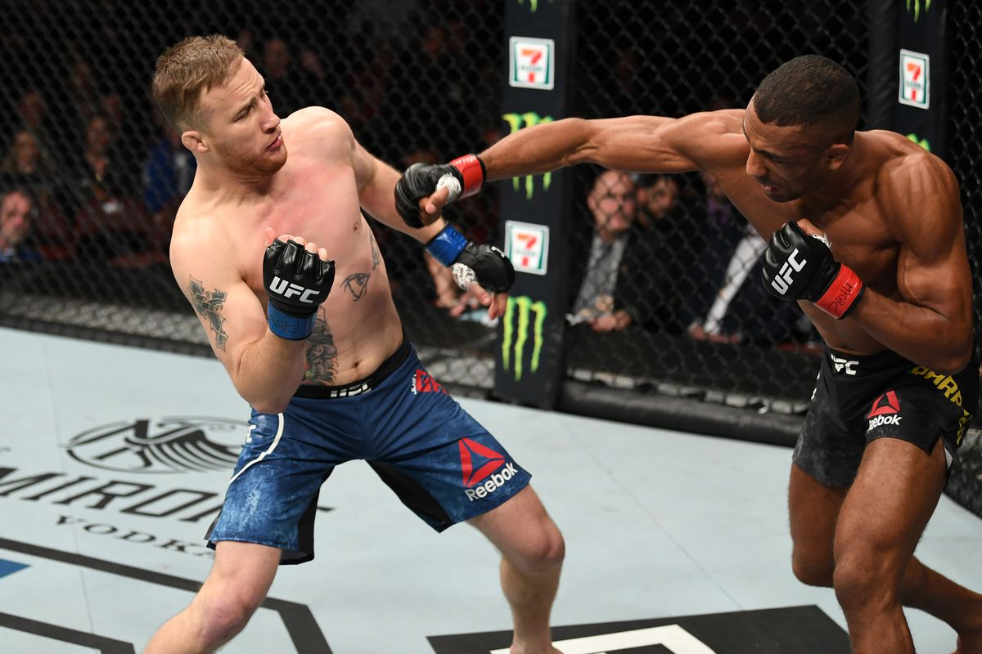
UFCPI: Return to Sport Protocol
Stage 7-Full contact Training
  Symptom free, C3Logix, Senaptec, and medical exam MUST be at or below baseline
    Phase 6 MMA:
Full Perceived Intensity-
            Don’t spar more than once (three round total) the first week back
            Pick your partner
            Wrestling-live
            Progressively add rounds over the course of weeks until you reach 2 sparring sessions of 5 rounds
            Return to full MMA-sparring (30 days)

Slide 33
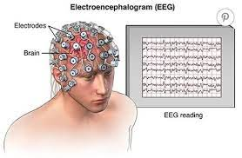
Post-Concussion Symptoms-Lingering Symptoms that aren’t resolving
Transcranial magnetic stimulation (TMS)
    Noninvasive form of brain stimulation in which a changing magnetic field is used to cause electric current at a specific area of the brain through electromagnetic induction.
qEEG
    EEG and the derived qEEG information can be interpreted and used by experts for clinical tool to evaluate brain function and to track the changes in brain function due to various interventions suck as neurofeedback or medication
Gyrostim
  Computer controlled multi-axis rotating chair. Safely rotates a person in pitch axis or the yaw axis, or both axes at the same time. Its purpose is to combine vestibular stimulation with multi-sensory processing exercises.
Re-evaluate Nutrition Interventions
Prevention:
    Sports Medicine
      Brain Games
      Balance/Vestibular exercises

Slide 34

Take Home Messages
Identifying type of concussion-so appropriate treatment is performed.
Relationships with athletes/coaches/teams influence the outcome measures of return to sport protocol.
There is no one size fits all approach for individual cases
Nutrition interventions can mitigate both acute and chronic injury-energy availability, inflammation, secondary effects.
Aerobic exercise can be beneficial with neuroplasticity of the brain after or within days of a TBI (Leddy et al., 2018).
EDUCATION, EDUCATION, EDUCATION
Notes:
- 2(matt) it takes a village-therefore team approach is needed for safe and effective return to sport
-3 (matt) there is no one size fits all approach for athletes return to sport every athlete responses differently due to the contextual differences

Slide 35
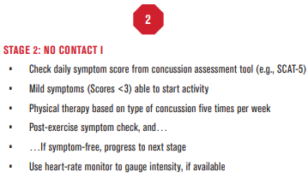
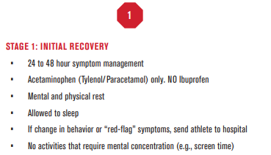
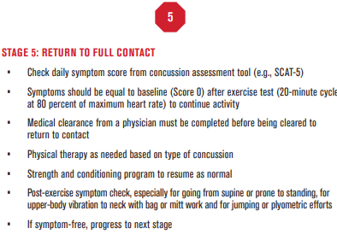
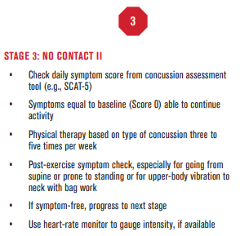
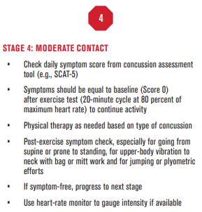
Interdisciplinary
Objectives

Slide 36

Questions?
Contact Information
Heather Linden|hlinden@ufc.com|310-616-6765
Clint Wattenberg|cwattenberg@ufc.com|607-227-9344
Matthew Crawley|mcrawley@ufc.com|716-517-5654
Charles Stull|cstull@ufc.com|202-553-9281

Slide 37
References
CDC. (2018, November 2). HEADS UP. Retrieved from Managing Return to Activities: https://www.cdc.gov/headsup/providers/return_to_activities.html
Haider, M., Leddy, J., Wilber, C., Viera, K., Bezherano, I., Wilkins, K., Miecznikowski, J & Willer, B. (2019). The predictive capacity of the buffalo concussion treadmill test after sport-related concussion in adolescents. Frontiers in Neurology, 10(395), 1-9. https://doi.org/10.3389/fneur.2019.00395
Leddy, J., Haider, M., Ellis, M., & Willer, B. (2018). Exercise is medicine for concussion. Current Sports Medicine Concussion, 17(8), 262-270. https://doi.org/10.1249/JSR.0000000000000505
Aubry M, Cantu R, Dvorak J, et al. Summary and Agreement statement of the 1st International Symposium on Concussion in Sport, Vienna 2001. Clin J Sport Med 2002; 12:6-11
UFCPI. (2021). Cross-sectional performance analysis and projection of the UFC athlete. Volume: 2. Zuffa

Slide 38
References Cont.
Dolan, E., Gualano, B., & Rawson, E. S. (2018). Beyond muscle: The effects of creatine supplementation on brain creatine, cognitive processing, and traumatic brain injury. European Journal of Sport Science, 19(1), 1-14. doi:10.1080/17461391.2018.1500644
Eimear Dolan, Bruno Gualano & Eric S. Rawson (2018): Beyond muscle: the effects of creatine supplementation on brain creatine, cognitive processing, and traumatic brain injury, European Journal of Sport Science, DOI: 10.1080/17461391.2018.1500644
Elamin, M., Ruskin, D. N., Masino, S. A., & Sacchetti, P. (2018). Ketogenic Diet Modulates NAD -Dependent Enzymes and Reduces DNA Damage in Hippocampus. Frontiers in Cellular Neuroscience, 12. doi:10.3389/fncel.2018.00263
Griesbach GS, Hovda DA, Gomez-Pinilla F. Exercise-induced improvement in cognitive performance after traumatic brain injury in rats is dependent on BDNF activation. Brain Res. 2009;1288:105-115
Jessen, N.A., Munk, A.S.F., Lundgaard, I. et al. The Glymphatic System: A Beginner’s Guide. Neurochem Res 40, 2583–2599 (2015). https://doi.org/10.1007/s11064-015-1581-6
Jensen, N. J., Wodschow, H. Z., Nilsson, M., & Rungby, J. (2020). Effects of Ketone Bodies on Brain Metabolism and Function in Neurodegenerative Diseases. International Journal of Molecular Sciences, 21(22), 8767. doi:10.3390/ijms21228767
Kennedy, D. (2016). B Vitamins and the Brain: Mechanisms, Dose and Efficacy—A Review. Nutrients, 8(2), 68. doi:10.3390/nu8020068
Keshavarzi, Z., Afshari, A. R., Mohammadzadeh, N., Mohebbi, M., Mohebbi, M., & Mollazadeh, H. (2017). Traumatic Brain Injury and the Gastrointestinal Tract: The Role of Female Sexual Hormones. Journal of Endocrinology and Metabolism, 7(6), 163-171. doi:10.14740/jem466w
Kreider et al. Journal of the International Society of Sports Nutrition (2017) 14:18 DOI 10.1186/s12970-017-0173-z
Mathias, J., & Alvaro, P. (2012). Prevalence of sleep disturbances, disorders, and problems following traumatic brain injury: A meta-analysis. Sleep Medicine, 13(7), 898-905. doi:10.1016/j.sleep.2012.04.006
Oliver, J. M., Anzalone, A. J., Jones, M. T., Kirk, K. M., Gable, D. A., Gao, Y., . . . Zetterberg, H. (2018). Nutritional Supplements for the Treatment and Prevention of Sports-Related Concussion — Omega 3 Fatty Acids: Evidence Still Lacking? Current Sports Medicine Reports, 17(3), 103-104. doi:10.1249/jsr.0000000000000465
Tavarez, T., Roehl, K., & Koffman, L. (2021). Nutrition in the Neurocritical Care Unit: A New Frontier. Current Treatment Options in Neurology, 23(5). doi:10.1007/s11940-021-00670-8
Sharma, S., Zhuang, Y., Ying, Z., Wu, A., & Gomez-Pinilla, F. (2009). Dietary curcumin supplementation counteracts reduction in levels of molecules involved in energy homeostasis after brain trauma. Neuroscience, 161(4), 1037-1044. doi:10.1016/j.neuroscience.2009.04.042
Zhang X, Jiang X. Effects of enteral nutrition on the barrier function of the intestinal mucosa and dopamine receptor expression in rats with traumatic brain injury. JPEN J Parenter Enteral Nutr. 2015 Jan;39(1):114-23. doi: 10.1177/0148607113501881. Epub 2013 Sep 18. PMID: 24047867.

